Slide 1
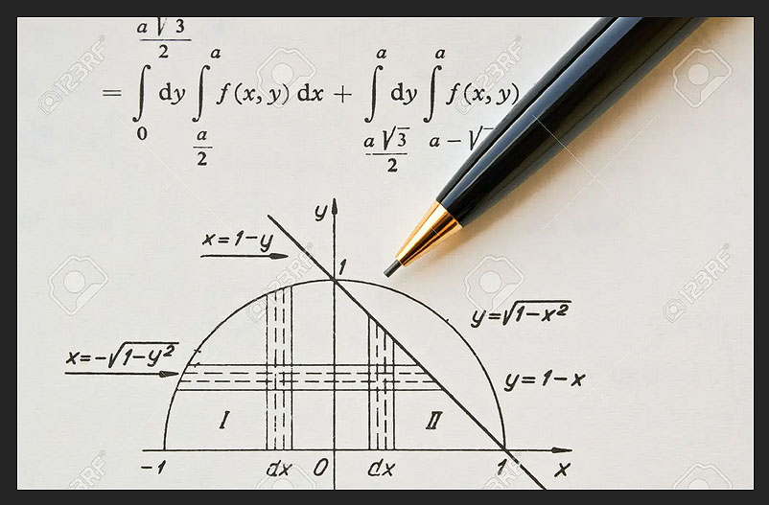
The Evolution of Mathematics
If the classical world provided the foundations of western civilization, it also drew on advances elsewhere in other societies, notably in India and China. Here, we build on the knowledge established by the time of the Roman Empire, and how successive generations gave rise to new insights in mathematics that formed the basis of contemporary science and culture.

Slide 2
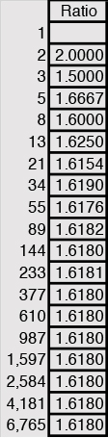
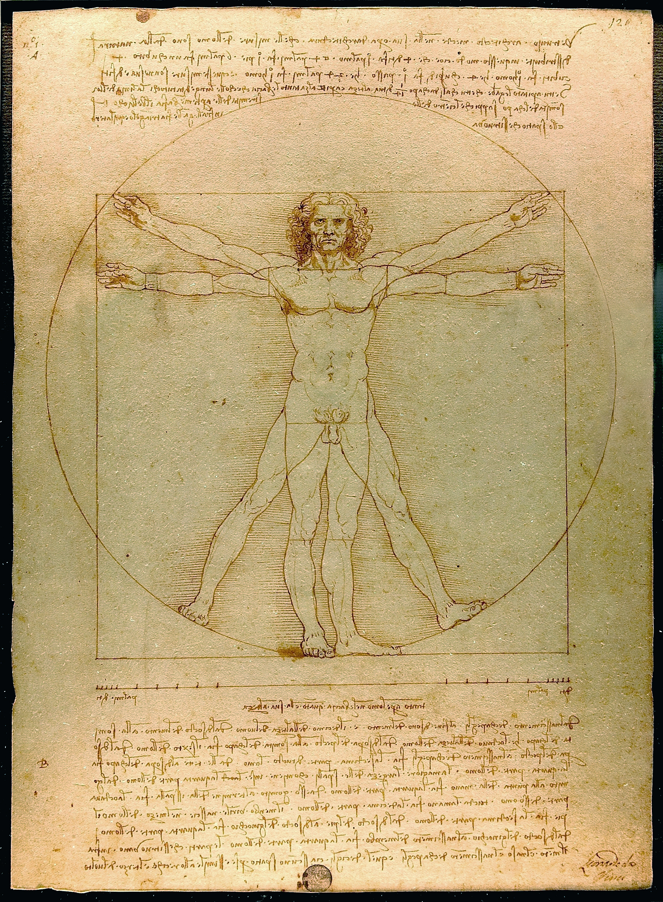
Phi, the Golden Mean in Nature, and Civilization
The Greek mathematician Pythagoras, known perhaps more for his formula for the solution of a right triangle, also is considered as the first to employ knowledge of phi, or 1.618, the ratio of a number to its preceding value in a sequence. The sequence was defined formally centuries later by Leonardo of Pisa, otherwise known as Fibonacci. The number series is given as at any one sequence beyond 2 the next is the sum of the preceding two numbers, i.e. 1, 2, 3, 5, 8,13,21,44. When a number in the series is divided by its preceding value, in the limit it approaches 1.618, the Golden Ratio. In the limit, phi is defined as (1 + sqrt(5))/2. Studies of the Parthenon find the ratio of 9:4 the most common, and so while Phidias and his contemporaries may have known of the Golden Mean, it had not yet entered the aesthetics of architectural design. The ratio did fascinate the ancients, though, in that the series often appears in nature, in the proportions of a nautilus shell, tree leaf configurations, among others. It also appears to be a pleasing proportion to the eye in painting and sculpture, as well as in proportions of the human body. In the Renaissance, Leonardo da Vinci expressed the golden mean in his drawing of Vetruvian Man in which the ratio of the radius of the circle to the side length of the square is 1.618. Actual measurements turned out a value of .606, no quite the mean but approximately so. However, phi does show up in approximations in The Last Supper, the Mona Lisa, and other works. In the 20th century, the Swiss-born architect Le Corbusier (1887-1965) published Le Modulor, a guide to architectural proportions based on phi, and which can be seen in various buildings he designed, including Unité d’Habitation (1952) and Carpenter Center (1961) at Harvard University.

Slide 3
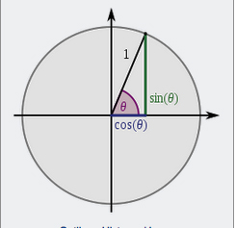
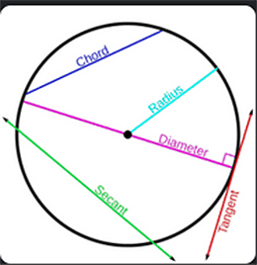
Pi, a Key to Mathematical Foundations
If phi, the Golden Mean, influenced visual perceptions of nature and works of art and design, pi shares equal importance. Pi is the ratio of a circle’s circumference to its diameter, has a non-repeating sequence beginning with 3.14, an irrational number. Pi also can be used to measure the area of a circle as the product of pi and the radius squared. March 14 today often is celebrated as pi day. It also has been designated by UNESCO as the International Day of Mathematics, i.e., 3/14.
Ancient Egyptians and Babylonians knew enough about pi to find its approximate value. Today, computer calculations have taken the value of pi to more than six billion digits, never once repeating itself.

Slide 4
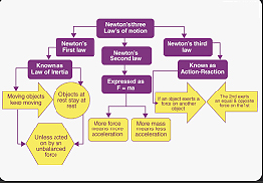
The Laws of Motion and the Foundations of Physics
From trigonometric measurements of circles and squares, ancient mathematicians also worked to understand the dynamics of motion. When Isaac Newton published his Mathematica Principia in 1687, he was building on a long line of contributions dating back over a thousand years. The three laws of motion listed by Newton owe their origins to Indian mathematicians and philosophers,
The Indian scientist and philosopher Rishi Kanada (ca 200-300CE) identified the Vaisheshika Sutras as the first text to articulate the relation between force and motion as far back as 600 BCE. Kanada’slist included heaviness (gurutva), fluidity (dravatva), viscidity (Sneha), traces (smskara), virture (dhama), vice (adharma) and sound. From the work of Hindu scholars, knowledge of stars and planets was expanding even before the ancient Greeks and Mesopotamians. However, the pioneering work of Iindian scholars and mathematicians was not well documented and went into relative decline. Moslem invaders absorbed the knowledge of Hindu scholars and transmitted them into Europe under the Andalusian Umayyad dynasty It was from translations of ancient texts that Newton was able to formally state the three laws of motion. Johannes Kepler and others would refine them to take elliptical orbiting into account.

Slide 5
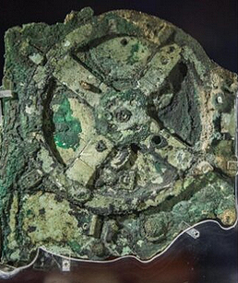
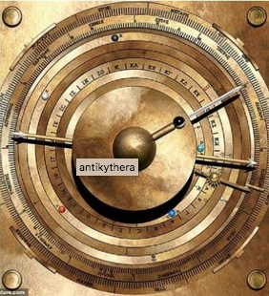
The Antikythera Mechanism
In 1901 a group of fishermen diving off the coast of the island of Antikythera discovered a strange metal object which they brought to the surface for examination. Measuring 34x18x9 centimeters (13.4x7.1x3.5 inches), it contained a s series of interacting gears never known before to have existed in ancient times. It is estimated to have been designed and constructed by Greek scientists approximately in 87 BCE, based on comparative carbon dating of the wooden shipwreck from which it was extracted.
Drawing on the Egyptian calendar, the mechanism enabled one to track the phases of the moon and the position of the planets with some degree of accuracy. What marred the mechanism was that Greek scientific knowledge at the time was based on a geocentric theory of the university, that is, the sun revolved around the earth. It would take Galileo and Copernicus centuries later to overturn the prevailing theory in favor of the current heliocentric theory of the solar system.
The Antikythera mechanism not only revealed the degree to which the Greeks had mastered the laws of motion, but also that there may well have been other mechanisms that preceded the Antikythera machine Today, we look at the mechanism as an early example of an analog computer that no doubt informed trade and shipping schedules at the time.

Slide 6
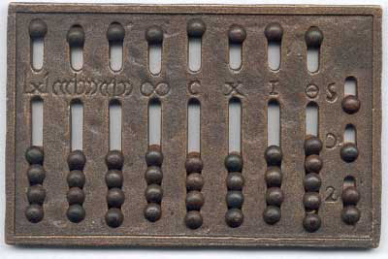
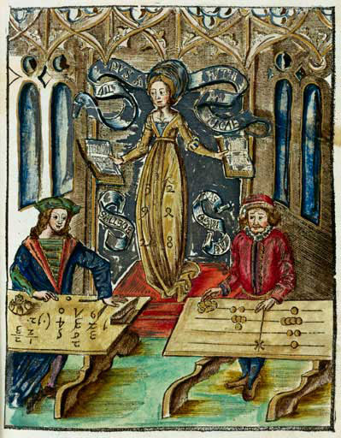
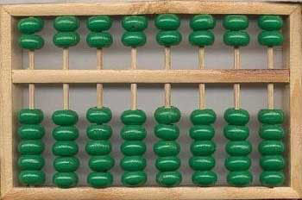
The Abacus as an early calculating machine
The abacus, a counting machine that place holds multiples of fives and then single digits, has been in use since ancient times. Thought to be of Asian, particularly Chinese, in origin, it is still widely used in many places, notably open markets where bulkier mechanical or electrical devices are either unavailable or costly to transport and utilize. An ancient Roman abacus illustrates how the Roman numerical system was conjoined via a set of movable beads into a decimal system, even though the Romans would not adopt such advanced systems until well after the expansion of Islam and the diffusion of Hindu-Arabic numbering. And during the Middle Ages, one could find widespread use of the abacus, particularly with the revival of commerce that followed the Crusades in the Middle East that began in 1095.
The Chinese SuanPan abacus on the upper right is of the type still commonly used in many markets today. Beginning in the 19th century, Charles Babbage introduced gear-based mechanical calculating machines, the forerunners of digital computers.

Slide 7
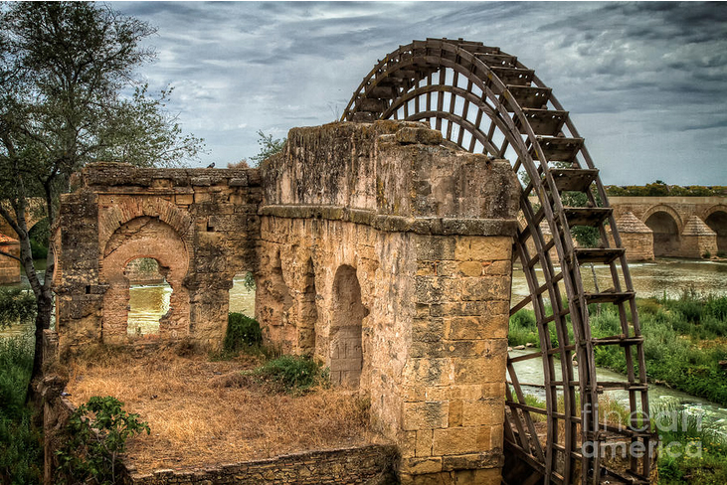
The Wheel, Gears, and Mechanical Waterpower
The wheel has been in operation as far back as 4,000 BCE. Its first uses included the use of carts driven by animal power to haul materials. It also became a common instrument in warfare, with Egyptian, Greek, and Roman chariots amply documented in their respective histories. And the wheel was also used to harness waterpower, both for lifting and directing water from streams into aqueducts for irrigation and drinking water. While the ancient Egyptians used a shaduf to rely on human leverage to support irrigation from the Nile, aqueducts greatly supported larger populations. Knowing the diameter and circumference provided a basis from which waterflow could be measured and what would be the carrying capacity of an area.

Slide 8

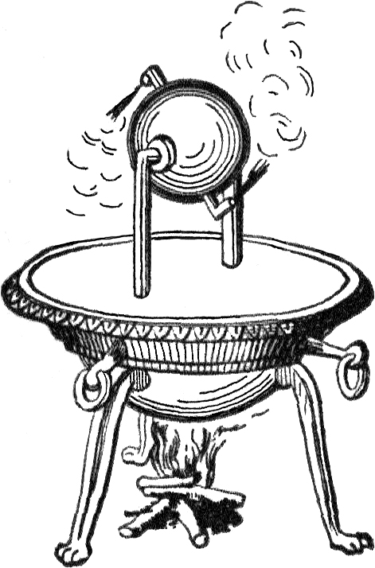
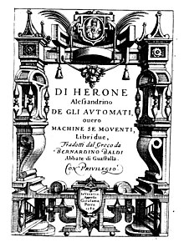
A Heroic Leap From Nature to Motive Force
If the ancient Greeks used sophisticated gear ratios to construct the Antikythera celestial mechanical computer, they also were making strides in the estimation and calculation of motive force. While calculations on the force of a waterwheel helped in the construction of aqueducts and irrigation systems, achieving higher mechanical force would involve the use of fire, from which we have the earliest formulations of steam engine technology.
The Greco-Egyptian mathematician and engineer Hero of Alexandria (10-75 CE) formulated an early form of a steam engine using the steam heat from fire to turn a circular device on an axis. He also formulated one of the first uses of wind power to operate an organ. Many of his inventions and use of mathematics were summarized in a sixteenth century history published in Latin

Slide 9
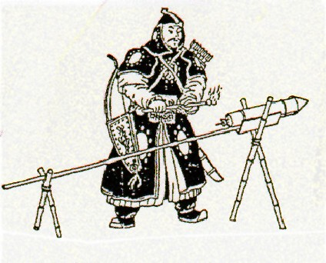
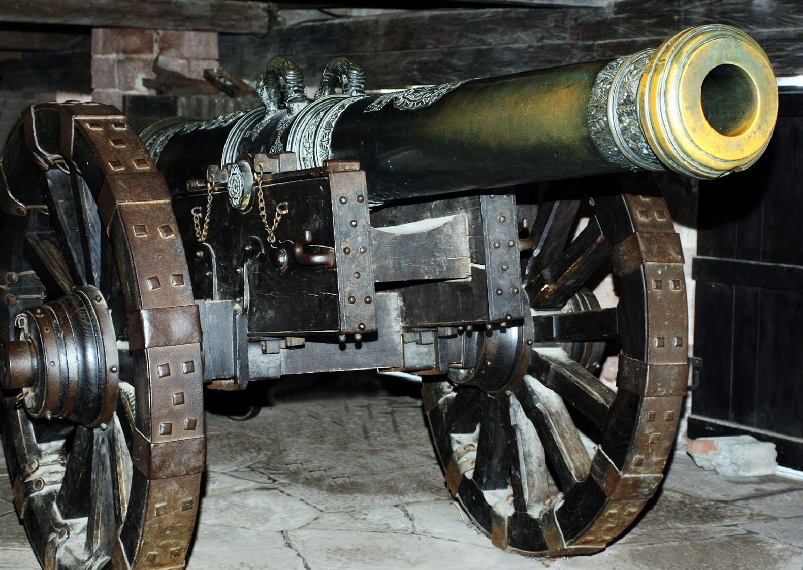
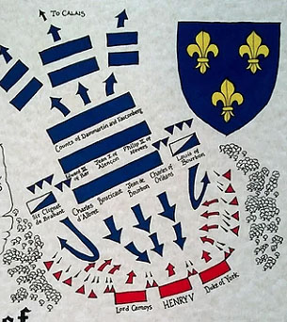
Gunpowder, Steam, and Energy
Back in the 9th century CE, the first recorded reference to gunpowder was noted in the Tang dynasty. It was under the Song dynasty that a gunpowder cannon was first used in warfare, in 1132. By 1288, a hand cannon was found in Mongol-held Manchuria, and a forerunner of hand-held guns. While the Romans used trebuchets to leverage the throwing of stones in siege warfare, the use of gunpowder and steam for weaponry in Europe would only spread following the fall of Constantinople to Ottoman siege cannons in 1453. Historic battles from the Roman Siege of Alessia in 52 BC, the Battle of Tours in 732 CE, the Norman invasion of England in 1066, the Battle of Crécy in 1346, the Battle of Agincourt in 1415, all relied on a mix of short and longbow weapons. In those historic battles, Thereafter, cannons were used in warfare, as in the Siege of Malta in 1565 and the Battle of Lepanto in 1571. The design of weapons at that time was not informed by a knowledge of thermodynamics, the science of energy and matter. That would await the onset of the Industrial Revolution in Europe and the development of explosive weapons and steam technology.

Slide 10
Mathematical Foundations of Thermodynamics
We owe our understanding of the laws of thermodynamics to Sadi Carnot (1796-1832), Rudolf Clausius (1822-1888), and (Lord Kelvin) William Thomson (1824-1907) What motivated interest in thermodynamics was how to maximize the efficiency of steam engines (and later electrical, and hen nuclear ones). When Thomas Savery (1650-1715) invented the first Newcomen steam engine in the 1690s, it was used to pump water from coal mines in England. James Watt (1736-1819) improved on the Newcomen steam engine with his Watt engine of 1776. Watt’s invention set England on the path of the industrial revolution . While first applied to coal steam pumping engines, the American inventor John Fitch (1743-1798) developed the first steam-powered boat in 1787. In turn, Richard Threvithick (1771-1833) invented the first steam railroad engine in 1804. As these inventions became innovation, scientists worked to discover the underlying principles of efficiency. Along the way, Daniel Fahrenheit (1686-1736) devised the eponymous scale in 1724, and still in use today. In turn, Swedish physicist Anders Celsius (1701-1744) proposed a centigrade temperatures scale in 1742. Today, the centigrade scale is most widely used in scientific research and is associated with the development of the metric system. Gabriel Mouton (1618-1694), a vicar in Lyons, France, proposed in 1670 a metric system based on a natural standard of length based on the circumference of the earth divided decimally. During the French Revolution, it was adopted in France in 1799 and now is the most widely used system of measurement of distance, volume, and weights in the world.

Slide 11
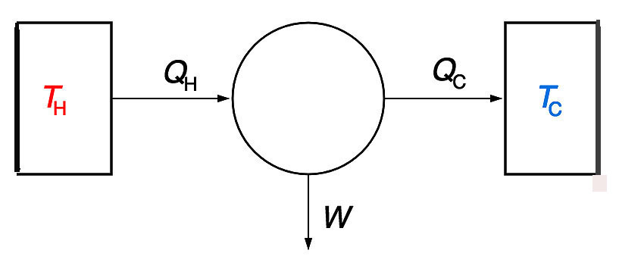
The Laws of Thermodynamics
Energy can be neither be created nor be destroyed. It can only be transformed from one form to another.
The entropy of any isolated system always increases.
The entropy of a system approaches a constant value when its temperature approaches absolute zero.

Slide 12

Energy Efficiency, Entropy, Environmental Pollution, and Climate Change
Thermodynamics, the science of heat, is central to our understanding of mechanical and electrical engineering, natural resource use, and climate change. The equations above state how energy is transformed into work, and from which we can derive energy efficiency and environmental emissions. Following the first law enables one to calculate the amount of work and waste (S) from a given process. In turn, one can then calculate the efficiency of work as the ratio of work to input energy in which waste is accounted for. In terms of electricity work capacity one can subtract from input energy the change in waste, which is then multiplied by a constant (4.187) lambda, which expresses work in terms of kilowatt capacity. The Second Law expresses efficiency in terms of the ratio of output temperature to input temperature which then is subtracted from one. The first and second laws are linked in that work is the amount of energy used in a given process. The greater the temperature difference between input and output energy, the more efficient the process. An internal combustion engine when first started may approach the ambient temperature and is thus inefficient. As the engine warms up, it delivers greater efficiency, or fuel economy, to a process. Over time, the level of entropy, or disorder, increases, leading to a search to reduce the corresponding level of environmental waste.

Slide 13
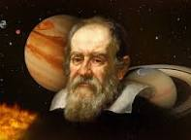
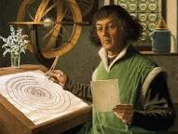

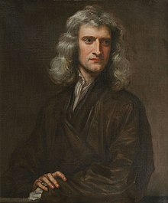


Foundations of Relativity
While the ancient Greeks built an analog computer to predict the motion of the moon, tides, seasons, and the planets, it was based on a geocentric theory of motion. It took Nicolaus Copernicus (1573-1543) to develop the heliocentric theory of the universe, and which was confirmed by telescopic observations undertaken by Galileo (1564-1642), for which he was condemned for heresy by the then Catholic Church. In turn, Johannes Kepler (1571-1630) discovered the elliptical motion of the planets around the sun. While advances in geometry and trigonometry helped in the calculations of the motions of the planets and the moon, traditional methods of mathematics were cumbersome and subject to error when it came to calculating the rate of change. Isaac Newton (1643-1724), and independently, Gottfried Wilhelm Leibniz (1646-1716) developed differential and integral calculus as a tool for studying astronomy as well as physics.
Calculus would help scientists deepen their understanding of the laws of thermodynamics, motion, and astronomy. In time, through insights regarding the nature of atomic particles, Albert Einstein (1879-1955) developed a theory of relativity in which time itself was no longer an absolute. Einstein was known for his famous equation E=MC² that links energy, mass, and the speed of light. It was on tis foundation that knowledge of nuclear energy was established.

Slide 14
Number Systems Slowly Catch Up
We have already noted that alphabetical languages were one path to the expansion of knowledge propelled by the printing press. At the same time, as advances in number systems were hampered by the absence of a decimal system that could account for fractions in a systematic fashion. From India, the number zero did enter the number system that was becoming increasingly common. And calculations of distance and volume were supported first by geometry and then trigonometry. It was from the Arabs, though, that algebra became a foundational tool for mathematical calculations. It enabled the solution of problems in two and three-dimensional space in which multiple solutions could be derived through use of the quadratic equation. By the time that Galileo, Copernicus, Newton, Leibnitz, and Kepler were exploring the laws of motion and planetary movement, the emergence of differential and integral calculus furthered the precision of the problems they sought to solve. Yet in ordinary lives, measures of time, distance, weight, and volume were hampered by reliance on cumbersome measures that did not lend themselves to many problems. The English system of weights held forth until well into the twentieth century in England, while continental Europe and elsewhere had long ago shifted measurement to the metric system. Although the English finally embraced the decimal metric system in their currency, weights, and volume measurements, the United States still has resisted a wholesale sift to the metric system. Gasoline is still sold in terms of tenths of a cent for a gallon at the pump, and raw materials are still measured in terms of short tuns. For export manufacturing it has required a conversion to the metric system to be accepted for sale in many markets. Thus, liquid beverages are sold by the liter instead of quarts, auto parts are manufactured using the metric system, among others. Sometimes you can see comparisons: for men using public urinals, a sign indicates 3.8lpf/1g, to indicate that one gallon of toilet water is equal to 3.8 liters per flush. As to automobiles, roads are still marked in miles, even though speedometers now display both kilometers and miles per hour.

Slide 15
Digital Measurement Accelerates the Flow of Knowledge
The expansion of mathematical knowledge still faced hurdles of unsolved problems. Consider, for example, the value of pi, which begins with 3.14 and continues in a non-repeating sequence to measure the ratio of the circumference to the diameter of a circle. Digital computing has enabled the calculation of pi up to several billion decimal points, even if it does not resolve the mystery of why this irregularity exists.
Additionally, several math problems remained solved for some time, while others still await a solution. One was Fermat’s Last Theorem: that no three positive integers 𝑎, 𝑏, and 𝑐 satisfy 𝑎𝑛+𝑏𝑛=𝑐𝑛 for integral 𝑛>2. Fermat died before he wrote his proof. In 1994 Andrew Wiles provided a proof. Other problems took up the attention of mathematicians, even if they posed no particular practical application.
In the more practical world, the development of statistics enabled mathematicians to tackle questions of probability and uncertainty. An early example involved what was known for a time as the Saint Petersburg Paraox. Following the foundation of St. Petersburg, Russia in the early 17th century, casino games attracted many to gamble. Paradoxically, in one game in which if you win at one round, you could double your earnings by playing the second round. In the limit, then, individuals should logically be willing to pay up to an infinite amount to gain an infinite sum. Yet the did not, which raised the question of what were those players trying to achieve at the casino It fell to Daniel Bernoulli (1700-1782) to observe the behavior of St. Petersburg casino players. In 1738 he wrote an essay in Latin, and which was translated and published in English in 1954 as “Exposition of a new theory on the measurement of risk”, Econometrica 22 (1954), 23-36. Bernoulli elaborated on how the expected value of an outcome was conditioned by a player’s attitude toward risk: risk averse, risk neutral, and risk loving. This distinction, first observed by John von Neumann and Oskar Morgenstern in their 1944 Treatise, Theory of Games and Economic Behavior, shaped decision making under uncertainty. From this have come tools to manage risk.

Slide 16
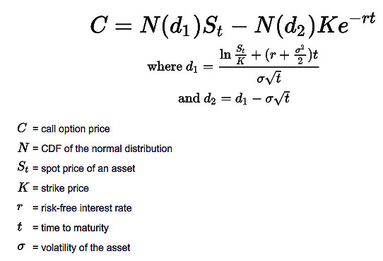
Decisions in a Stochastic World
Risk is present in any decision involving the future. As Yogi Berra is said to have observed: “It’s difficult to make predictions, especially about the future”. With the evolution of national income accounting from which we have estimates of the GDP, NI, PI, and related measures, why there are fluctuations has been a perennial question of interest to policymakers. While some sectors of an economy seem relatively predictable, others are beset by fluctuations, especially those affected by weather. Even though weather predictions have come a long way, for years, farmers faced decisions involving lags: how much to spend on this year’s crop when all of the information I have is past patterns of production and prices. One way to hedge against commodity risk was to develop forward contracts, i.e., a promise to deliver a quantity of a good at a given price at a given moment in time.
Another was the development of option price contracts in which buyers and sellers engage in a contract with the right to buy or sell at a given price at a given moment in the future. Decomposition enabled these derivative contracts a clue as to which direction market prices seemed to move, based on the volume and pricing of derivative contracts. The Black-Sholes model of an option contract resulted in a Nobel prize to Robert Merton and Myron Sholes in 1973. Such contracts are widely used today.

