Slide 1
Machines Leverage Energy and Power
Since the Neolithic period, civilizations have survived or fallen in response to how well they marshalled resources in production and consumption. We know full well that for many civilizations, marshaling resources was built on a system of slavery – an institution common to the Mesopotamian, Egyptian, Greek, and Roman civilizations. At the same time, these civilizations also began to harness mechanical energy to accomplish key instruments for production and consumption. Already we have noted the Antikythera Mechanism in the Second century BCE in ancient Greece. In turn, the Egyptians developed the shaduf, a leveraged water lifting device for irrigation. In times of conflict, semi-sailed rowing warships were used to ram opponents, while trebuchet machines were devised to hurl projectiles against opponents. And from the time of the Ottomans, gunpowder was used in cannons to destroy enemy structures. With the innovation of steam, warships were propelled first by coal, then oil, and more recently, nuclear energy to reach target destinations. Guided missile technologies such a drones allow rockets to direct explosive force on target structures and populations. With each generation, the lethality ratio of destructive power relative to a given devise has increased at a near exponential rate. Since the dropping of the atomic bombs on Hiroshima and Nagasaki in 1945, we have lived with the threat of global thermonuclear destruction. In short, machines can leverage energy for good or for evil, in which how societies choose to govern themselves becomes a critical factor.

Slide 2
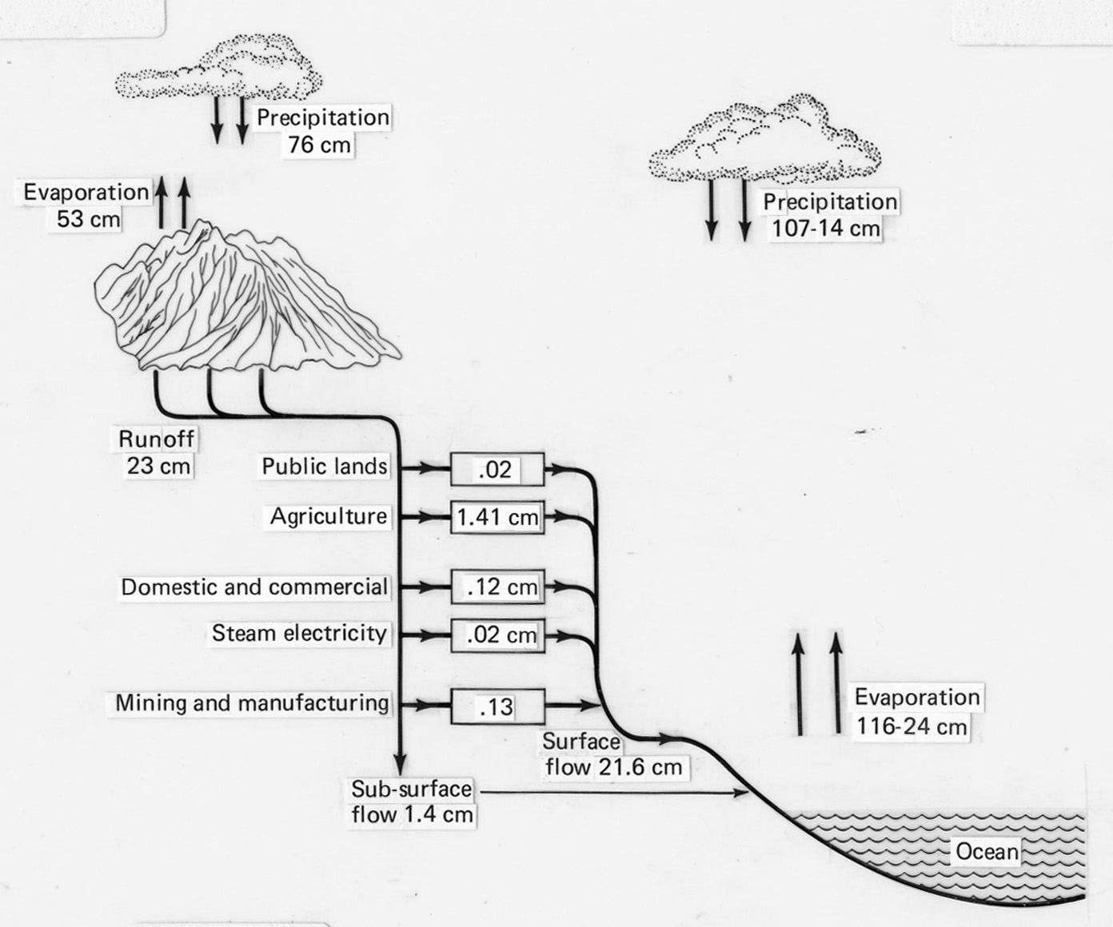
Measuring Evaporation-Precipitation Water Cycles
In a given climate zone (temperature range, elevation, humidity), we can trace the amount of water flows from precipitation and runoff from which we can estimate the carrying capacity of an environment for agricultural and related natural resource use.

Slide 3
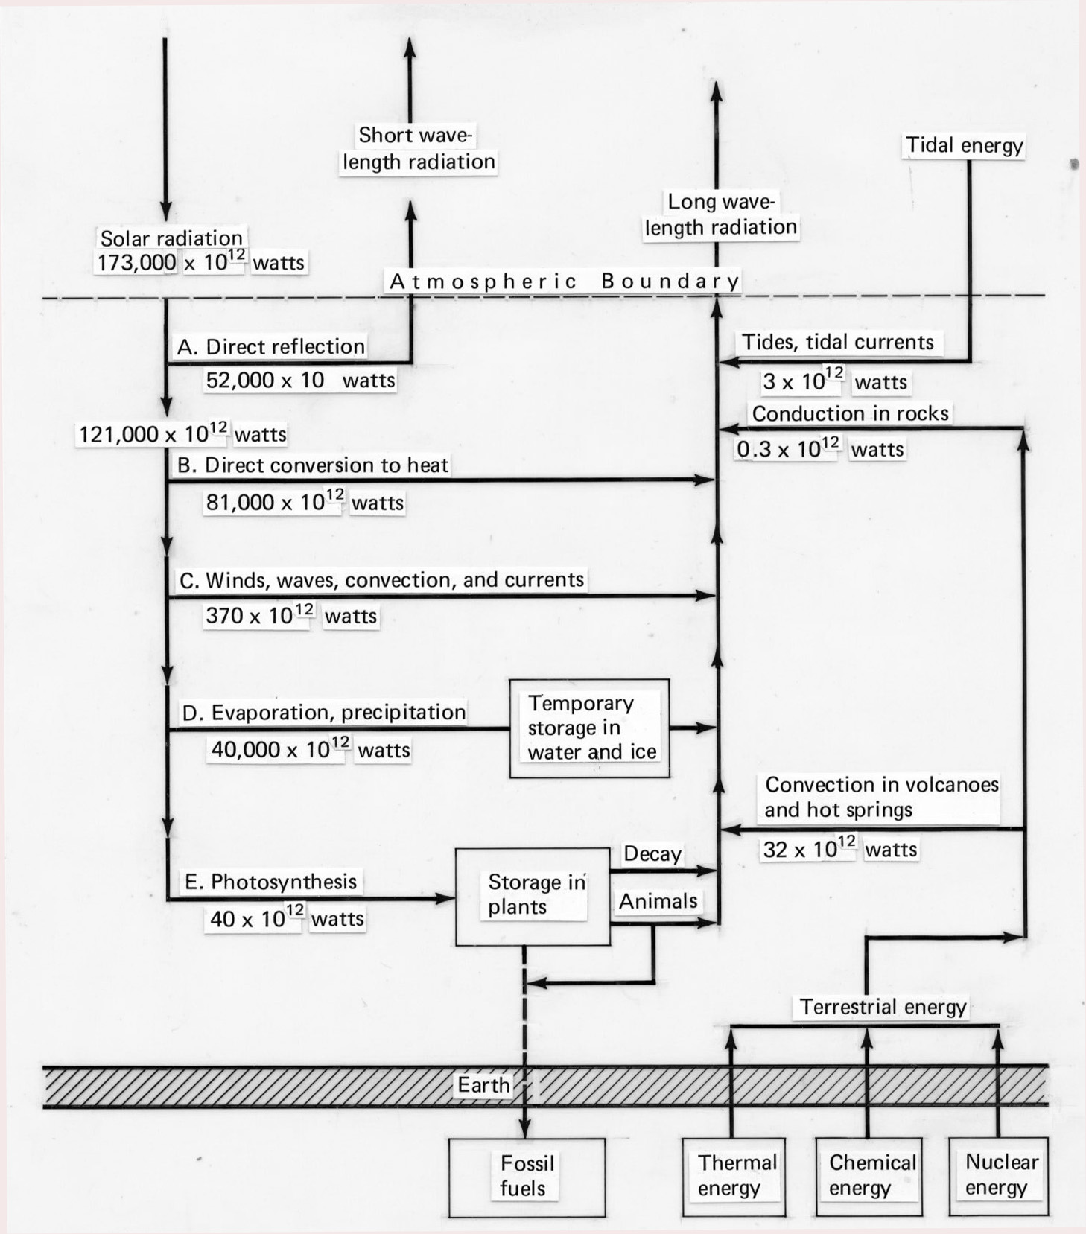
Water Cycles and Solar Energy
Solar energy can be used to produce heat for industrial, commercial, and residential use. It also can be used to produce electricity.

Slide 4
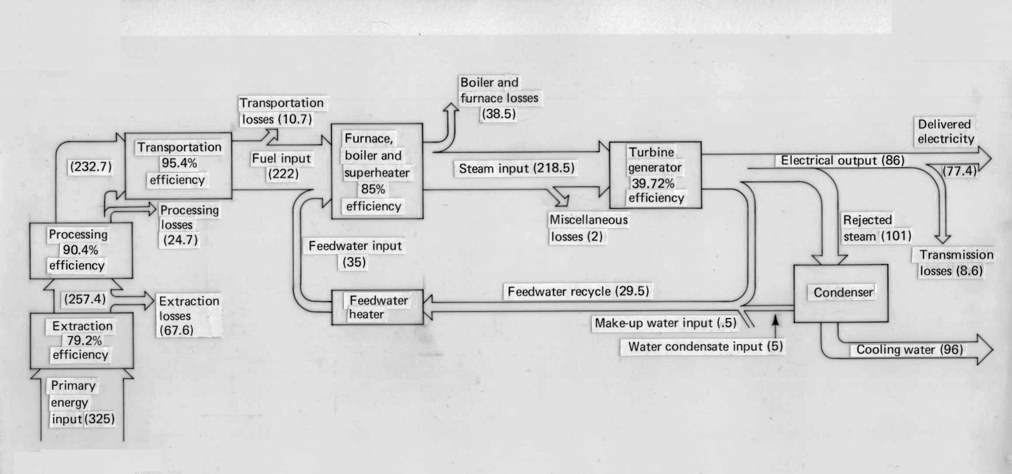
Thermodynamics Inform Energy Conversion Efficiency and Loss Calculations
Outside of solar electrical energy, most commercial uses of electricity are derived from steam technologies. Tracking conversion and losses provides the basis for deriving first law efficiency of a given technology.

Slide 5
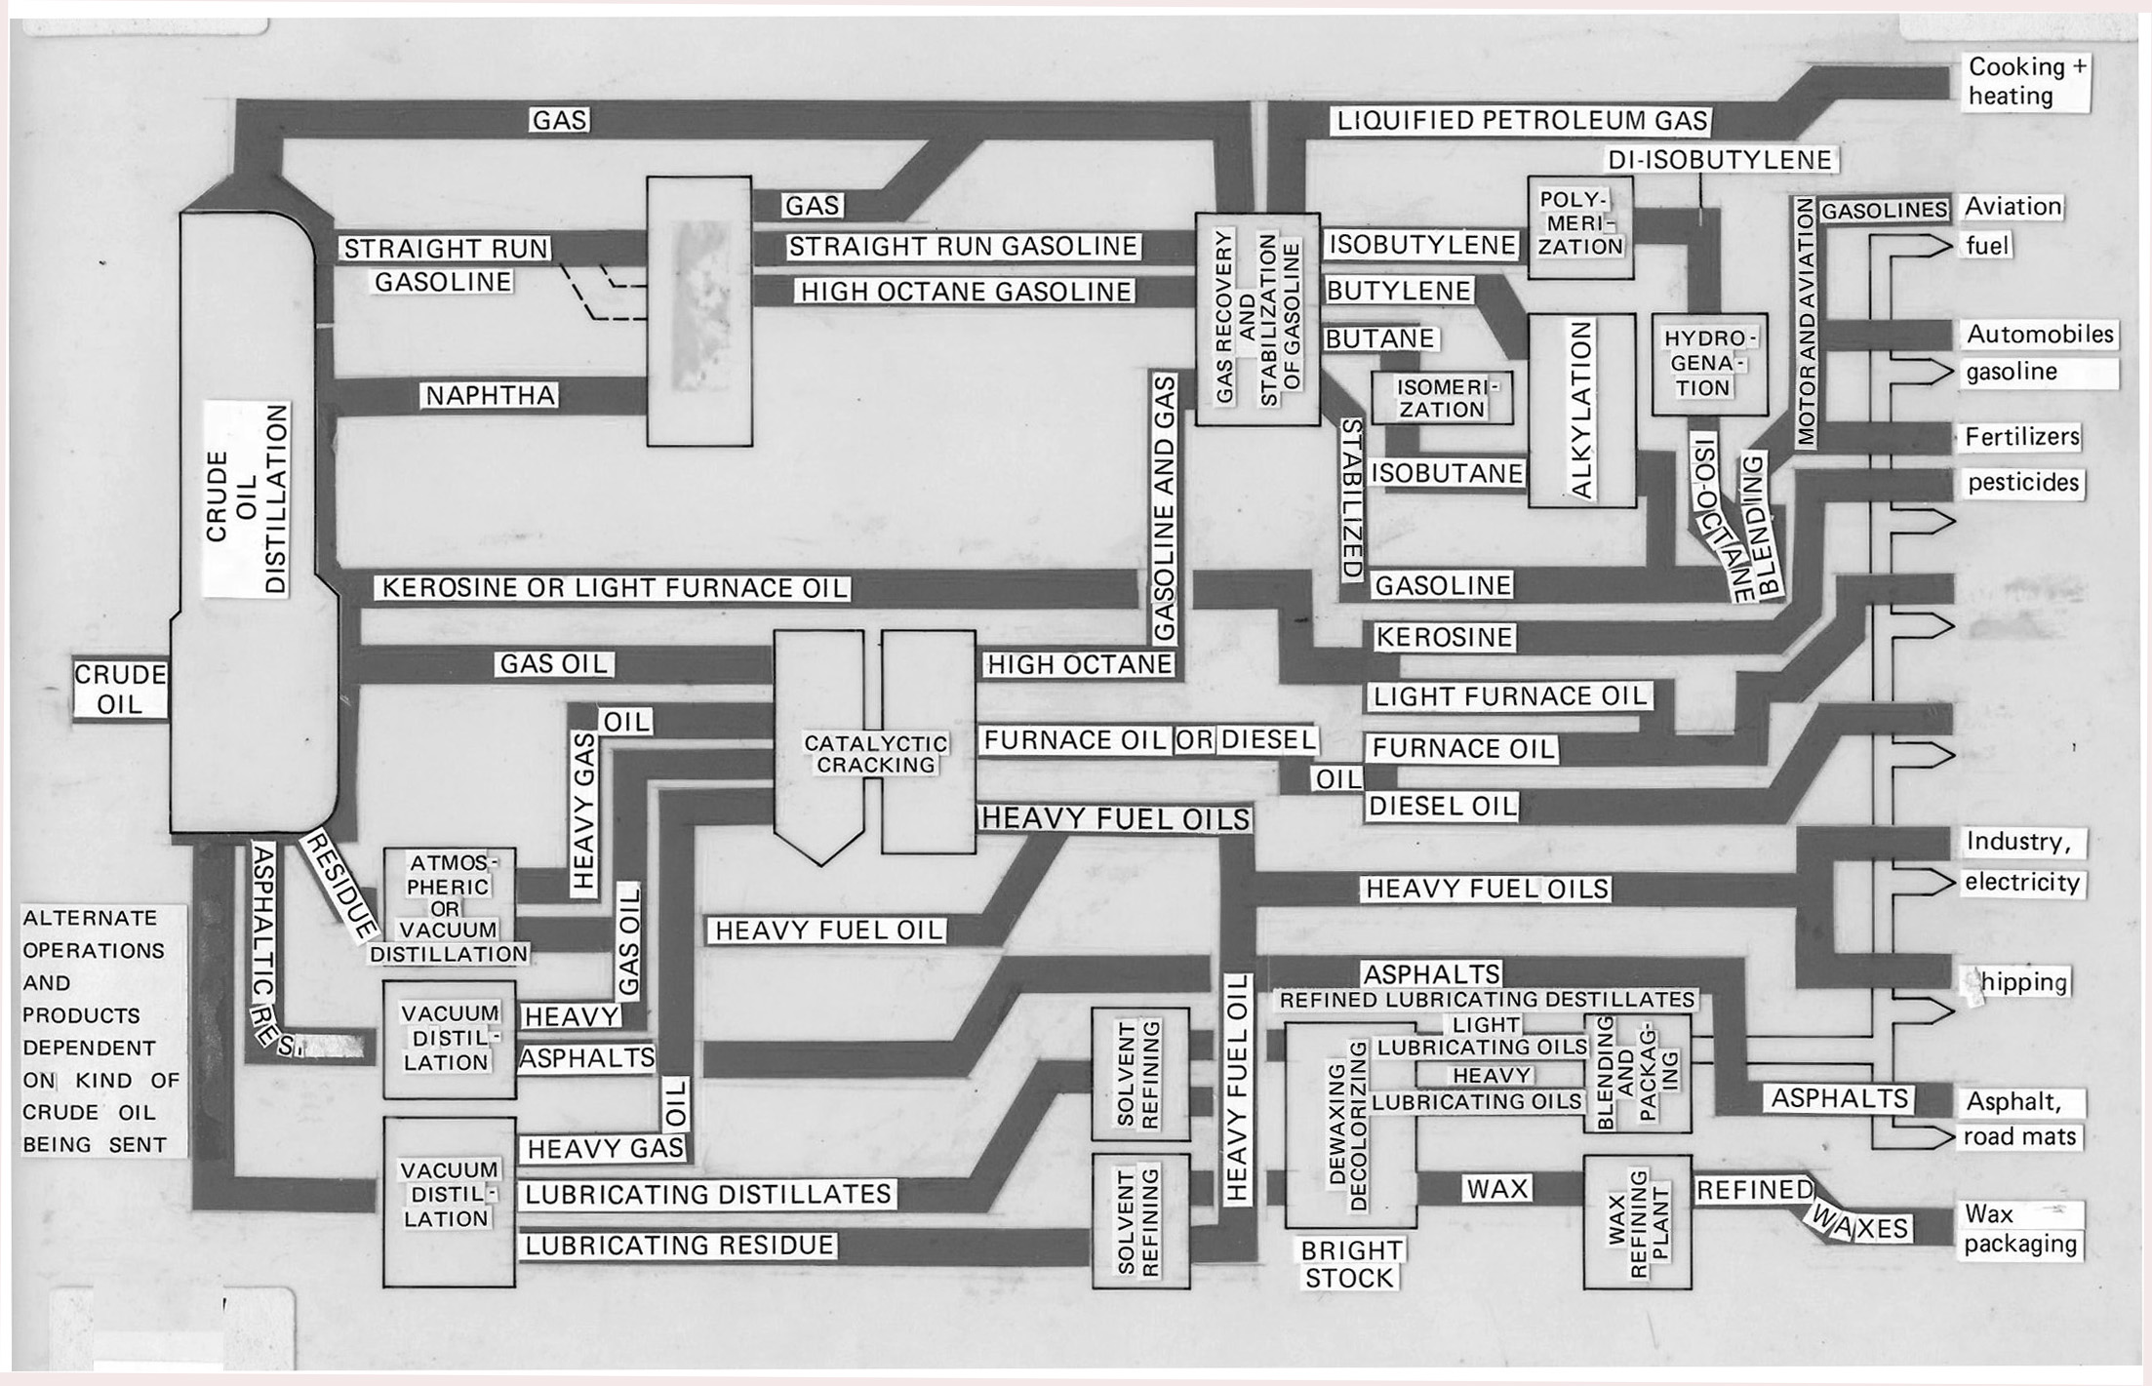
Similar Calculations Apply to Fossil Fuel Technologies
Conventional fossil fuel technologies convert a liquid (crude oil) into a stream of refined end-use products. For natural gas, it can be compressed to remain either in a gas form, or reduced the liquefied national gas (LNG) for long-range distribution.

Slide 6
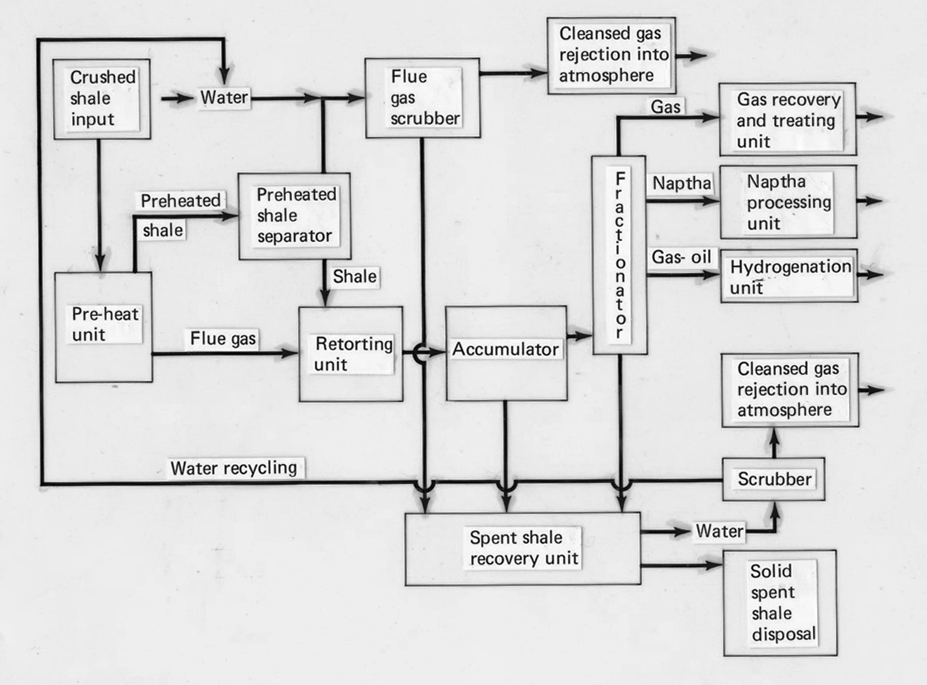
Fracking is an extension of Fossil Fuel Refinement Technology
Shale oil is liquid oil deposits compressed into rock structures. To extract usable oil, the rock must be broken down, a process known as fracking. It can affect the geological stability of an environment given that breaking down rocks can weaken the ground and facilitate groundwater seepage pollution.

Slide 7
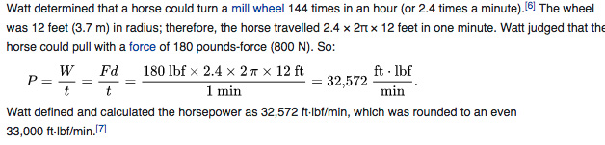
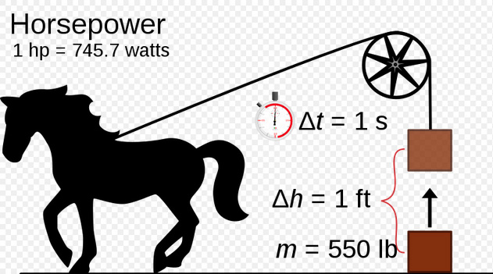
Deriving Standard Measures of Energy
When the Ottomans fired siege cannons to break the walls of Constantinople in 1453, they relied on brute force rather than a precise estimate of how much force would be needed to break through. The same was true for other conflicts and civilian applications, including Thomas Savery’s steam engine. By the late 18th century, however, a move toward standardization was under way, and James Watt’s improvement on the steam engine was a pivotal one. Watt devised a measurement of power between physical horsepower and electrical energy, which was so denoted in his honor as the watt. Horsepower measures became widespread in steam engine and later internal combustion engine technologies. It is still in use today. However, with the advent of commercial electricity, tracking power through the measurement of a watt has drawn increased attention. It is used in deriving estimates of the performance of missile technology, commercial and military shipping, as well as in aviation.

Slide 8
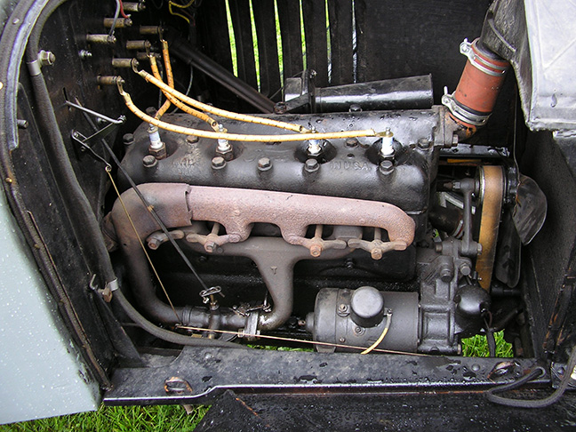
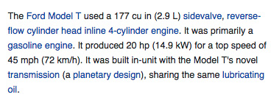
Henry Ford’s Model T automobile engine
With the advent of mass production, standardization of interchangeable parts also necessitated estimation of how much power would be needed to move a vehicle of a certain weight over variable elevation surfaces. Ford’s assembly line standardization set the pace in motion. It would be imitated throughout industrialized countries.

Slide 9
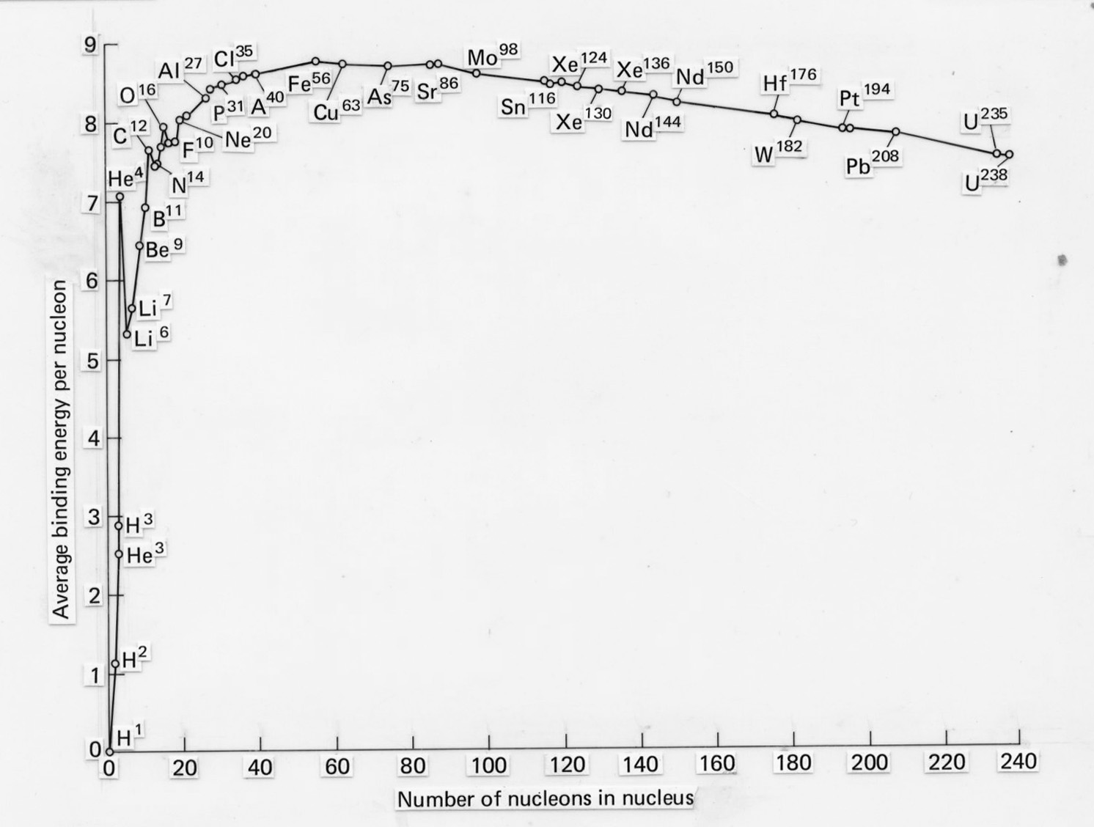
The Curve of Binding Energy and Thermodynamics
The curve of binding energy displays a configuration of elements in relation to the density of nucleons and the energy per nucleon. Uranium 235, 238, and Plutonium offer the probability of relatively high density and high levels of energy suitable for nuclear fission.

Slide 10
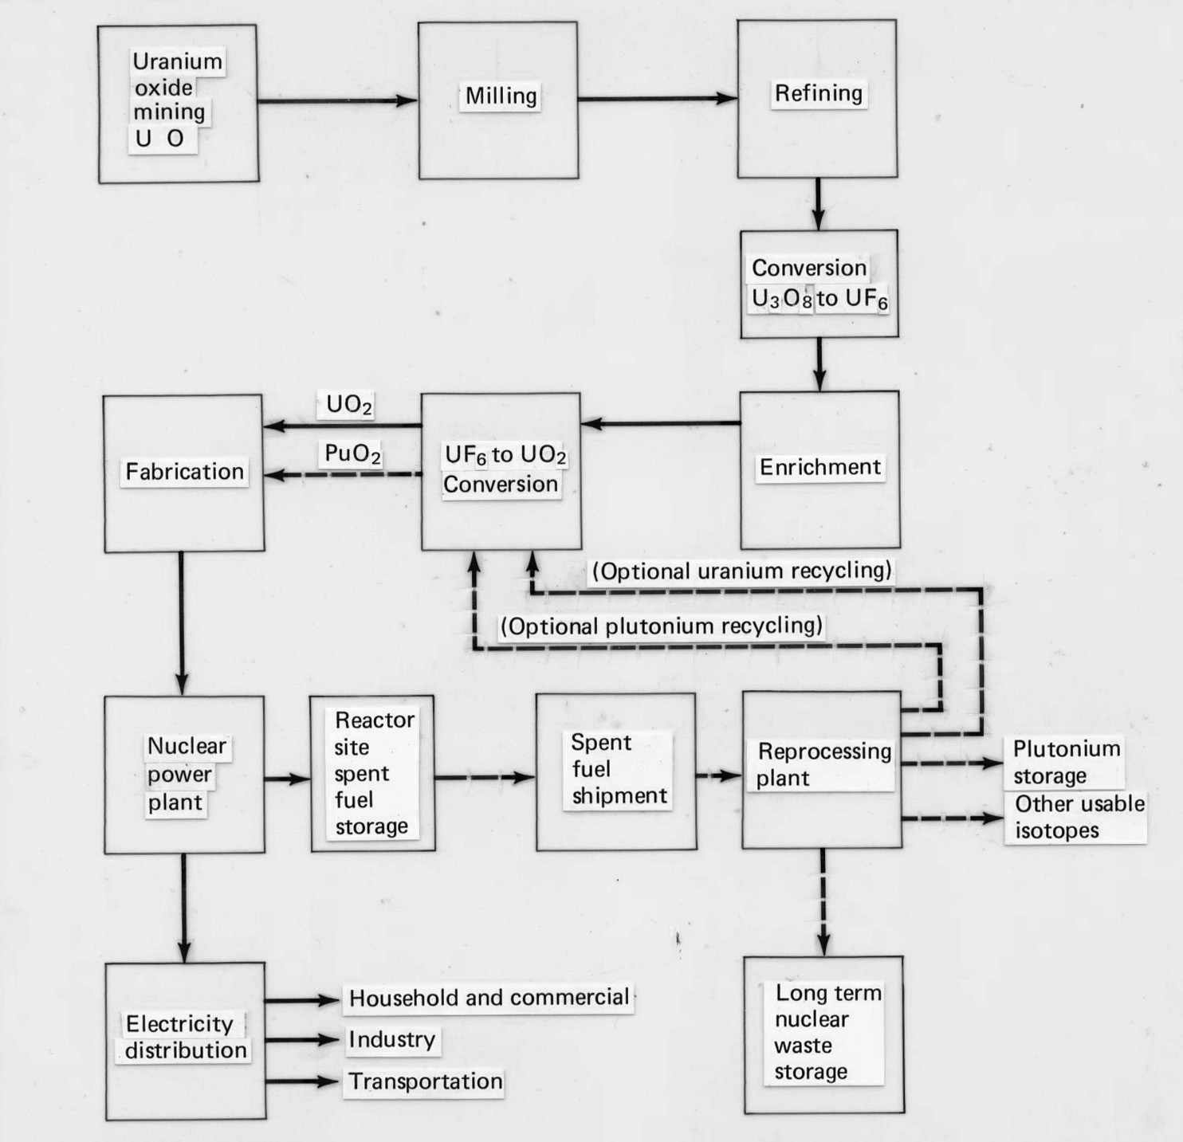
The Nuclear Fuel Cycle
From mineral mining, uranium is refined, converted, enriched to a desired level. For commercial use, the enriched uranium is placed into fuel rods that are inserted in a sealed steam boiler unit from which electricity is then generated. As with fossil fuels, spent nuclear fuel poses a disposal problem for which electric utilities now pay storage fees until such time as a more permanent solution is adopted. For nuclear weapons, enrichment to a higher- level poses not just explosive force but radiation contamination that can last for thousands of years.

Slide 11
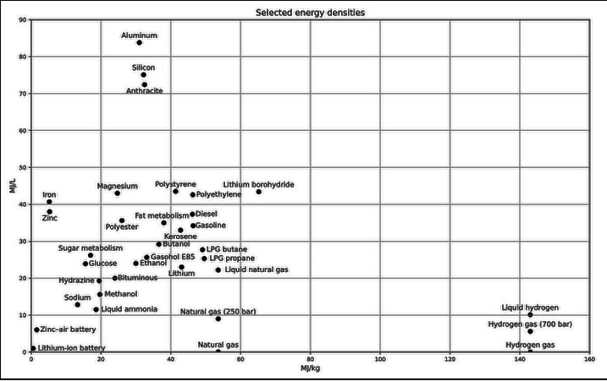
Energy Storage Densities
Metals contain varying energy storage densities. Lead acid batteries have long predominated common uses since they are relatively inexpensive to produce. Higher storage density materials such as lithium batteries are more expensive. Given that solar and wind energy resources are variable, a key to expanding their use is the development of competitively high storage battery technologies. Battery storage technology has been a critical factor in the expansion of electric vehicles and for which Tesla has concentrated on producing high density battery storage systems for vehicles but also for prospective commercial and residential use in capturing solar energy. Nicolas Tesla’s invention of alternating current enabled the transmission over long distances, a factor that constrained Thomas Edison’s direct current innovation with the advent of commercial electricity for industrial, commercial, and residential use.

Slide 12
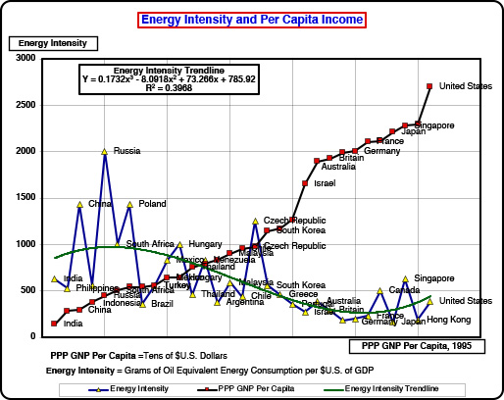
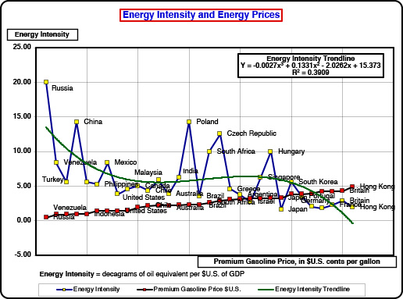
Energy and the Economy
Given that the second law of thermodynamics precludes a zero emissions possibility, managing economic growth in a sustainable fashion involves the use of relative prices in the form of taxes and subsidies to affect end-use choices. In the short-run, energy price increases induce relatively small degrees of resource substitution and conservation. Over the longer term, relatively high energy prices reduce the energy intensity of an economy, thereby permitting higher levels of per capita income without significantly increasing environmental emissions that affect global climate change.

Slide 13
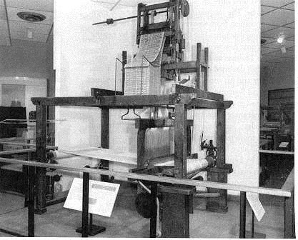
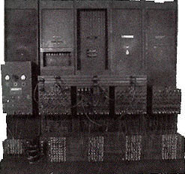

Binary Code as the foundation of the Digital Economy
The adoption of binary code for digital storage and communication ushered in the wave of technologies we now seem to take for granted. One of the first programmable devices was Louis Jacquard’s 1840 loom. Using a series of perforated cards, it enabled the production of fabricated cloth with predetermined designs. In 1890, the U.S. Census used batch cards on Herman Hollerith’s machine to compile systematic data for the first time. In 1946 the University of Pennsylvania was the site of the first digital electronic computer. Using vacuum tubes, it weighed over a ton and took up a full-sized room to operate its 4-kilobyte capacity to execute the four basic mathematical instructions of addition, subtraction, multiplication, and division. With the invention of the transistor in 1947, semiconductor chips evolved with ever greater storage capacity. Today’s iPhone 13 pro has a capacity of 1 terabyte of memory, at a retail prices of $1,500. On a per kilobyte and inflation adjusted price, today’s digital devices offer storage capacity at a fraction of what was needed for ENIAC and its immediate successors in the mainframe computer industry.

Slide 14
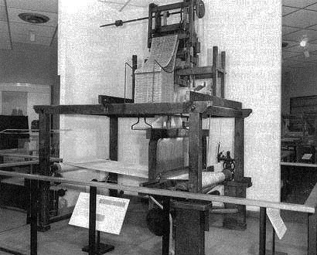
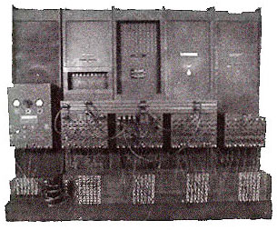
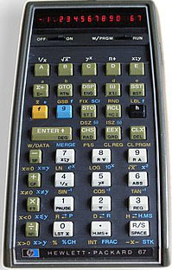
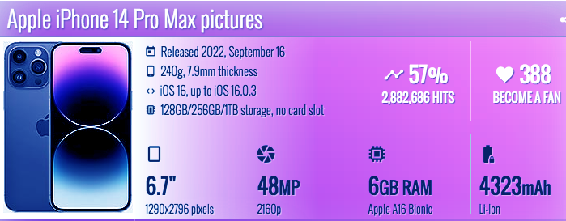
Digital Computing Comes of Age
Jacquard Loom, ca 1840’s
Eniac Computer, ca. 1945
HP programmable
calculator, 1976
The 20th century has been called, among other things, the Age of Information. What has made this possible is the extraordinary expansion of digital computing and memory, as the above images serve to demonstrate. From the programmable punch card of a Jacquard loom to the first digital electronic computer Eniac (with its 4k of memory), the invention of the transistor has accompanied the rise of ever more memory and computing capacity through the production of semi-conductors. Speeds of computation have risen in tandem, with the future looking to quantum computers that promise the speed of computing to be something on the order of 150 times the capacity of today’s computer devices, be they mainframe, desktop, laptop, or mobile smart phones.

Slide 15
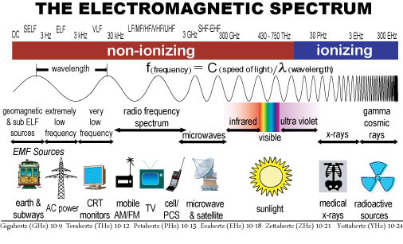
Telecommunications Technology
Nineteenth century science brought about discoveries of the properties of various frequencies along the electromagnetic spectrum. Marie Curie (1867-1934), Henri Curie (1859-1906) and Henri Becquerel (1852-1908) were jointly awarded a Nobel Prize in 1903 for discoveries of radiation, or ionizing rays. In the non-ionizing spectrum, Nicolas’ Tesla’s alternating current became possible, along with radio, television, mobile AM/FM, microwave and satellite communications, along with cellular and blue tooth technologies. Innovations using these technologies have transformed how we are designing transportation vehicles as well as household devices, all the way to today’s smart technologies in which we can exercise remote control activation controls. These technologies were crucial to the development of remote communication for orbital and space technologies, and for subsequent interplanetary exploration.

Slide 16
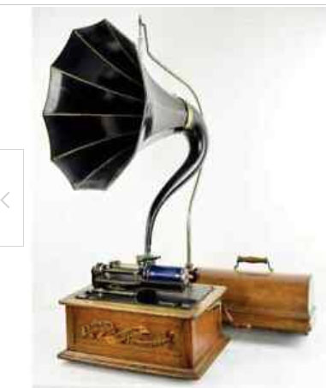

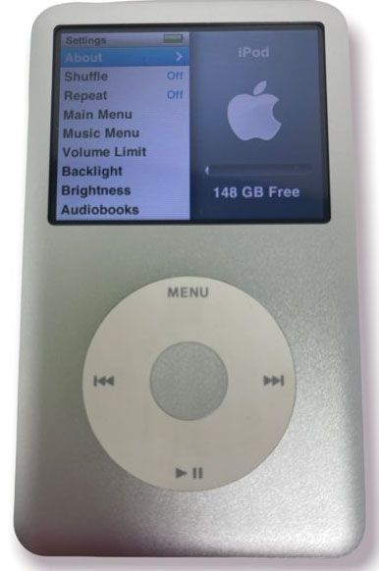

Technology Affects Sound Recording and Storage Devices
When Thomas Edison (1847-1931) invented the phonograph, it relied on analog technology to store sounds. Sound was originally stored on cylinders, after which the phonograph record was devised. Early phonographs used 78 rpm disks to play musical recordings. In 1948, the LP record was introduced, based on vinyl rather than bakelite technology of the old 78’s. The first 45 rpm disks were introduced in 1949 and soon populated jukeboxes in local restaurants. In 1979, the first cd disks were introduced and soon were favored over vinyl recordings for the ability to deliver crisp sounds. The first mp3 music players were introduced in 1997, followed by the first mp4 video players in 2001. Video streaming has become the most popular form of music consumption today, even though there is a revival of vinyl recordings to some extent. Smart wireless devices can now be used on site or remotely to control radio and video reception, along with controls for temperature and command routines.

Slide 17
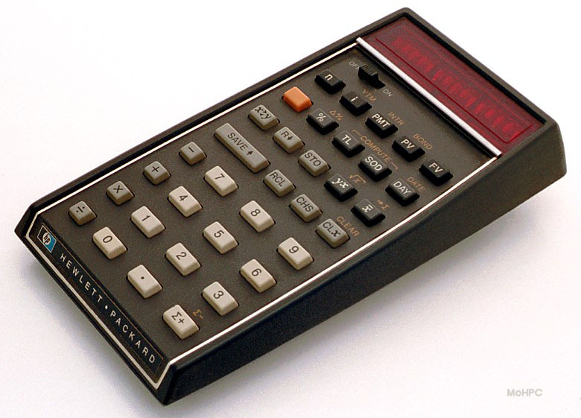
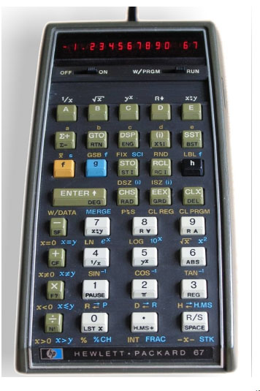
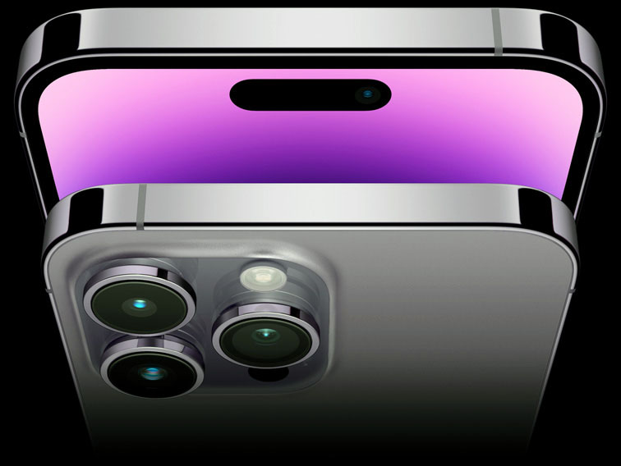
Solid State Electronics and Sustainable Development
HP 80 Programmable Calculator 1973
HP-67 Programmable Calculator 1976
Apple iPhone 14 2022
Hewlett-Packard, a company started by William Hewlett (1913-2001) and David Packard (1912-1996) in a Palo Alto, California garage in 1939 made pioneering advances in computer technology. In the 1960’s, when the space program was looking to master landing someone on the moon, calculations on fuel use, gravity, speed, landing and return, were critical issues to the safety of the astronauts undertaking the mission. When Apollo 9 landed on the moon on July 20, 1969, Neil Armstrong (1930-2012) was able to proclaim, “one small step for man, one large step for mankind as flickering black and white images were transmitted back to earth. Buzz Aldrin (1930- ) soon joined him while Michael Collins (1930-2021) kept the lunar orbiter safely in position for the return launch. While mainframe computers back on earth were sending information to Armstrong and Aldrin as to where to land, how long to stay, what samples to gather, what the NASA mission proved was not just the success of the mission but also the value of new materials that could enable onsite experiments and calculations. HP went on to produce the first hand-held programmable calculator, the HP-80 in 1973, followed by the plastic strip HP-67 in 1976. It was in that year that the Apple 1 desktop computer weas introduced by Steve Jobs (1955-2011) and Steve Wozniak (1951- ), which thereafter set the direction of personal computing. Today’s latest iPhone can store up to 1 terabyte of memory, while the Eniac of 1945 only had 4k of memory.

Slide 18
Does Technology Affect our Aesthetic Sensibilities?
The Fibonacci series appears in the foundation of aspects of art, beauty and life. Even music has a foundation in the series, as:
There are 13 notes in the span of any note through its octave.
A scale is composed of 8 notes, of which the
5th and 3rd notes create the basic foundation of all chords, and
are based on a tone which are combination of 2 steps and 1 step from the root tone, that is the 1st note of the scale.
Note too how the piano keyboard scale of C to C above of 13 keys has 8 white keys and 5 black keys, split into groups of 3 and 2. While some might “note” that there are only 12 “notes” in the scale, if you don’t have a root and octave, a start and an end, you have no means of calculating the gradations in between, so this 13th note as the octave is essential to computing the frequencies of the other notes. The word “octave” comes from the Latin word for 8, referring to the eight tones of the complete musical scale, which in the key of C they are: C-D-E-F-G-A-B-C.
In a scale, the dominant note is the 5th note of the major scale, which is also the 8th note of all 13 notes that comprise the octave. This provides an added instance of Fibonacci numbers in key musical relationships. Interestingly, 8/13 is .61538, which approximates phi. What’s more, the typical three chord song in the key of A is made up of A, its Fibonacci & phi partner E, and D, to which A bears the same relationship as E does to A. This is analogous to the “A is to B as B is to C” basis for the golden section, or in this case “D is to A as A is to E.”
Here’s another view of the Fibonacci relationship presented by Gerben Schwab in his YouTube video. First, number the 8 notes of the octave scale. Next, number the 13 notes of the chromatic scale. The Fibonacci numbers, in red on both scales, fall on the same keys in both methods (C, D, E, G and C). This creates the Fibonacci ratios of 1:1, 2:3, 3:5, 5:8 and 8:13

Slide 19
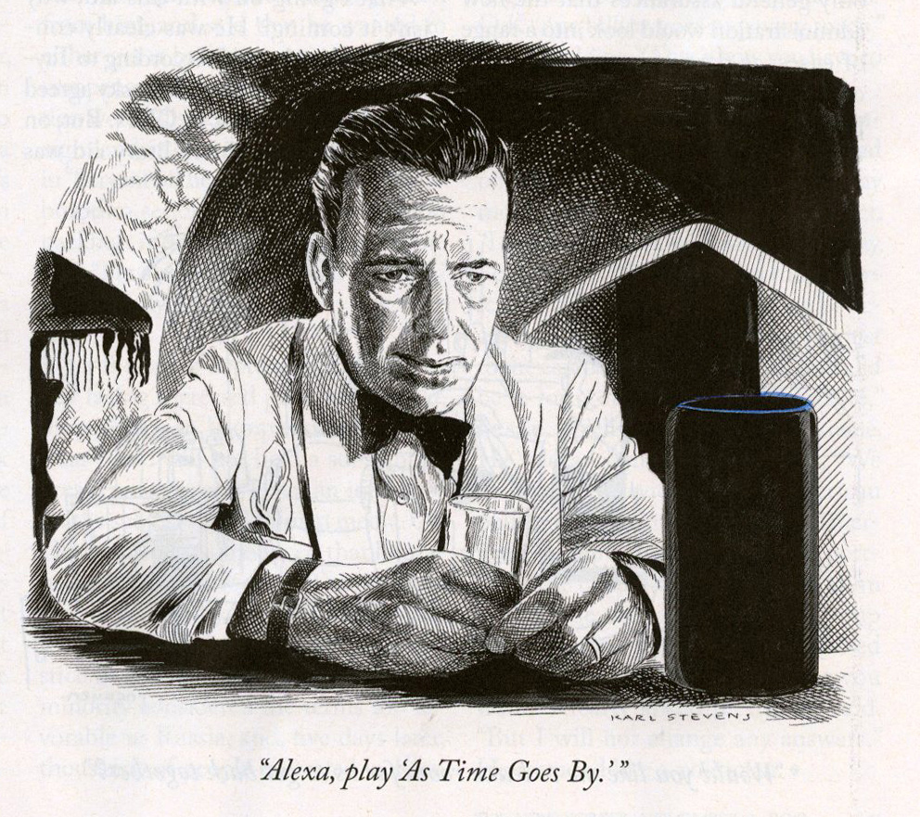
Mathematical Elegance Often Defies Logic of the Senses

