Slide 1

Whither Numbers, Math, and Civilization?
Oscar Wilde is said to have opined as to what is a cynic, to which he offered: “Someone who knows the price of everything and the value of nothing”. We live in a digital world that depends on measurement. The difficulty in any system of measurement is how to interpret it in terms of our senses, which means how our neurons lead us to act. In an ideal world, we make decisions based on the accumulation of objective facts from which value judgments may be imposed. When those facts become distorted as “alternative facts”, the very rational basis on which decisions can be made undermine how a society may be governed, i.e., its political legitimacy. If there is an ideal mode of governance, it is one in which those in power can be held to account, and which is the core of a democratic society. In what follows we identify some examples of how measurement informs our understanding of not only natural phenomena but also economic ones that in turn shape political decisions.

Slide 2
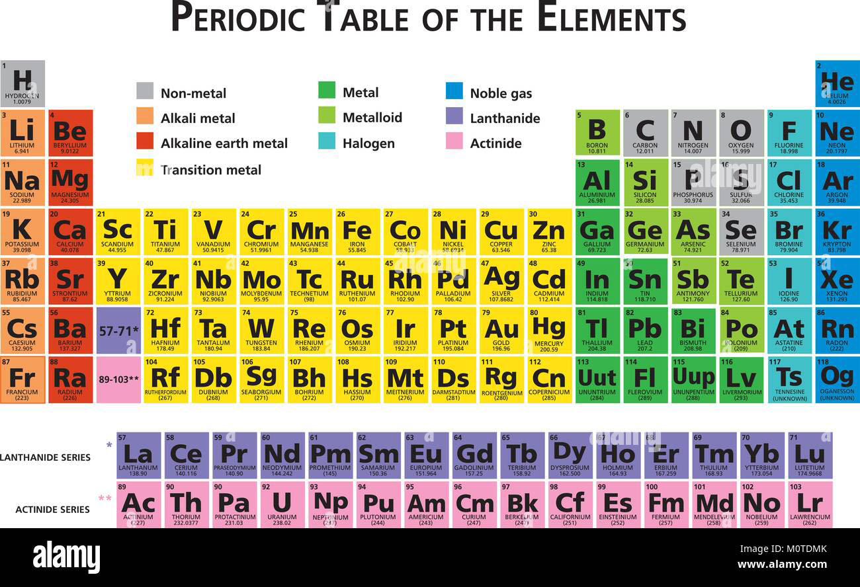
Better Living through Chemistry
Building on the Hindu-Arabic number system, we have been able to construct a vast universe of scientific understanding down to the atomic level. From Mendeleyev’s Periodic Table of the Elements, we have been able through chemical formulae to identify artificial elements that can be combined into more stable forms from which we can extract useful materials and accessible energy resources to construct and expand economic activity.

Slide 3

Chemical Equations embody our Number Systems at a Higher Level
Chemical equations state how combinations of elements in various proportions lead to a transformed compound, in the case, the creation of Sodium Nitrate.

Slide 4
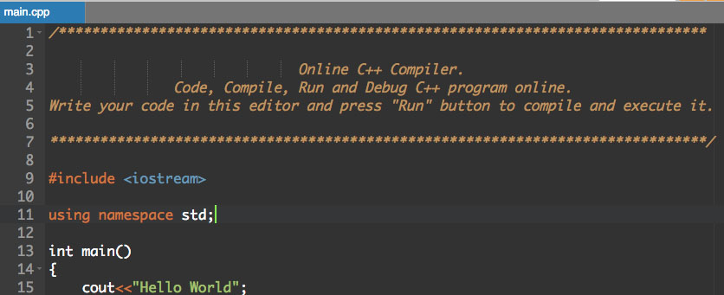
Computer Programs use primacy languages and Compilers to Function
Programming languages can be copyright protected, as can the applications from which a particular program can operate, such as Microsoft Office.

Slide 5
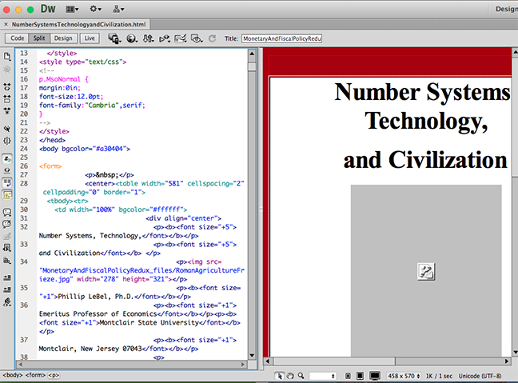
A Compiler enables tracking of web content and format

Slide 6
How do Economic Numbers Guide our Gecisions?
Economic growth, measured in terms of purchasing power parity of the Gross Domestic Product, has historically served as a measure of progress. Yet, it does not reflect the composition of goods and services, nor the quality of the environment beyond what is spent for its conservation, nor whether the natural resource base on which it is based can be sustained.

Slide 7
Does Looking Out for Number One Make Sense?
During the twentieth century, the U.S. achieved global economic and military dominance. As other countries have made technological and economic advances, some suggest that the twenty first century will be the Chinese century. By PPP measures, China already has surpassed the United States, even though on a per capita basis, it is still far below the United States. One question is to the extent that the United States is displaced by China or some other configuration, what rules will apply to global governance? Will science and mathematics still enable social progress or will the associated democratic institutions be replaced by autocratic ones? Would such a scenario preclude the evolution of a more inclusive society that is environmentally sustainable. Mathematics can not answer the question of social governance. It can only devise means of tracking indicators. Thus, the question of global governance rules should constitute a priority within the context of international relations, in particular the extent to which that destructive conflict can be avoided.

Slide 8
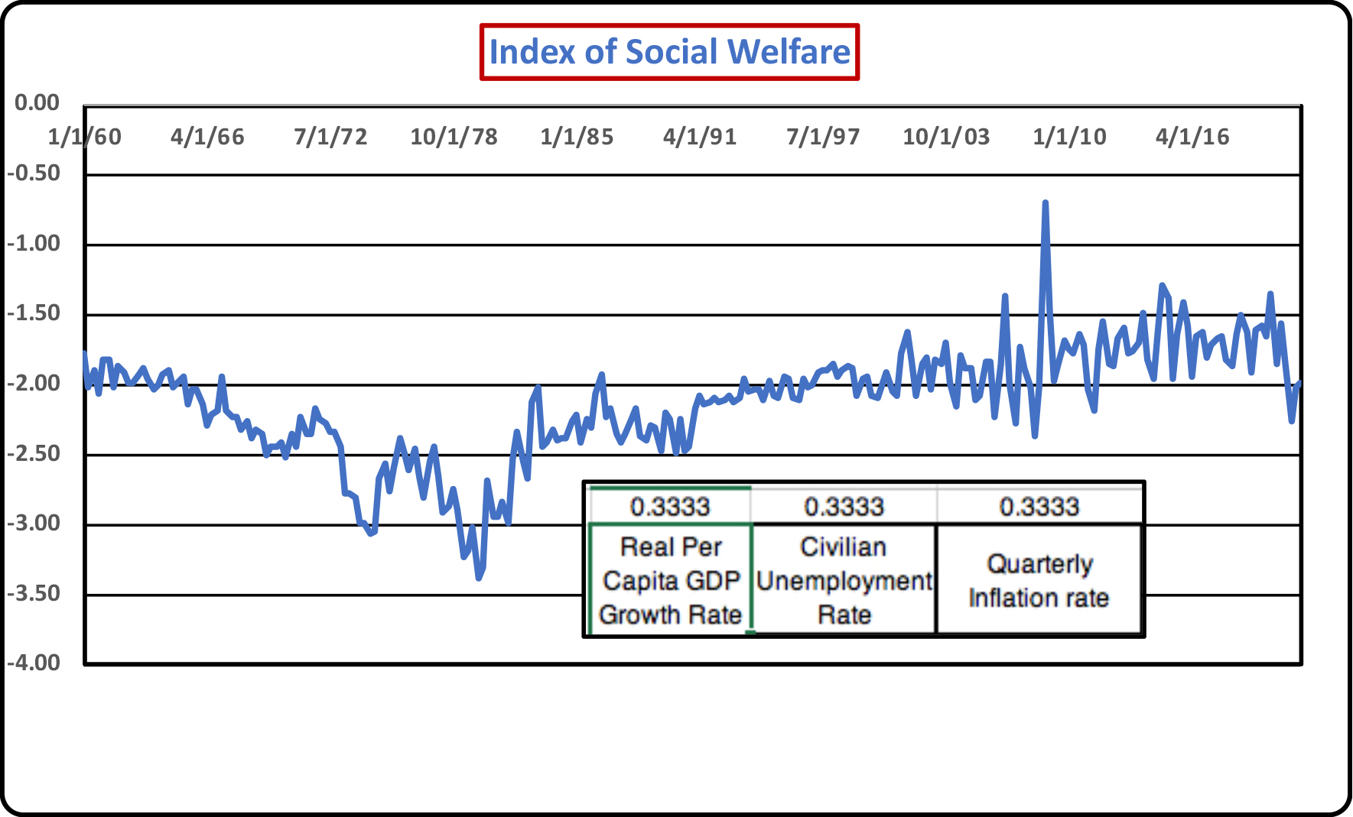
A Numerical Index of Social Welfare

Slide 9
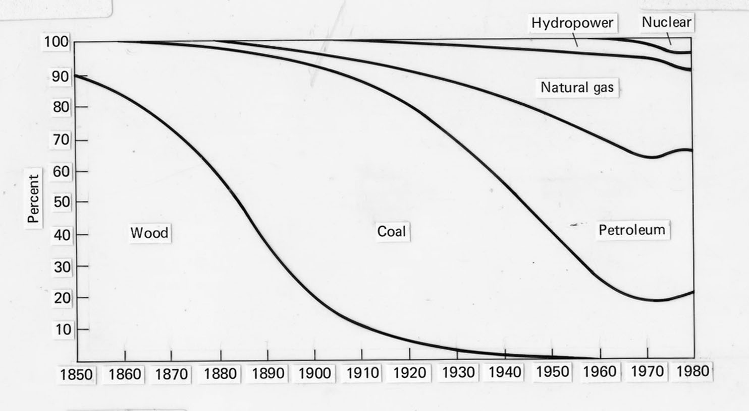
Can Economic Growth Be Sustained through Natural Resource Use?
The theme of the limits to growth has been a perennial one ever since the industrial revolution. The shift in natural resource use to a fossil and nuclear fuel economy raises questions of how to minimize environmental pollution while achieving sustainable increases in real income for a rising world population. The 1970 book, The Limits to Growth, relied on a mathematical model of resource depletion and rising pollution that has been offset by technological change.

Slide 10
Global Climate Models to Forecast Future Economic Growth
The IPCC has forecast irreversible global warming if measures are not taken to limit the increase in surface land and water temperatures. In a Business as Usual scenario in which nothing is done, rising temperatures will lead to polar ice melting that will raise sea level temperatures, flooding lands that will affect hundreds of millions of people living in low-lying areas. Mathematical models are essential to bring numerical estimates to these predictions. However, they can only establish a base from which policy choices are made. How those choices are made depends on individual perceptions of risk and how people respond in the presence of risk. Do we make decisions on the basis of rational calculations or do we react by emotion in making critical decisions?

Slide 11
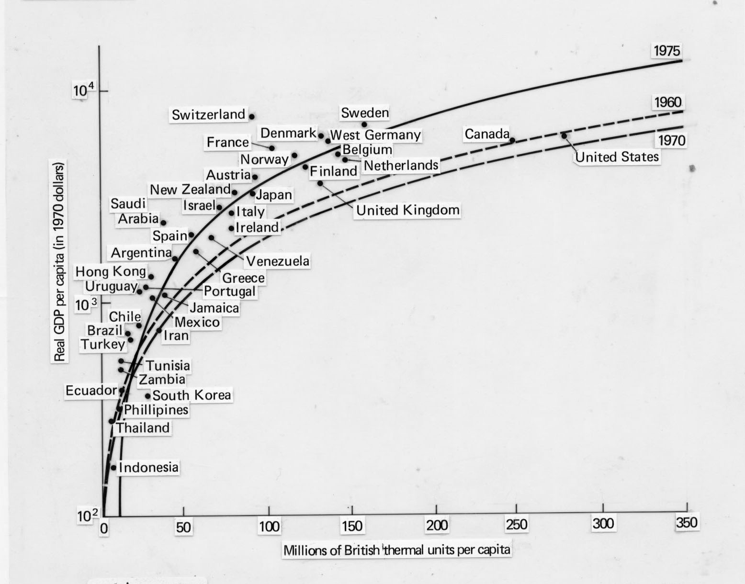
Aggregate Energy Intensity Defines Production Possibilities
Paul Ehrlich (1932- ) and Julian Simon (1932-1998) once made a bet as to whether the U.S. would run out of resources. Simon won the bet by taking into account resource substitution and conservation of energy. While the historical wager looked promising, does the future hold the same choices? Aggregate energy intensity, the amount of energy per unit of economic output (PPP GDP per capita) is a now standard way of tracking how resource substitution and conservation demonstrate the extent to which rising population levels can support higher levels of real per capita income.

Slide 12
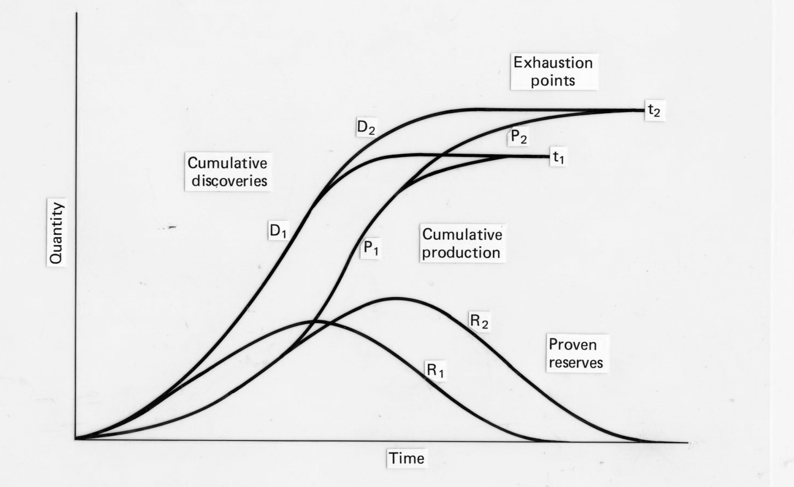
Natural Resource Use is Shaped by Resource Use with Resource Substitution and Conservation
“Running out of natural resources depends on the economic recoverability of natural resources and thus on the underlying regime of natural resource prices. The earth is never likely to physically exhaust its natural resource stocks. Instead, rising prices of natural resources leads to technological innovation that substitutes existing paths for more sustainable ones.

Slide 13
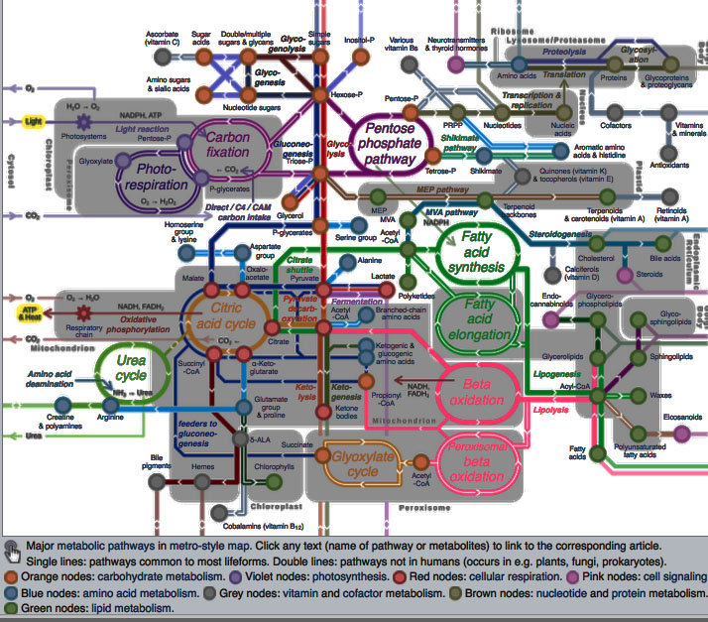
Mathematical Contours of Modern Medicine
From the time of the European Middle Ages, popular conjectures were shaped in part by the Four Horsemen of the Apocalypse: Conquest, War, Famine, and Death. The fatalism of such thinking was conditioned by the slow progress of medicine and enlightened governance. While the world has demonstrated a rising capacity for destructive war (10 million dead in WWI; 65 million dead in WW2), advances in medicine, agriculture, and economic management have raised life expectancy around the world and have reduced famine to at least as much a question of food distribution as it is one of climate extremes. With the advent of modern vaccines and medicine, the world is on the threshold of applying MRNA knowledge to prevent pandemics from posing the deadly threats once posed.

Slide 14
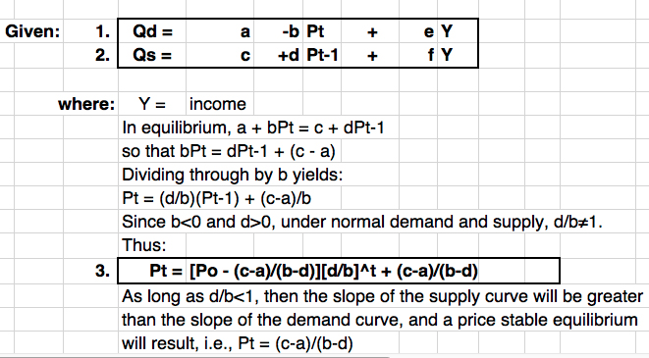
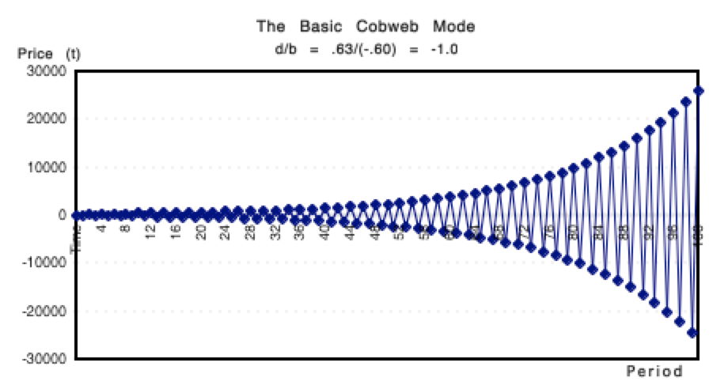
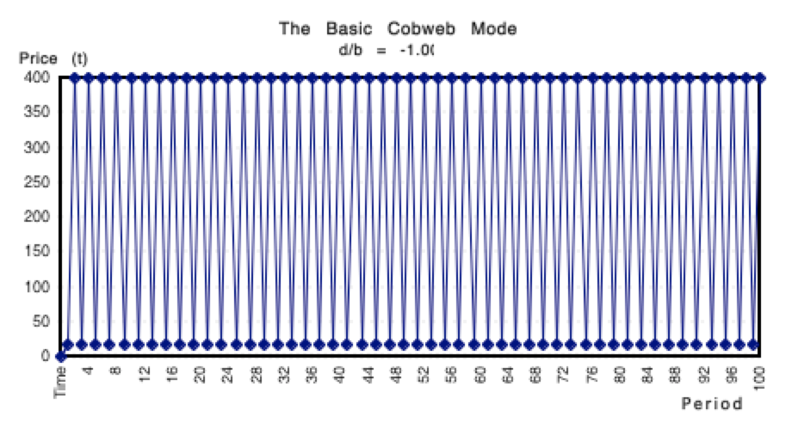
Managing Risk through Mathematics is a Key to the Future
A traditional source of economic uncertainty has been the role of climate variability on agricultural production. A “cobweb” model of pricing was one of the first attempts to discover where price stability would emerge from divergent time decisions between demand and supply. The cobweb model offered a first order way to predict whether markets were headed for more instability, stability, or oscillating price behavior over time.

Slide 15
Chaos in Asset Pricing – Can Markets be Efficient?
A simple differential equation illustrates how one can demonstrate price stability that under a higher order can resemble complete chaos. In commodity and financial markets, to the extent that chaos prevails, it becomes difficult to make key investment decisions. We already have covered the Black-Sholes option price model. Another possibility is to use buffer stocks to stabilize commodity price fluctuations. International Oil companies devised a 1928 agreement at Achnacarry, Scotland to stabilize global crude oil prices through a system of quotas. OPEC, founded in 1960, based its structure and operations precisely on this system of production quotas. Such cartels tend to be inherently unstable, even more so when global political differences invoke embargoes and biased allocation of primary resources.

Slide 16
Mathematical Modeling of Commodity Price Stabilization
Commodity price stabilization, whether total or partial, involves an administrative cost of buffer stock management.

Slide 17
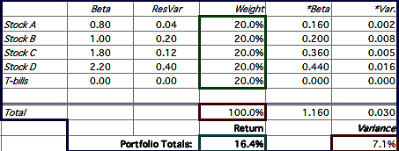
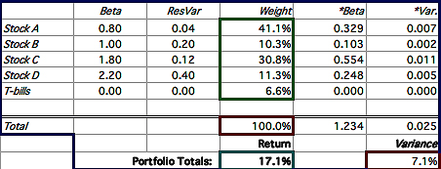
Managing Portfolio Risk Through Mathematical Models
In 1952, Harry Markowitz (1927- ) published Portfolio Selection, a book that established the basis of modern portfolio theory. One can maximize the rate of return or minimize the risk (variance) for a given level of return. Algorithms permit the derivation of rebalancing decisions that guide many portfolio management strategies today. Markowitz was awarded the Nobel Prize for his work in 1990.

Slide 18
Deriving an Index of Aggregate Market Risk
The Chicago Board of Options Exchange was the first to adopt the use of the Black-Sholes option price model to primary commodities. Since then, and since 1986, the CBOE has provided a daily measure of market volatility in which the price of commodities over its daily high and low provide a measure of volatility from which the VIX index has been possible. Such aggregate market risk shapes daily portfolio and real commodity financial decisions.

Slide 19
Market Risk Measurement does not solve the problem of political governance and political legitimacy
In a democracy, what determines political legitimacy? Is it the voter turnout rate, the eligibility and inclusiveness of the electorate, or the electoral college and/or popular vote majority? These questions are yet unresolved at the level of the United States, but also abroad among other countries choosing to govern themselves by democratic elections.

Slide 20
Expanding the Electorate Is only One Key to Legitimacy
Broadening the franchise is one path to political legitimacy. As to whether the outcome of an election is legitimate depends on the voter participation rate as well as the Electoral College and popular vote majority. IN the U.S., an electoral victory requires only a 51 percent majority, while the Electoral College outcome may differ by a different amount, though always producing a majority outcome unless the Supreme Court is required to break a tie.

Slide 21
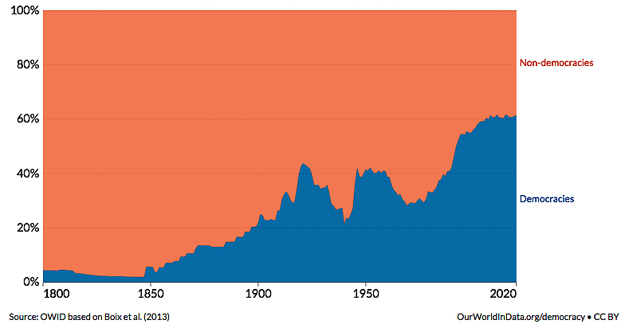
The Political Legitimacy of Democratic Governance Requires a clear Definition of Property Rights and Judicial Independence
”It has been said that democracy is the worst form of government except all the others that have been tried” Winston Churchill.

