Slide 1

Constraints On Political Legitimacy:
Origins and Implications
Even if one has a credible record of economic stabilization and growth with an equitable distribution of income and wealth, periodic ”crises”, that is, sudden shifts up or down in some indicator often leads to a policy response. The response may tend to under or overestimate the impact magnitude of a “crisis”, in which case the re-emergence of more predictable patterns takes time to settle.
At the heart of such disruptions is risk. We can measure risk in terms of standard measures such as the standard deviation of an event from the norm, or by the coefficient of variation, which is the standard deviation divided by the mean of a sample. Or we could simply use a volatility index such as the VIX, which is tracked daily. In any case, how risk is perceived, measured, and acted upon affects how monetary and fiscal policy are exercised, and in so doing, the extent to which political legitimacy is seen as endangered through mis-judgements of policy makers and political officials.

Slide 2
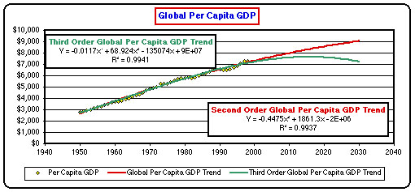
Despite Periodic Downturns, the Global Economy Has Generally Enjoyed Rising Per Capita Real Income Since the End of the Second World War

Slide 3
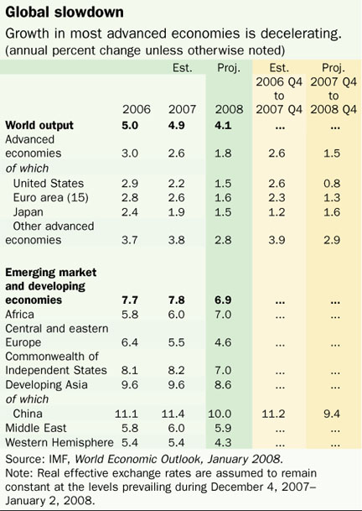
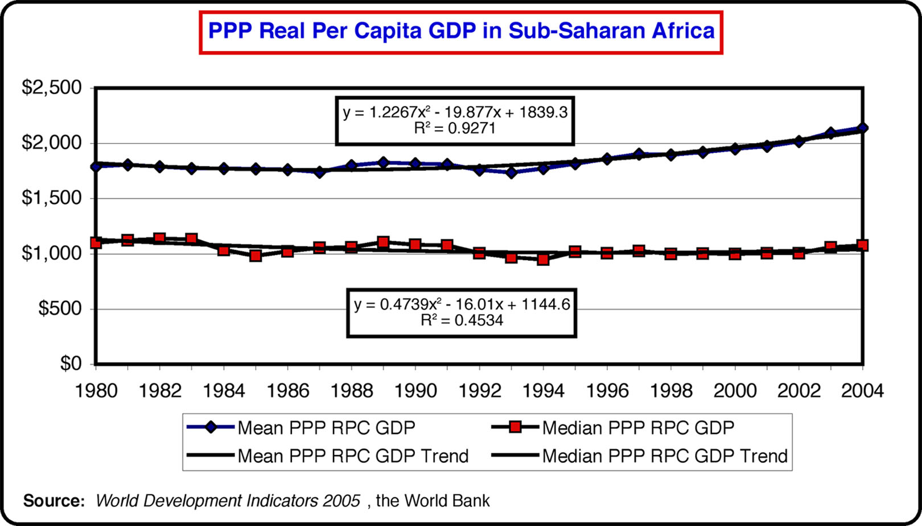
Economic Growth Varies Significantly by Region

Slide 4
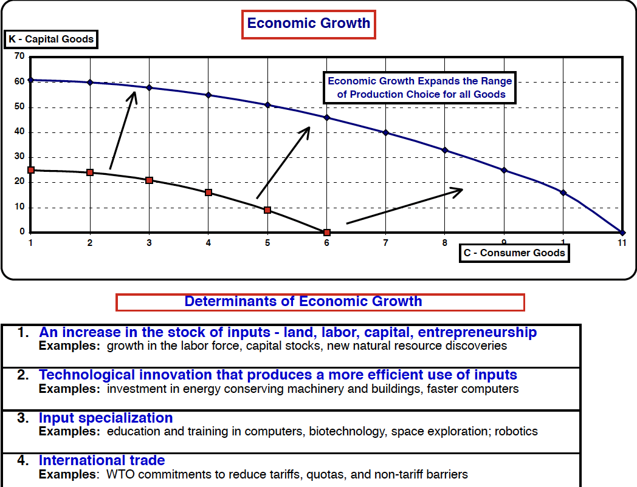
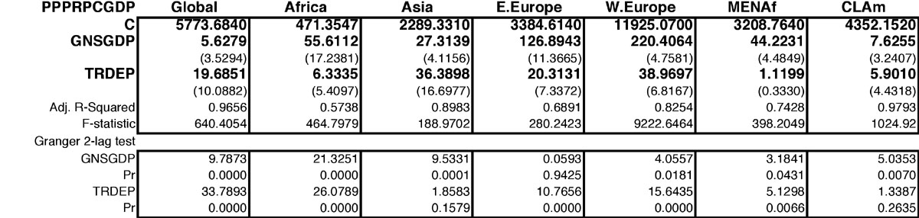
What Drives Economic Growth?

Slide 5
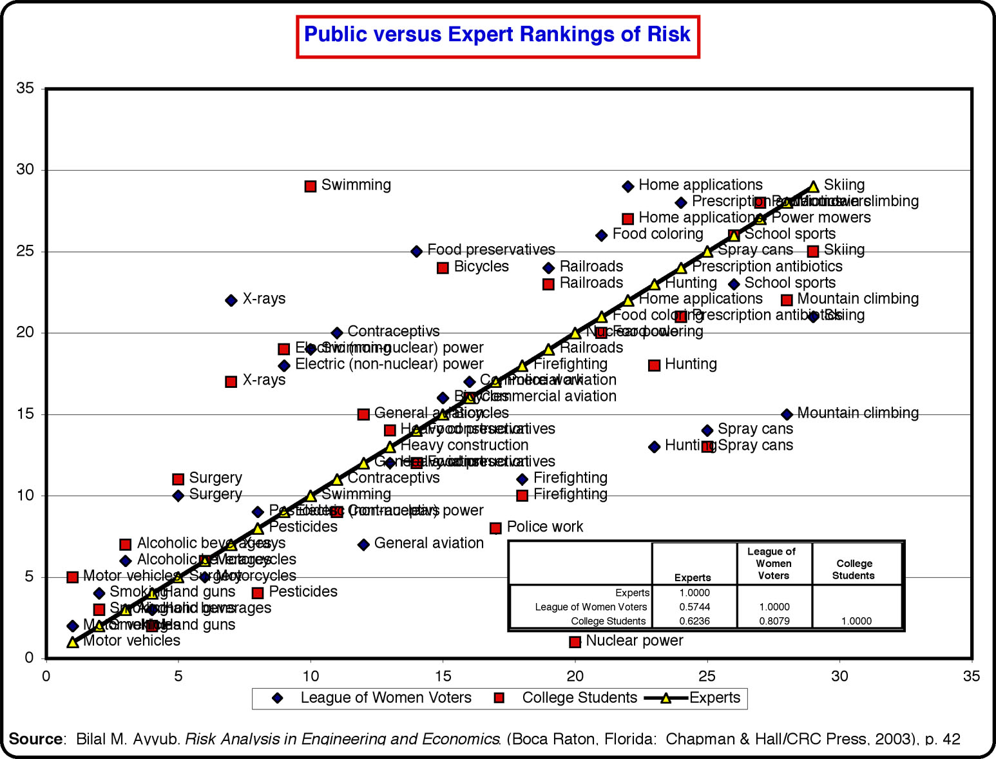
All Growth Determinants Depend Significantly on Perceptions of and Attitudes Toward Risk
Points left and above the solid line indicate lower risk ranking perception than experts,
while those right and below indicate higher risk ranking perception than experts

Slide 6
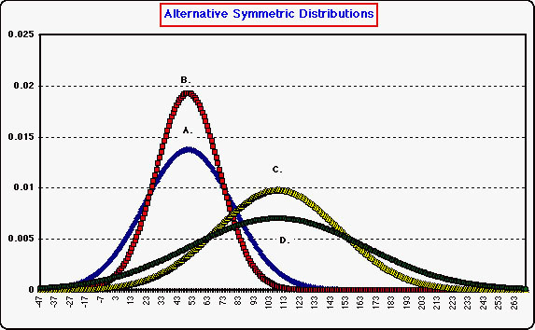
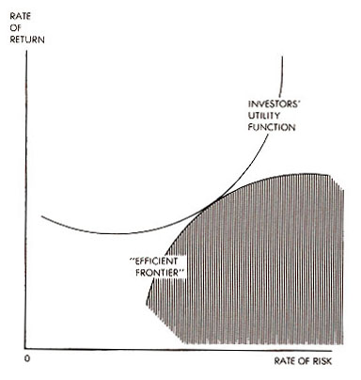
In any Decision Involving Future Outcomes,
Attitudes Toward Risk Are Variable and Change with New Levels of Information

Slide 7
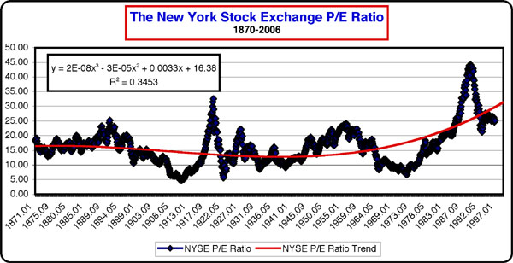
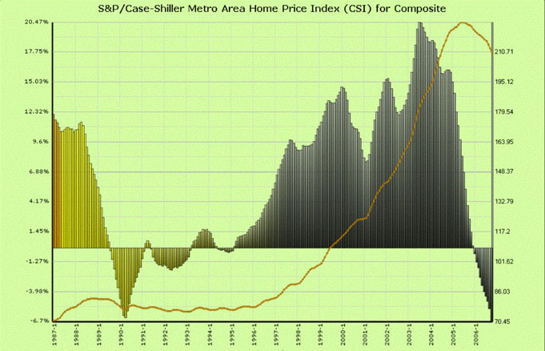
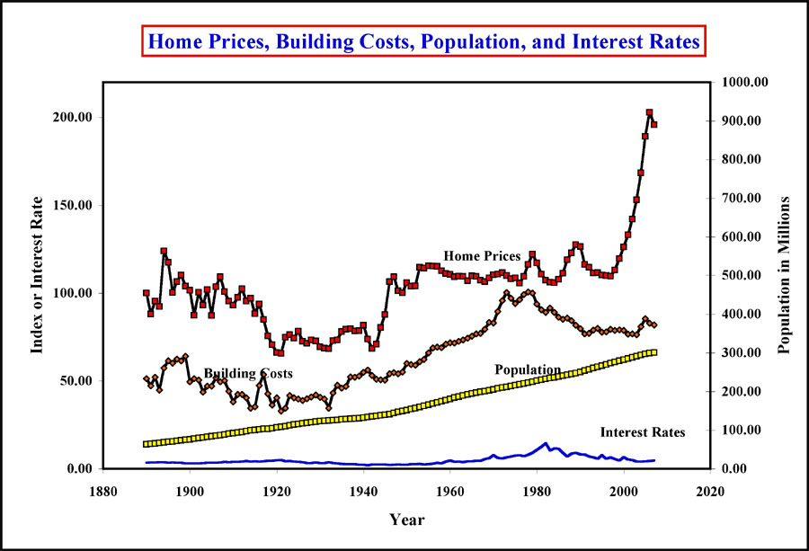
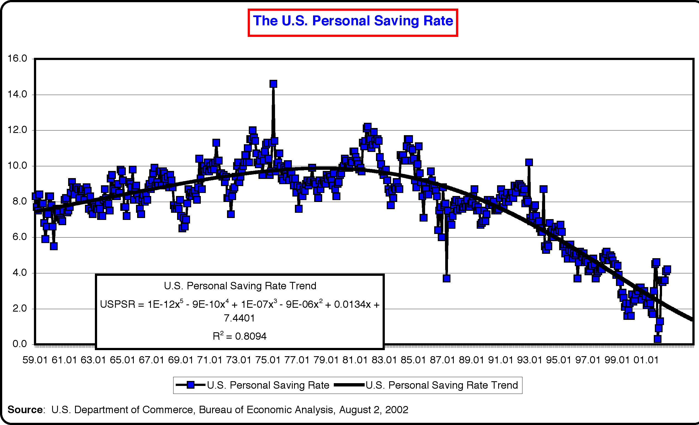
Perceptions of Financial and Economic Risk
Affect Consumer and Investment Spending

Slide 8
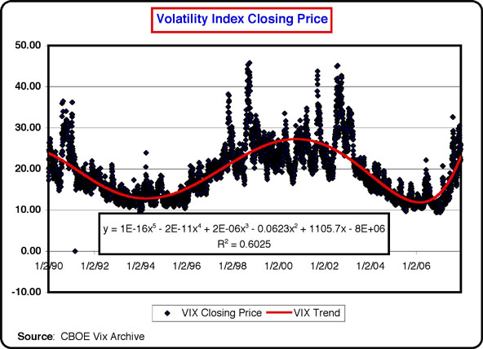
Tracking Risk and Uncertainty
Draws on Common Economic Indicators
Risk and uncertainty can be tracked through various measures of volatility, as in the CBOE’s Volatility Futures Index. Increases in index values reflect not only stock market noise, but underlying certainty in such sectors as housing that increase the volatility of industries tied to housing construction and sales.

Slide 9
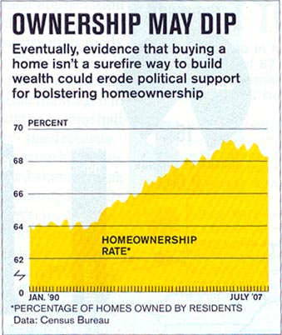
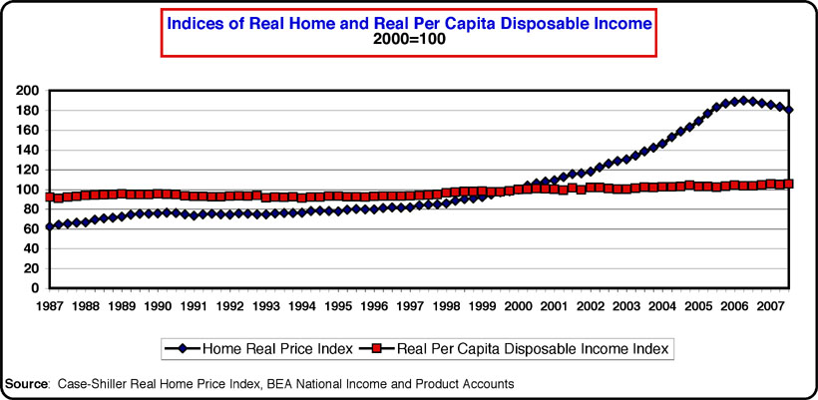
Why Has the Sub-Prime Housing Market Created Recession Risk?
1. Housing Prices Have Risen Faster Than Incomes
When this happens, by any measure, it becomes increasingly difficult to service housing mortgage debt, and the default rate rises accordingly.

Slide 10
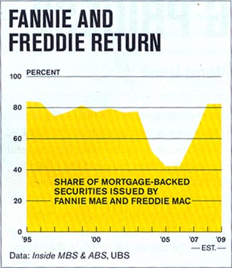
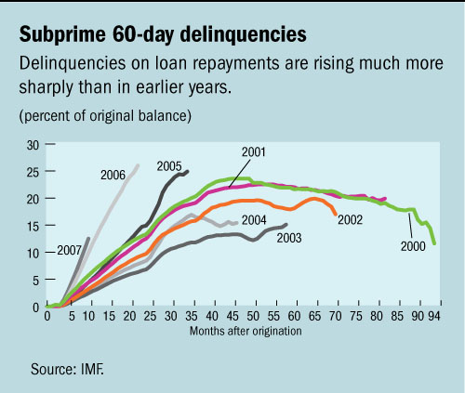
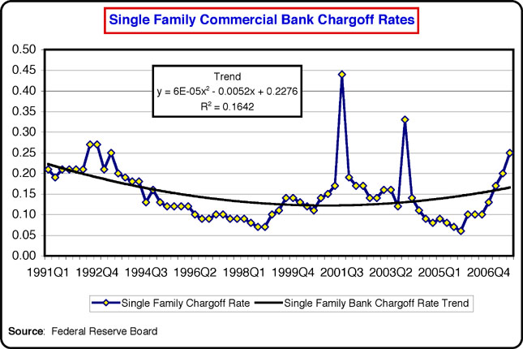
2. When affordability declines, delinquency rates increase, as do foreclosures, leading to larger bank write-offs, and declines in equity values. Declines in equity values lead to reduced consumer and investment spending, thus trending to recession.
Why Has the Sub-Prime Housing Market Created Recession Risk - 2
Delinquency strikes first in sub-prime markets, where balloon mortgages, ARMs, and interest-only mortgages represent a rising share of overall lending.

Slide 11
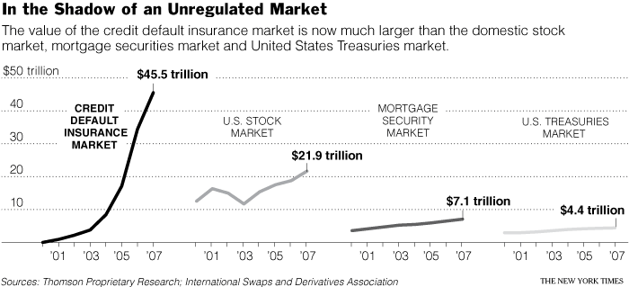
3. When mortgage-backed securities are traded in the market as collateralized debt obligations (CDO’s), it becomes more difficult to price them efficiently, with the result that bank balance sheets do not provide an accurate measure of exposure. This leads to pressures for greater regulatory oversight through such agencies as the SEC, and the Federal Reserve. However, some institutions such as AIG, are state chartered, and thus beyond traditional oversight. When they failed, government had the choice of either letting them disappear, as in the case of Lehman Brothers, or stepping in with financial cash infusions, as in the case of AIG.
Why Has the Sub-Prime Housing Market Created Recession Risk - 3

Slide 12
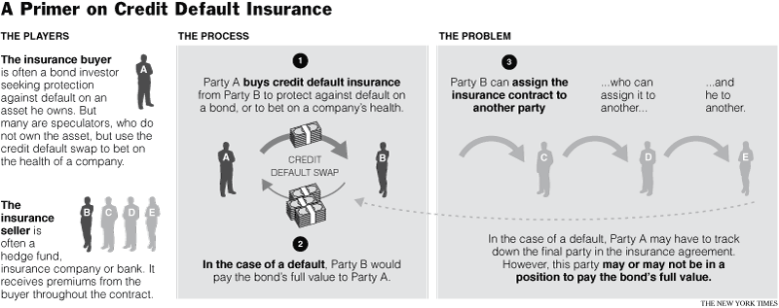
4. Risk is greater when traders swap assets as a form of insurance against default, but for which there is no clearinghouse to provide transparency in the levels of transactions and risk exposure. Part of the current efforts at regulatory reform involve the requirement of a clearinghouse for such contracts as credit default swaps. Other measures involve greater global coordination of regulatory standards, such as through the G-20 countries, the IMF, and the Bank for International Settlements (BIS) in Switzerland.
Why Has the Sub-Prime Housing Market Created Recession Risk - 4

Slide 13
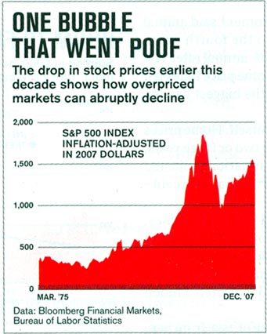
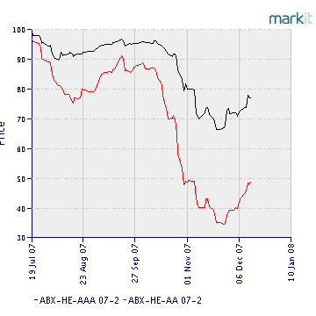
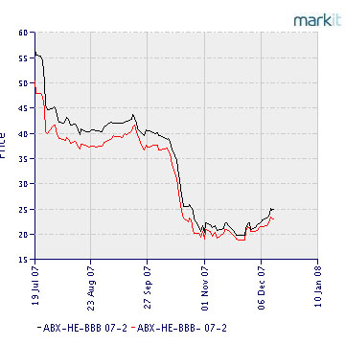
Can Market Information Predict Housing Price Valuations?
When sub-prime mortgage defaults reduce earnings and increase market volatility, traders look for tracking stocks to help them predict where the market is headed. One such measure is the use of the ABX index. This index provides an indicator of underlying values of sub-prime mortgages relative to prime mortgage valuations, and ranges from AAA to BBB levels.
Recent infusions of credit by the Federal Reserve and the creation of housing financial consortia by the Treasury have raised ABX ratings.
Market credit agencies such as Standard and Poor’s, Moody, and Fitch Oppenheimer often have lagged information that provides an imperfect measure of underling levels of risk. As a result, investors become more risk averse and capital markets trend to declines in value, thus moving the economy into recession.
Although greater regulation may be used, it is not obvious that regulation per se can increase the level of market efficiency. How much regulation may be needed has not been determined.

Slide 14
How Did Housing Market Dynamics Lead to the Current Economic Downturn?
First is the shift from equities to housing that took place following the 2000 stock market tech stock bubble decline.
Second is the computerized automation of mortgage filings that began in the 1990s
Third is the use of mortgage-backed securities by major financial institutions such as Fannie Mae and Freddie Mac. These institutions are backed by the full faith and credit of the U.S. government, which led them to expand credit to higher risk markets. New debt instruments such as collateralized debt obligations (cdo’s) were used to diversify mortgage risks through large portfolios, but whose buyers did not necessarily know the underlying risks when these assets were traded in the market.
Fourth is the rise in interest-only and adjustable rate mortgages (ARM’s) to default-prone borrowers on the assumption that rising prices would create sufficient equity to offset higher risks - in other words, a housing bubble economy
Fifth is the reduction of interest rates by the Federal Reserve that began with the effort to offset the downside effects of 9/11 and which have continued up to the present.
Sixth, in the presence of lower interest rates, borrowers used home equity loans to offset declines in personal savings to expand consumption to unsustainable levels.
Seventh, as households reduced the rate of personal saving, housing finance became driven increasingly by foreign capital inflows, particularly from East Asian economies such as China. When default rates rose, consumer spending slowed, thus spreading the housing downturn to export-driven economies such as China.

Slide 15
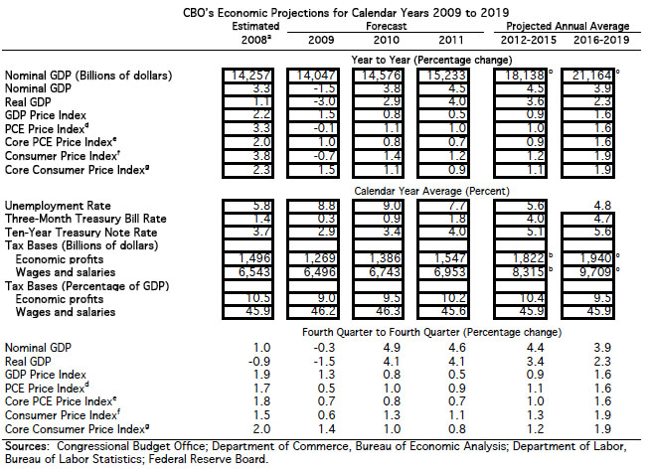
The Current Economic Outlook in the United States:
Short Term Declines in 2009, Gradual Recovery in 2010

Slide 16
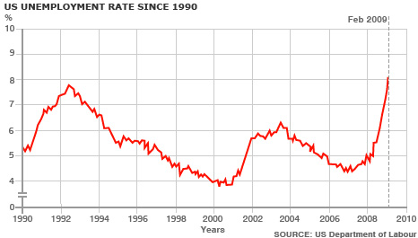
Policy Options to Offset a Recession
Expand the level of regulatory oversight to non-bank financial institutions that offer bank equivalent products, e.g. mortgage-backed securities.
Adopt low interest rates to stimulate consumption and investment spending
Provide guarantees and low interest loans to financial institutions to maintain lending and liquidity
Accelerate mergers and acquisitions to facilitate financial stability
Use public assets to increase equity holdings of selected private institutions to restore credit and liquidity levels
Expand deposit insurance coverage for banking institutions
Expand funding to banks to reduce mortgage rate defaults
Adopt fiscal stimulus legislation that includes tax cuts to stimulate consumer spending, along with an expansion of public spending to offset declines in private sector withdrawals

Slide 17
Policy Responses to the Current Recession
Although housing prices entered a major decline as far back as 2007, overall economic activity did not begin to slow until the latter part of the year. By 2008, banks faced major credit shortages, leading to mergers and defaults, with the effective demise of traditional investment banks such as Lehman Brothers, Merrill Lynch, and JP Morgan Chase. (Merrill Lynch was acquired by Bank of America in 2007).
The initial response of Congress to bank credit shortages was to adopt the $200 billion Temporary Asset Relief Program (TARP), whose initial purpose was to provide US Treasury funding to purchase “toxic”, i.e. underperforming bank assets. When this did not work, the US Treasury shifted to direct cash injections into banks, followed by Congressional hearings on whether troubled firms such as General Motors should qualify for federal funding to offset falling sales as credit shortages expanded.
As the U.S. economy shrank by an annual rate of 6 percent during the last quarter of 2008, other countries enacted a similar series of stimulus packages designed to offset declining sales and credit.
Following the election of Barack Obama in 2008, the U.S. Congress enacted a $787 billion stimulus package to provide tax cuts and increased federal spending, primarily on infrastructure, to stimulate aggregate demand.
In the short run, the global economic downturn has not yet reached an apparent bottom, with revised forecasts now calling for a recovery toward the latter part of 2009 or in 2010. More global summits appear to be in order, with some calling for a major overall of global financial institutions such as the IMF and the World Bank.
Historical evidence indicates that every major recession eventually ends with an infusion of credit and spending, and the current episode seems little different.

Slide 18
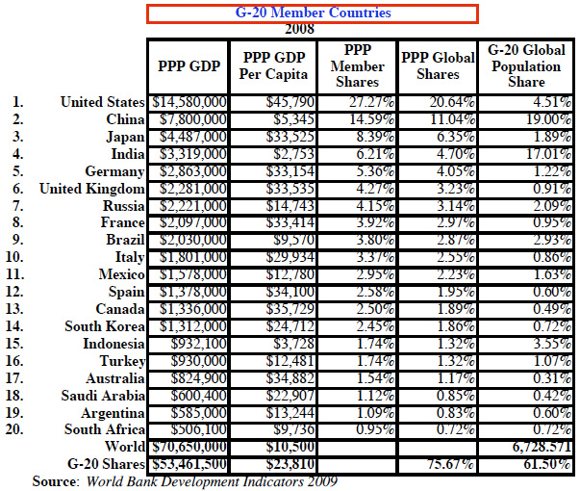
The G-20 Summit
London, UK - April 2, 2009

Slide 19
G-20 Commitments:
Coordinate global fiscal and monetary policy expansion through tax cuts and temporary increases in deficit spending.
Provide additional funding to the IMF and World Bank to assist developing economies in offsetting the declines in regional growth ($50 billion for the IMF to developing countries).
Engage in systematic reform of financial institutions through higher capital reserves for banks, expanded oversight of non-bank financial institutions, shrinkage of tax havens around the world, and a reform of credit rating agencies to provide banks with greater transparency in adopting loan portfolio choices.
Maintain a commitment to the WTO process of expanding global trade and investment and an avoidance of protectionist measures.
Adopt longer-term measures that are consistent with ongoing concerns over global climate change through an expansion of green technologies.

Slide 20
How Are Developing Economies Affected?
Developing economies have seen the initial impact of the global recession in terms of a decline in primary commodity prices on which many depend. Crude oil prices, which peaked at $147 a barrel in 2007 have fallen to a current range of $44-$50 a barrel, while agricultural commodities have seen similar declines. Coffee, cocoa, palm oil prices have generally fallen in tandem with the decline in crude oil prices as consumer demand in major consuming countries has fallen.
Foreign direct investment, on which economic growth in many developing economies has depended, has also entered a decline, creating a shortfall in aggregate savings and investment. The World Bank has just issued a revised forecast for Africa’s growth, which was projected to expand at an annual rate of over 6 percent in 2007 but which is now projected to grow by no more than 3 percent in 2009, even as developed economies such as the US, Europe, China, and Japan face further projected declines in their respective GDP for the current year.
Remittance from abroad that are earned in higher income countries where disapora populations are found are likely to decline as developed economy recession patterns unfold. (Remittances to Ethiopia accounted for 1.6% of GDP in 2006 (WB data)).
The outlook for Ethiopia: Ethiopia’s exports of coffee, hides, flowers, and tchat may weaken, thus placing pressure on government finances in the near term. As with many developing economies, Ethiopia may seek expanded international assistance through the IMF and the World Bank to offset declines in foreign direct investment and in weakening export markets. In the short term, this will expand the current levels of external public debt and debt service ratios, thus lowering prospects for economic growth in the absence of a revival of key export markets.

Slide 21
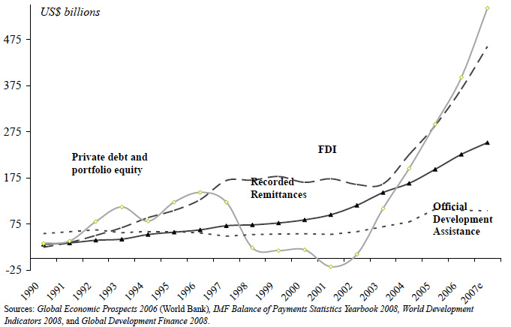
Relative Magnitudes of Capital Flows to Developing Economies:
FDI, Private Debt and Portfolio Equity, along with Remittances have exceeded official development assistance by substantial margins

Slide 22
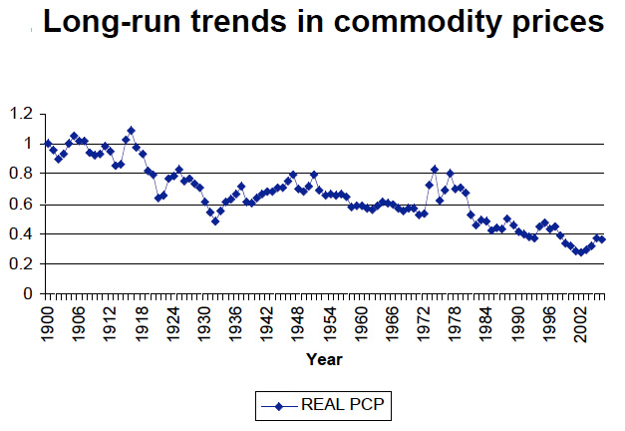
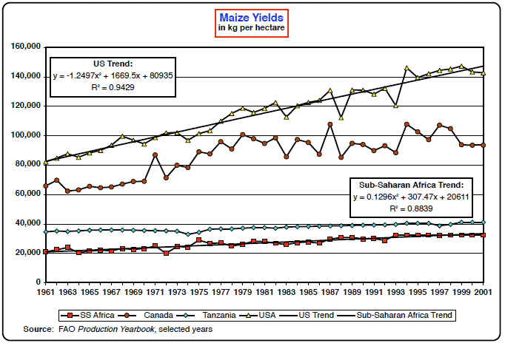
Economic Recovery Must Address Longer Term Structural Issues:
Commodity Prices Display Secular Declines that in the presence of population growth and global competition can only be offset by productivity increases and product and factor substitution

Slide 23
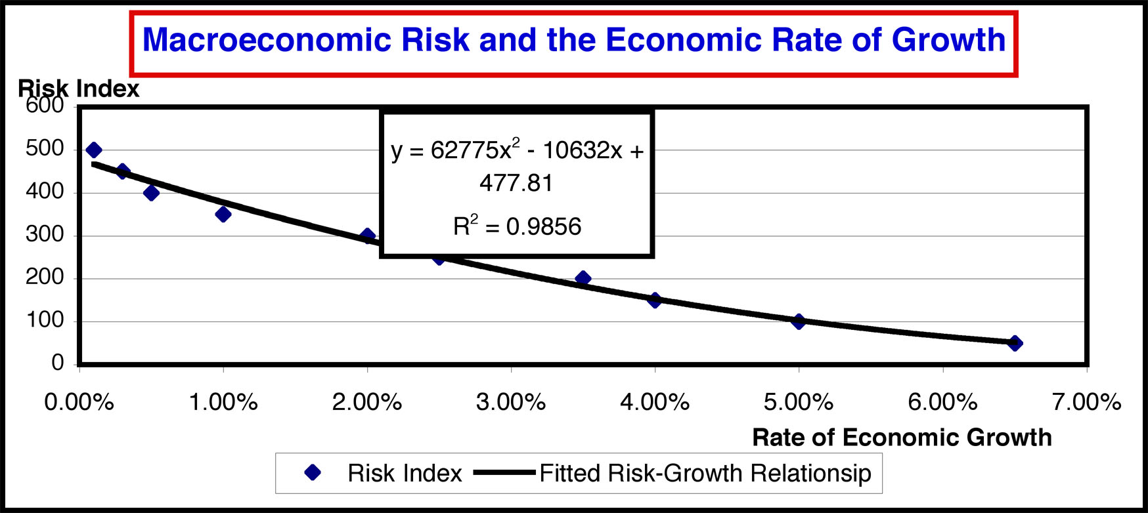
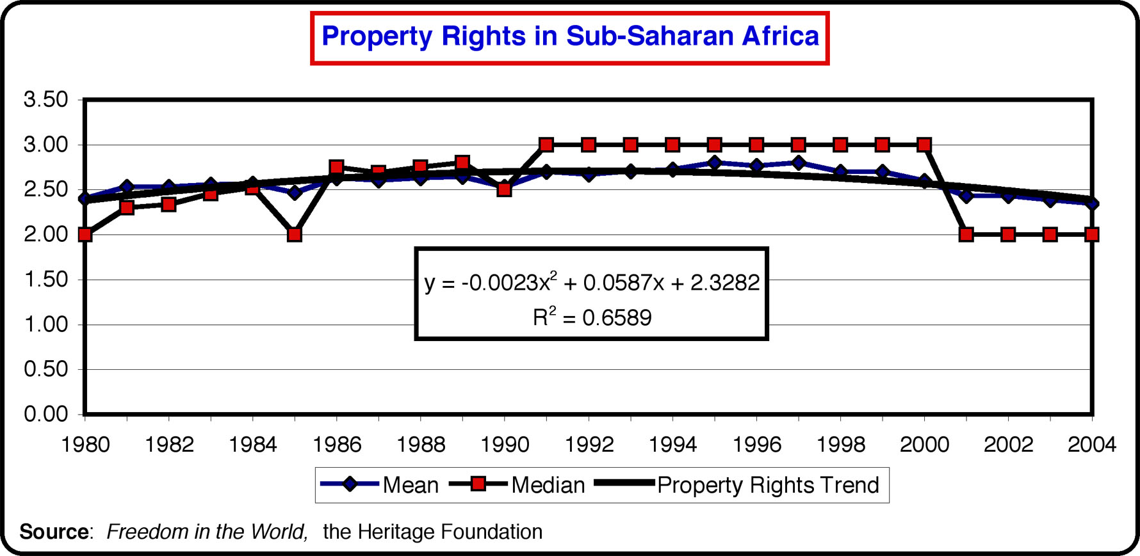
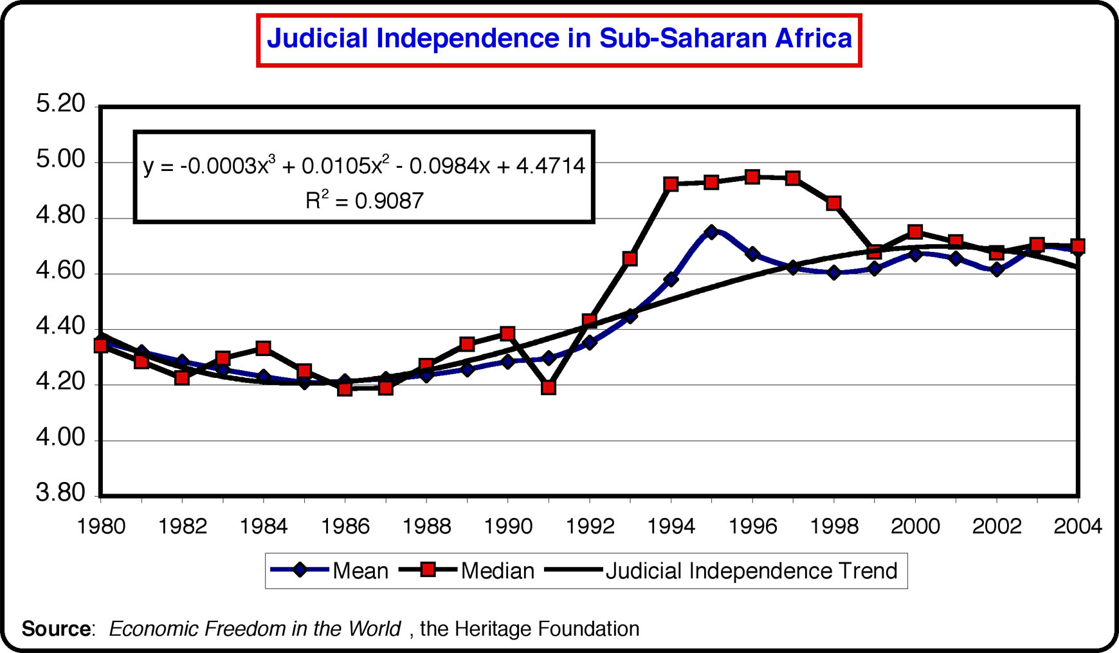
Strategic Considerations for Developing Economies
1. Adopt measures that reduce long term inflationary pressures along with other steps to reduce the level of aggregate country risk

Slide 24
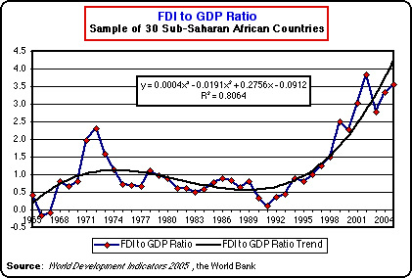
Strategic Considerations for Developing Economies - 2
2. Seek opportunities to maintain access to global capital and product markets rather than revert to protectionism - a measure that applies to developed economies as well

Slide 25
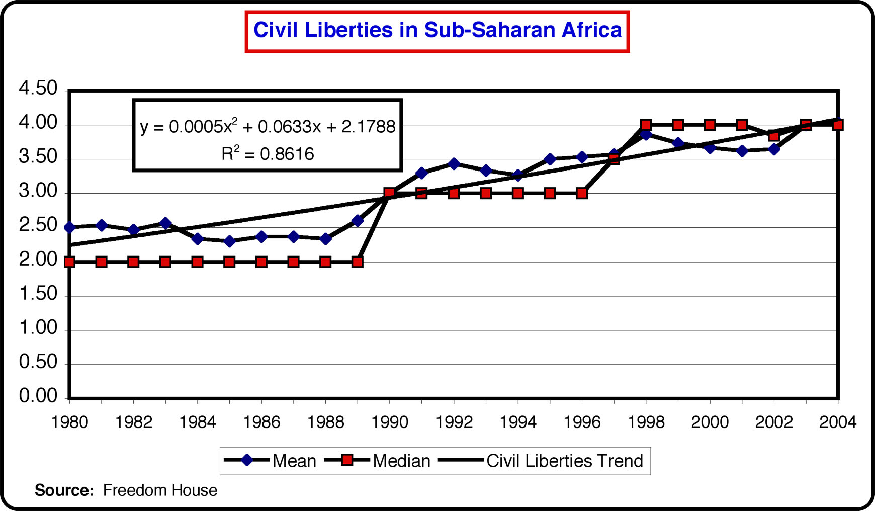
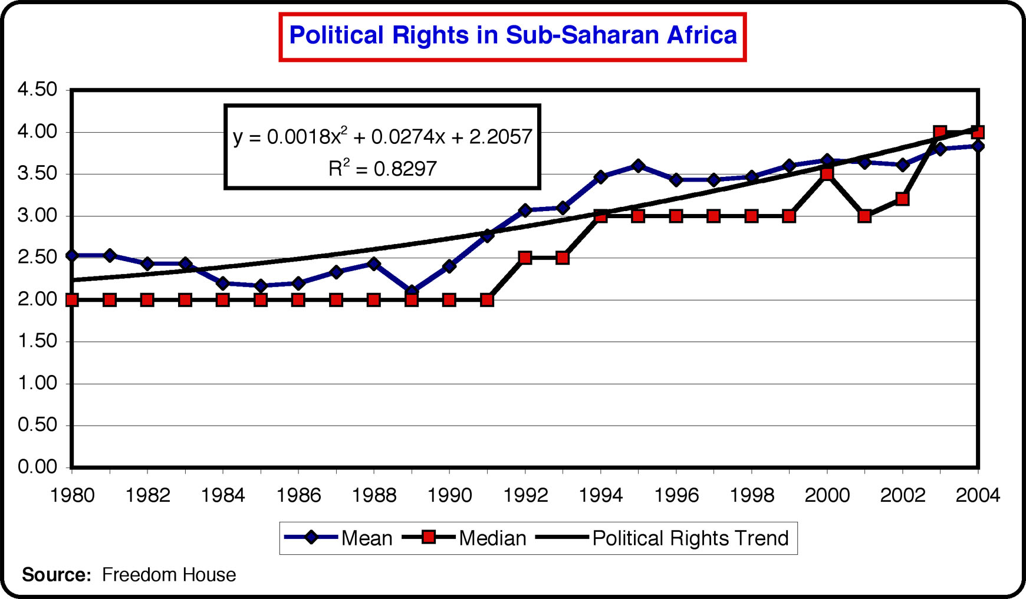
Strategic Considerations for Developing Economies - 3
3. Pursue measures that provide increased transparency and accountability in markets and in the public sphere so as to enhance economic efficiency and social equity

Slide 26
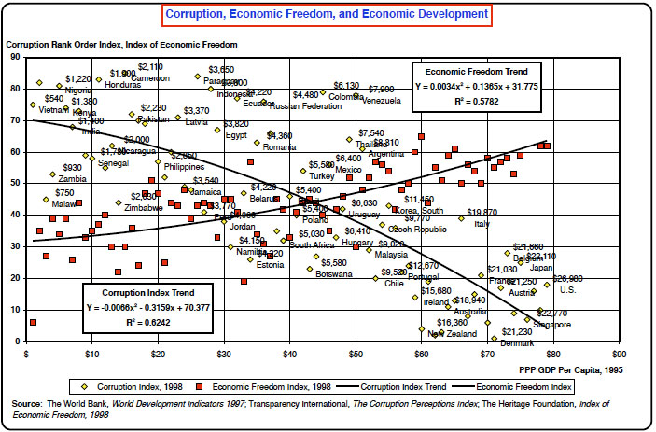
Strategic Considerations for Developing Economies
Does Good Governance Make a Difference?

