Slide 1
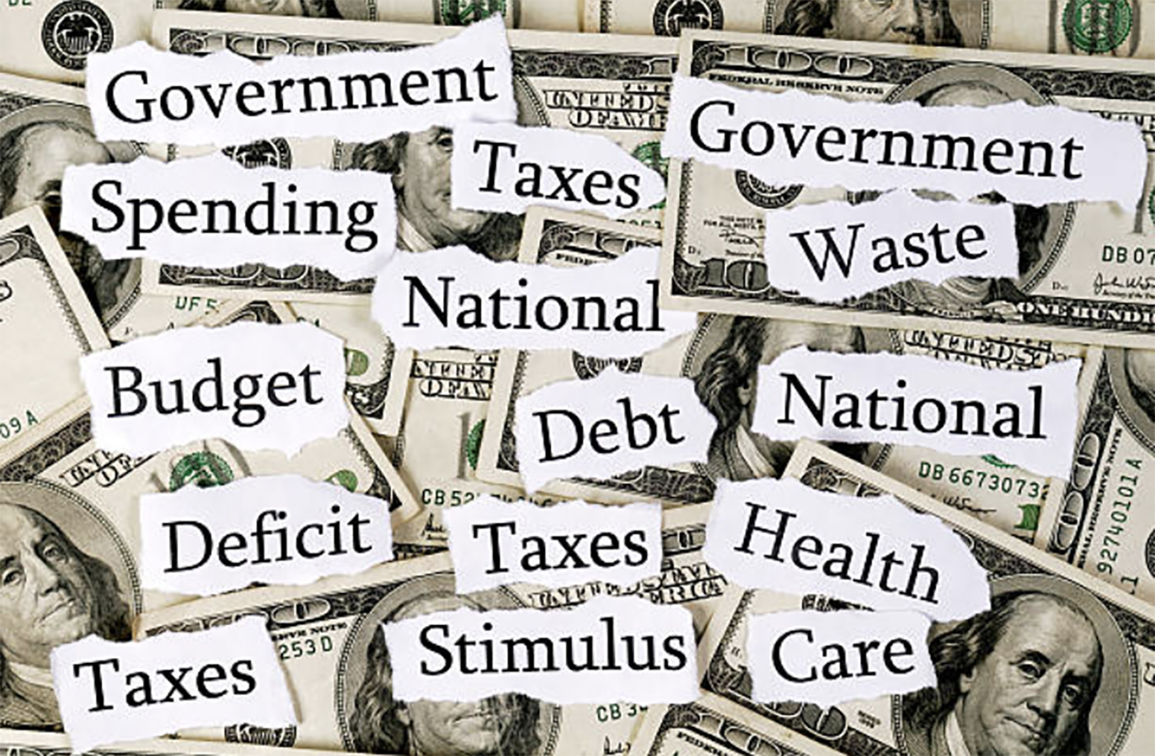
On The Size of Government
Arguments over the size of government are as old as the founding of the United States. In 1776, the War of Independence was fought essentially over the size of government and against the rule of Great Britain. When the Articles of Confederation were adopted in 1777 and ratified in 1781, they looked to government playing a small role in the economy, and limited essentially to matters of national defense. When the U.S. Constitution replaced the Articles of Confederation in 1787, the notion of shared powers between the federal and state government institutions reflected a continuing commitment to a relatively small size of government in the economy. The original Bill of Rights, adopted in 1791, did not envision an enlargement of government size, but only a stipulation of spectic rights and responsibilities.

Slide 2

Government Size Indicators
Measuring the size of government can be undertaken in terms of the number of employees and/or the level of tax revenues, the level and composition of government expenditures, and the level of debt. To this, one can then place the size of government tax revenues and expenditures in a relative context in terms of time and across countries. If there is a common denominator in all of this, it is in terms of perceptions of risk. Linking risk into the measurement of government size raises the question of whether a greater or lesser degree of government intervention increases or reduces the level, and perceptions, of risk.
Once these factors have been taken into account, the next question linked to government size is monetary policy and how its role affects the level of risk and stabilization.

Slide 3
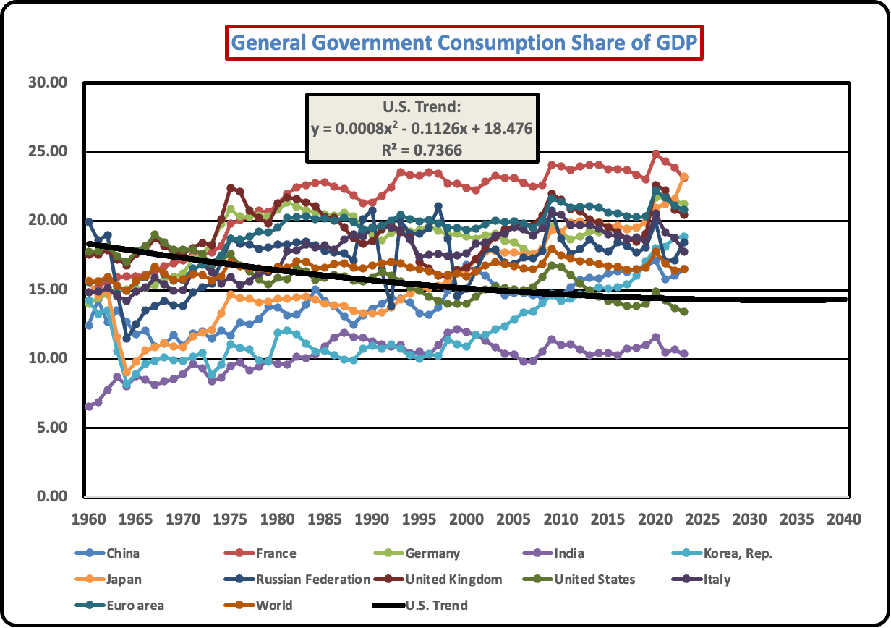
Government Consumption Share of GDP
In comparison to other major economies, the government consumption share of GDP has remained relatively stable at around 20 percent of GDP. Consumption expenditures refers to specific categories of the government budget as in expenditures on national defense, health, and education. It does not include transfer expenditures by government that are sizeable, as in the case of Social Security spending. Overall, the U.’s. tends to have a smaller share of government spending on consumption goods and services in comparison with other major world economies. This affirms the U.S. as a major market capitalist state.

Slide 4
Government Spending to GDP Ratio
A large and growing share of government spending consists of transfer payments, notably Social Security, in addition to unemployment compensation, veterans benefits, and similar categories. The distinction is that while government consumption as a ratio to GDP reflects actual purchases of goods and services, transfer payments involve a time differential in which past services through employment now generate benefits in retirement.
Looking at a sample of countries using IMF data, the vast expansion of total government spending arose from the Great Depression in the 1930’s followed by World War II and the rise of welfare state spending in the postwar era. Given that much of this has resulted in a rising level of public debt and debt service payments, the question is whether such fiscal policies are sustainable. The rise in the U.S. is similar though less in scope than among other economies shown here.

Slide 5
Ratio of Government Social Spending to GDP
Social spending is at the heart of the welfare state. Where in 1960, key developed economies spent an average of just under ten percent in 1960, by 2021 it had risen to an average of over 20 percent. This doubling of social spending has been financed in most countries by a mix of taxation and government debt. Taxation, as in the use of payroll taxes on Social Security in the United States, tends to reduce the rate of economic growth, other things equal. Debt financing defers the immediate effect on debt but is offset as debt service payments claim a growing share of government budgets.

Slide 6
Historical U.S. Central Government Debt to GDP Ratio
When a government budget deficit arises from an excess of spending over revenues, there are three choices to consider. One is to reduce spending to bring the budget into balance. Another is to raise taxes to the same end. Since taxes tend to generate the highest level of opposition, spending reductions come in as a second. However, even reductions in government spending may also generation opposition, leaving government borrowing as the third option. As long as the government can sell bills and bonds debt instruments at competitive interest rates, things may operate with relatively little immediate opposition. However, as governments experience unprecedented borrowing, rising debt levels may bring the government close to bankruptcy. How to avoid this possibility asks what are the factors that determine the demand for government debt.
Over the long term, the U.S. has had an average of -3.33 percent central government debt to GDP ratio. As illustrated in the above chart, the actual ratio has reached beyond 15 percent, as in the case of the Great Depression of the 1930’s and in the early 2020’s in response to the COVID pandemic.

Slide 7
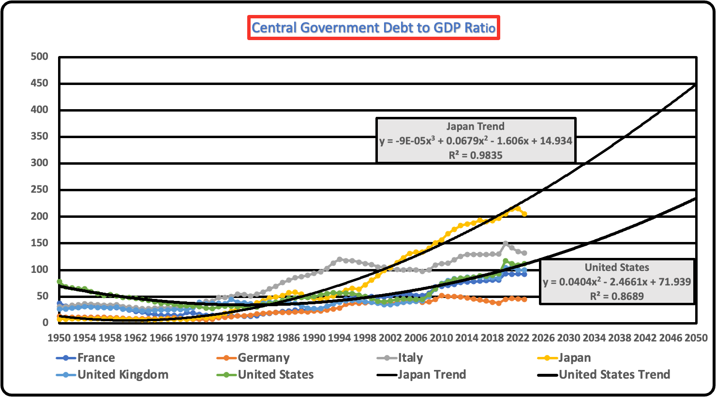
International Government Debt to GDP Ratios
Looking at international comparisons, the United States is not the relatively most indebted government. Interestingly, Japan has a higher government debt to GDP ratio, and the ratio of the Japanese debt ratio of over 200 percent is roughly twice that of the United States, and Japan has not faced significant adverse consequences. Many smaller countries have had critical financial crises when government debt ratios were well less than 100 percent. How is it, then, that countries such as the United States and Japan endure such high debt ratios without experiencing a major international financial crisis?

Slide 8
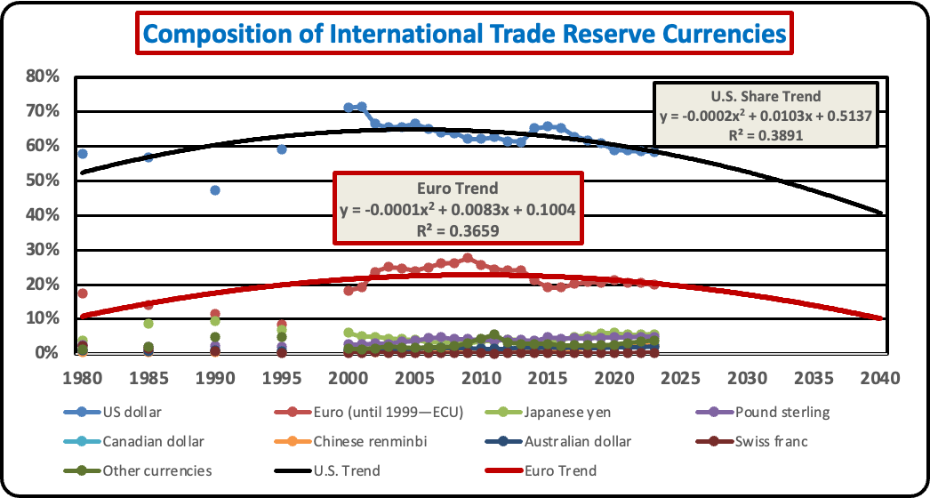
Government Debt and Currency Reserves
One factor that enables the United States to endure chronic budget deficits is the role of the dollar as a reserve country in the global economy. From the late nineteenth century until the Great Depression of the 1930’s, the British pound sterling served as the dominant currency, a reflection of its historical colonial rule . After the First World War, and then the Second, Great Britain could no longer afford the costs of a colonial empire. As colonial possessions gave way to political independence, and as the United States economy ended up with a surplus of both gold and related assets, the dollar replaced the British pound. There was no formal declaration of the dollar as a world reserve currency – only confidence that trade would be facilitated through use of the dollar in international transactions and that the dollar would not experience inflation at rates in excess of the alternative currencies such as the German deutsche mark, the Japanese yen and later, the euro from its introduction in 1993 and in 1999 began to circulate in digital, paper, and coin form.

Slide 9
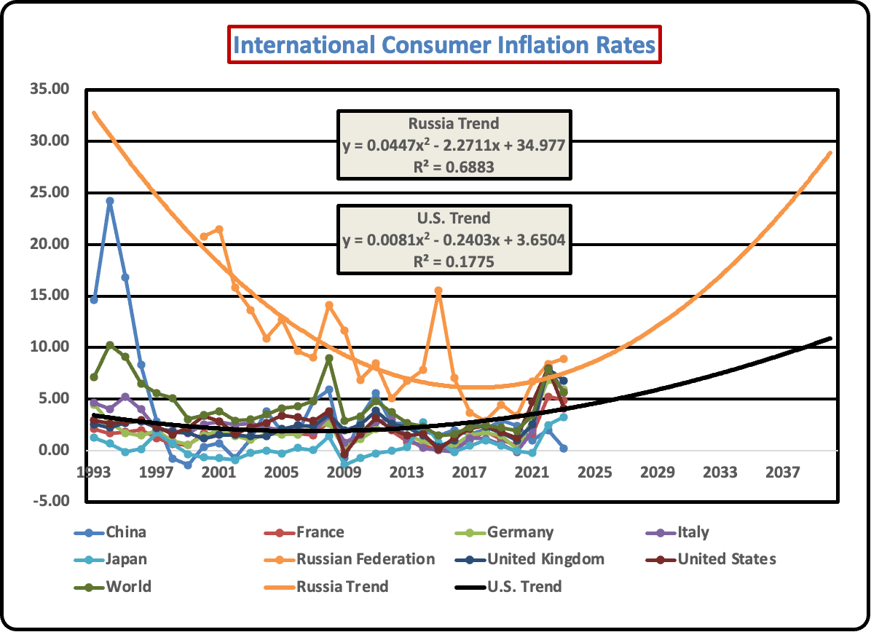
Inflation in Perspective
Inflation arises when there is too much money chasing too few goods, as the cliché goes. The history of most countries is replete with examples of inflation and how inflation has generated political upheaval. Long ago, French jurist Jean Bodin (1530-1596) formulated the first quantity theory of money, MV=PQ (where M=the money supply, V=the velocity of circulation, Q=the quantity of goods and services produced, and P=the price level), in observing the vast inflation in sixteenth century Spain as the colonial conquests in Central and Latin America brought vast quantities of gold and silver for which no corresponding increase in production of Spain’s goods and services took place. Although the sixteenth century Spanish inflation did not result in the collapse of the Spanish monarchy, other events showed how it could do so. One of the most notable was the collapse of the Weimar Republic in the 1920’s. Faced with an unsustainable burden of reparations arising from the 1919 Treaty of Versailles, the German government simply allowed the printing of money, resulting in the hyperinflation of 1923 and the rise of Adolf Hitler and the Nazi regime in the 1930’s.

Slide 10

Measuring Inflation
Inflation is measured in terms of indices of retail and wholesale prices for respective baskets of goods and services. Surveys are undertaken on a monthly basis by the Department of Labor Statistics, which tracks both inflation and unemployment data. There are two types of measures: the Laspeyres and Paasche indices. The Laspeyres index is constructed for a representative group of consumers making purchases on a periodic basis and frequency. With the fixed quantities of a basket, the survey then tracks the prices used to purchase the basked over time. In contrast, the Paasche index takes today’s representative group of consumers and uses it to reconstruct the cost of a basket over the same time period. Taking stock of the fact that consumers change the quantities of their purchases in part due to changes in prices, neither the Laspeyres nor the Paasche indices captures the most representative measure of inflation. Yale University economist Irving Fisher (1867-1947) long ago suggested a weighted average of the two indices, which he characterized as the geometric mean of the Laspeyres and Paasche indices. Today, the Bureau of Labor Statistics relies primarily on the Laspeyres index but updates the series through a periodic re-calculation of the base. Elections can be decided on such indices of economic welfare, so they are important indicators of how the economy is performing.

Slide 11
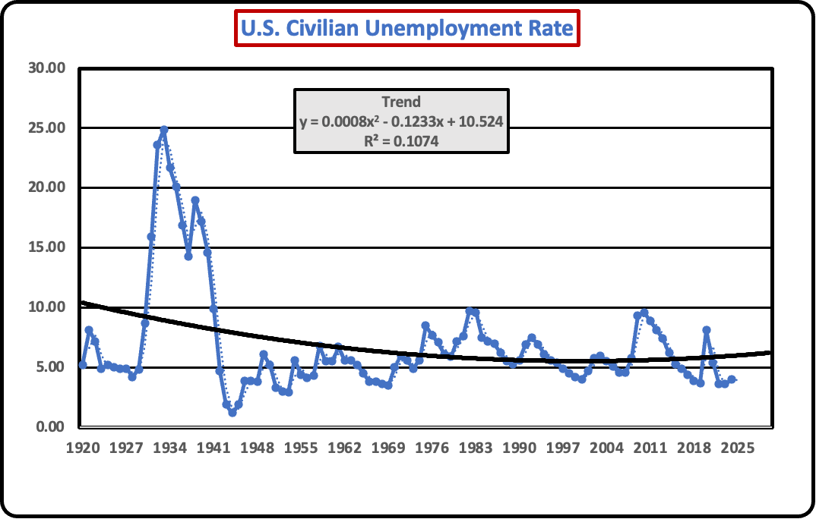
Measuring Unemployment
Beyond the measurement of inflation, the rate of unemployment stands as another critical benchmark of economic performance. The Bureau of Labor Statistics is the primary source of measuring employment and unemployment. As with inflation reports, the unemployment rate is usually measured by an estimate of the labor force both working and unemployed. The unemployment rate is calculated as the total number of unemployed divided by the sum of the employed and unemployed workers. The Bureau usually provides a civilian and total unemployment rate, the latter of which includes those in military service. As the Equation of Exchange illustrates, one can link inflation and unemployment through estimates of changes in the money supply (and interest rates) and the level of output production. Together, the inflation and unemployment rates constitute what the late New York Times columnist and economist Leonard Silk (1918-1995) dubbed as the Misery Index.

Slide 12
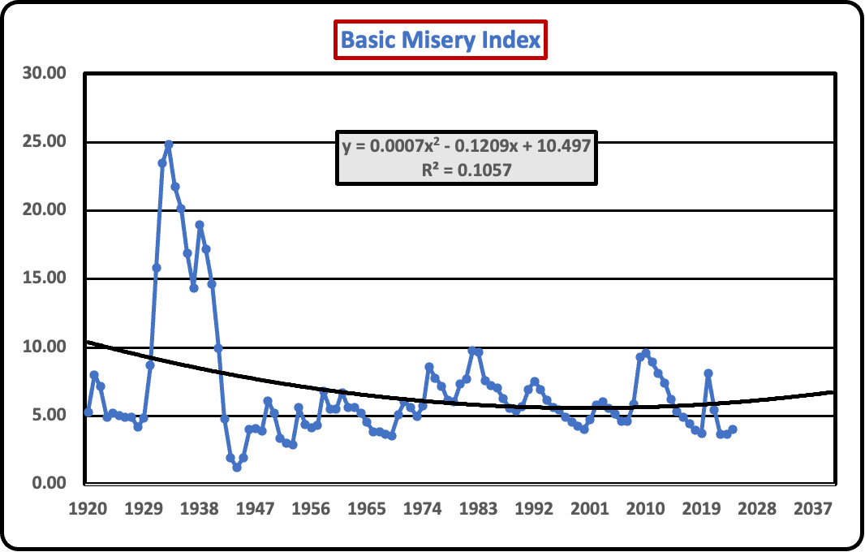
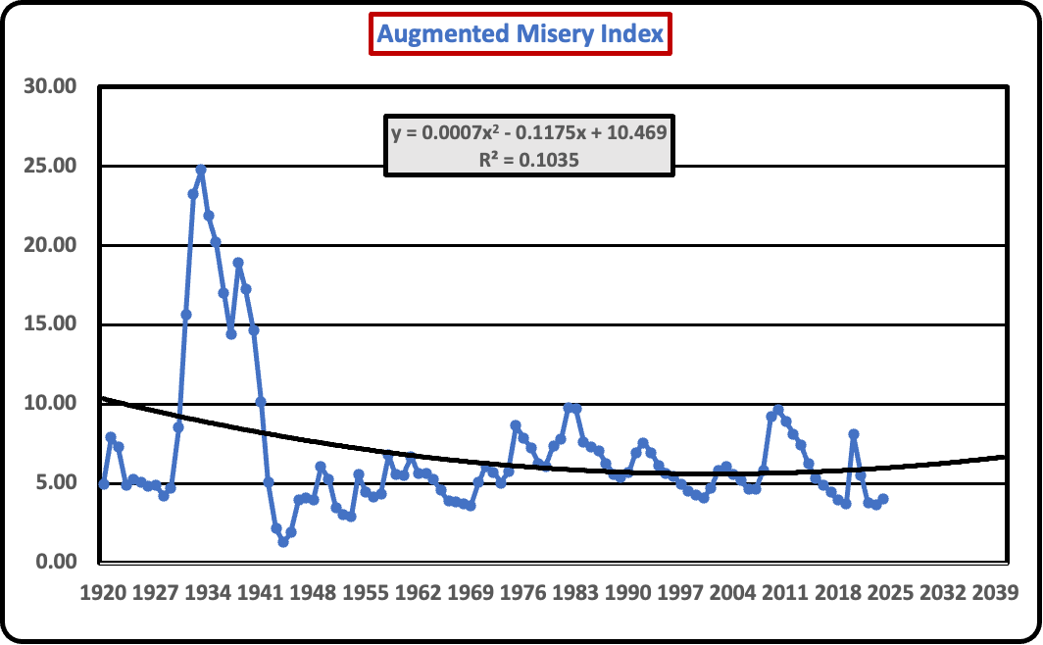
The Misery Index, Economic Growth, and Inequality
Elections, and political governance are decided on many issues, of which economic indicators is a key measure. The Misery Index can be defined and calibrated in a variety of ways. The simplest is the unweighted sum of the inflation and unemployment rates. A more complex measure is the rate of per capita GDP (or personal income) growth minus the unweighted sum of the basic misery index, shown here as the Augmented Misery Index. While taken together they include a broad indicator of the economy to which one can add a third indicator, namely, the distribution of income.

Slide 13
Measuring Inequality and Social Welfare
Given a basic or augmented misery index, one further dimension is the inclusion of inequality – whether of per capita (or household) income or wealth. Unlike the Misery Index, there is less than university agreement as to what constitutes an objective interpretation of inequality. The bottom chart shows that inequality and per capita income do not reveal a monotonic relationship. More importantly, how does inequality integrate with social welfare?

Slide 14
An Index of Social Welfare
While the various components of a social welfare index – Per Capita PPP real GDP, the Misery Index, and a Gini inequality index, by putting them together we have a rough composite measure of total social welfare. How this index varies depends in part on the weights attached to each component. In turn, those weights can, and tend, to change as the population perceives the importance of any one or in combination with the others. What drives changes in weights is the level of perception of risk, which is a major factor in determining what should be the size of government in the economy. Economists have undertaken extensive research on attitudes toward risk and how they shape consumer and investment behavior, in addition to how citizens vote in an election.

