Slide 1
International Trade, Manufacturing, and Per Capita GDP
How important is the manufacturing share of GDP to PPP GDP per capita? Using a sample of major economies engaged in international trade, it is important first of all to track the growth of PPP per capita income. As the above sample illustrates, since 1990 all the sample countries have enjoyed increases in per capita GDP, with the United States remaining in first position in the sample international ranking.

Slide 2
Tracking the Manufacturing Share of GDP
While all of the sample countries have enjoyed increases in PPP per capita GDP, they generally have experienced a decline in the manufacturing share of GDP. Inasmuch as manufacturing is essential to an economy, it does not follow that it must be produced domestically. What it does present is the extent to which manufacturing technology becomes diffused across trade participating countries, thus raising the question of national identity and sovereignty

Slide 3
Tracing The Trade Share of GDP
Since 1990, global growth in PPP per capita GDP has been matched generally by an increase in the trade share of a country’s GDP. This is consistent with the fact that trade and investment are key drivers of economic growth, and it has been driven largely by an increase in the trade services share of GDP, as the manufacturing share has tended to decline.

Slide 4
Correlation of GDP Trade Share and PPP Per Capita GDP
We find a negative correlation between the Trade Share of GDP and PPP Per Capita GDP, as suggested in the previous slides. While correlation does not equal causation, the negative relationship suggests that something else may be driving economic growth as much as the manufacturing share of GDP.

Slide 5
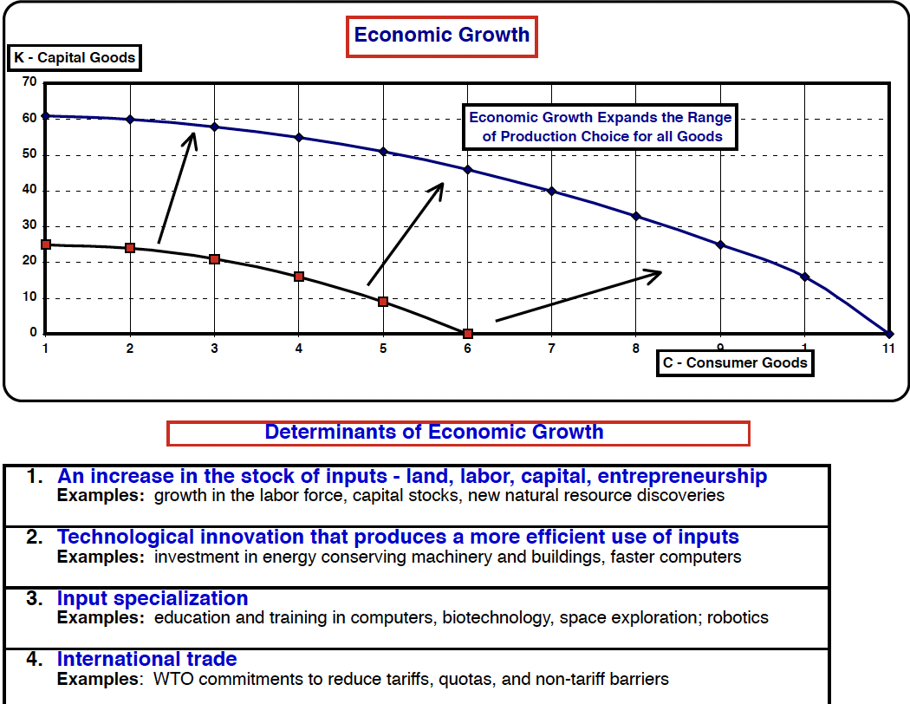
What Determines economic growth?
While economists structure various models of economic growth, we know that four factors are the most important in driving an economy forward. International trade is one of the four key factors, along with how much an economy saves and invests.

Slide 6
Growth and Trade
Per capita GDP and international trade have a positive correlation of just under .60. The correlation varies by international region, but the overall positive relationship suggests that greater trade reflects a more efficient use of resources. When tariffs are used to generate government revenue, they tend to reduce dependency on international trade. In an extreme case such as the 1930 Smoot-Hawley Tariff of 60 percent on U.S. imported goods, it can lead, or worse, a reduction in international income to depression levels.

Slide 7
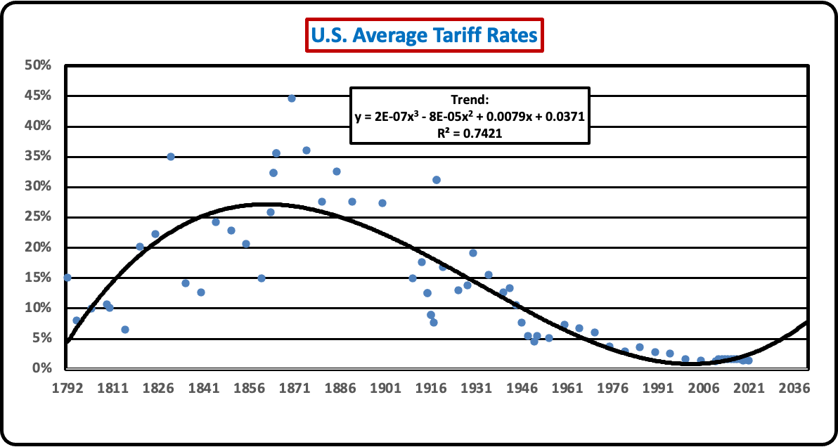
Taxes and Government Spending shape how much an economy saves and invests, and thus grows - Tariffs are one form of taxation.
Until recently, the U.S. has shifted from a dependence on tariffs to the promotion of lower tariff rates to expand increases in global per capita income. Until the enactment of the 16th amendment in 1913, the U.S. had relied on a variety of taxes to support government expenditures. Following the enactment of the 1930 Smoot-Hawley tariff of 50 percent, the U.S. came to realize that tariffs were reducing international trade and were a major factor in contributing to the Great Depression of the 1930’s. In 1934, it adopted the Reciprocal Trade Agreement which sought to equalize tariff rates with the counties with whom trade was conducted. After the Second World War, Congress adopted GATT (The General Agreement on Trade and Tariffs) in a bid to progressively lower international tariff barriers. This policy continued with the creation of the World Trade Organization in 1995, the U.S. continued the policy of negotiating lower tariff rates. In 2011, China was admitted to the WTO, but chose to impose indirect means of restricting imports in contravention of WTO rules. China’s admission to the WTO highlighted the fact that countries were relying more on non-tariff barriers to protect domestic industries.

Slide 8
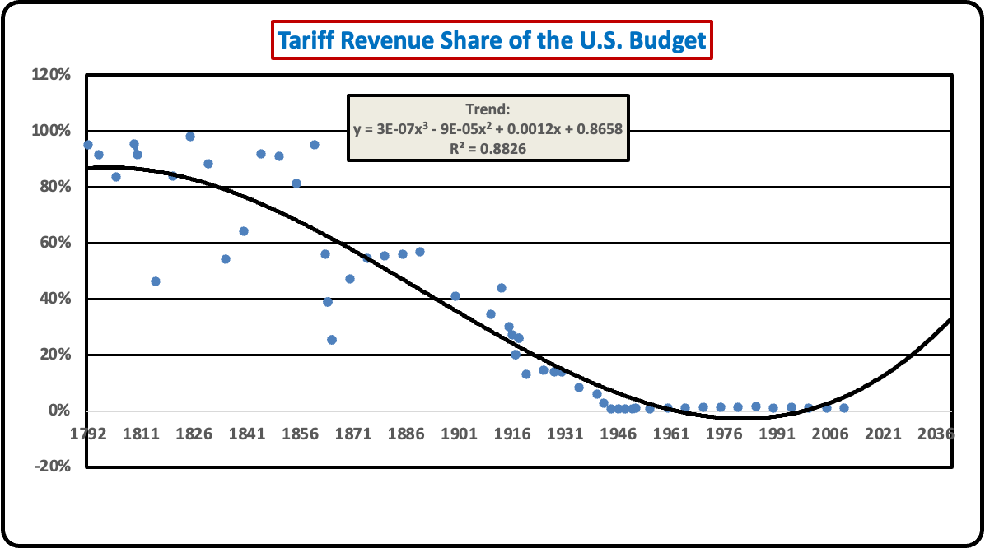
U.S. Tariff Revenues Over Time
As the U.S. adopted the income tax in 1913, tariff revenues as a percentage of government revenue began a downward trend where they have accounted for approximately one percent of government revenues. This has coincided with a massive expansion of international trade since the Second World War ad in which the United States has become a principal beneficiary. The benefit has been not just in terms of the size of the U.S. economy, but on the share of GDP arising from international trade.

Slide 9
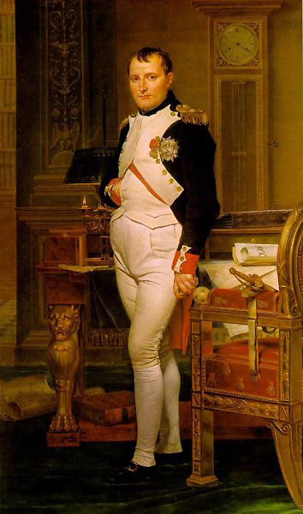
Comparative Advantage in Historical Perspective
The French revolution of 1789 produced a series of changing governments, few of which were sufficiently stable to produce a measured degree of social order. This changed with the assumption of power by Napoleon Bonaparte (1769-1821), who through a string of military victories against the Italians, the Austrians, and the Prussians, soon found himself in a near perpetual state of war with England and Russia. To contain England, he imposed an economic blockade as a prelude to a plan for invasion in the early years of the 19th century. While invasion was forestalled by Nelson’s defeat of the French in the Battle of Trafalgar in October 1805, the blockade continued in a limited fashion until the fall of Napoleon in the Battle of Waterloo in 1814.

Slide 10
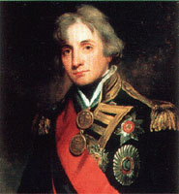
Comparative Advantage in Historical Perspective
The French revolution of 1789 produced a series of changing governments, few of which were sufficiently stable to produce a measured degree of social order. This changed with the assumption of power by Napoleon Bonaparte (1769-1821), who through a string of military victories against the Italians, the Austrians, and the Prussians, soon found himself in a near perpetual state of war with England and Russia. To contain England, he imposed an economic blockade as a prelude to a plan for invasion in the early years of the 19th century. While invasion was forestalled by Nelson’s defeat of the French in the Battle of Trafalgar in October 1805, the blockade continued in a limited fashion until the fall of Napoleon in the Battle of Waterloo in 1814.

Slide 11
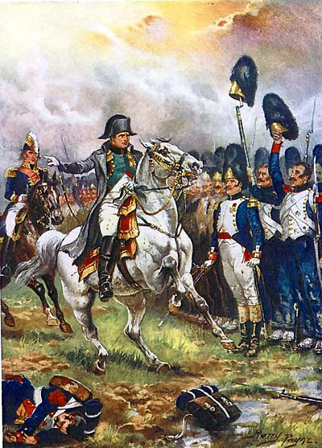
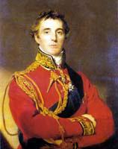
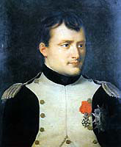
The Fall of Empire and the Tide of Trade
Napoleon’s decisive defeat by Wellington and Blucher at the Battle of Waterloo in 1815 produced a restoration of traditional European power. Much of this was done through the Congress of Vienna, which established borders that remained largely unchanged until the First World War. At the same time, countries such as England that had suffered from the Napoleonic continental system of closed trade then took up a great debate on whether to once again open their borders to trade along the lines they had been following prior to the Napoleonic wars.

Slide 12
Can Economic Growth be Sustained?
Sustainable economic growth depends to no small extent on how countries apply fiscal and monetary policy to achieve stabilization in support of economic growth. Corruption and mismanagement can bring about a decline in capacity, including a great depression and the collapse of international trade and investment as took place during the 1930’s, and in the reconstruction of trade and capital flows following the Second World War. As countries turn inward in pursuit of narrow self-interest, the risk of a global collapse is ever present, as is the impact of climate change on global governance. To return to the poet John Donne, “No Man is an Island” holds as true today as it did in the past. What now is needed is greater scrutiny of how monetary and fiscal policy play out in an age of cybercurrencies and unaccountable governance.

