Slide 1
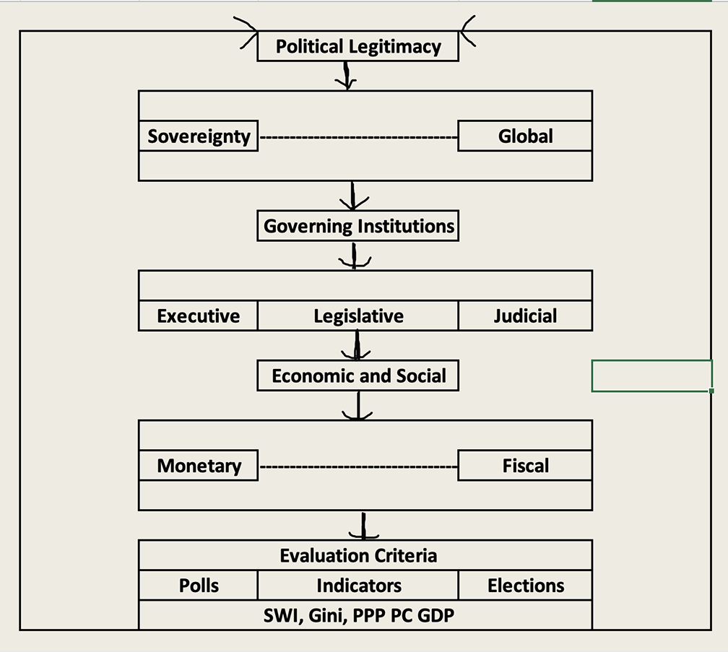
Political Legitimacy via Monetary and Fiscal Policy
How countries rise and fall is a function of how governance affects political legitimacy. Political legitimacy derives from a series of factors, among them being how well does a governing institution affect economic and social welfare. Depending on how a society is governed, e.g., democracy vs. autocracy, governments delegate responsibility for monetary and fiscal policy through enabling legislation that defines the range and scope of a mandate, from which evaluative criteria provide feedback as to the degree of political legitimacy that has been met according to established norms.

Slide 2
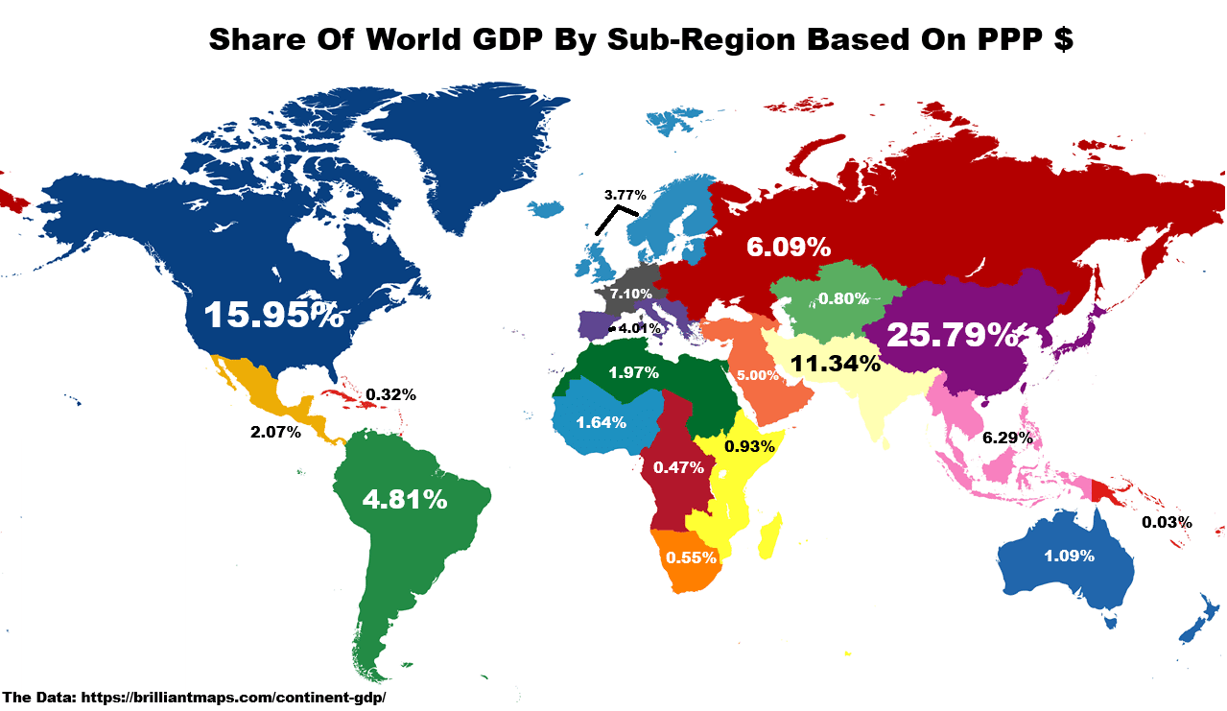
Composition of Global GDP
Today, the United States economy accounts for approximately sixteen percent of global production, coming in on Purchasing Power Parity, or PPP, measures of GDP, with China as the largest at twenty-five percent. Although China has a PPP GDP larger than that of the United States, its currency, the yuen, represents only a fraction of global currency reserves. The reason why this disparity exists is that the United States dollar is fully convertible throughout the world’s economies, and as long as inflation rates in the United States are lower on average than elsewhere, central bankers around the world are willing to rely on the collar as their principal reserve currency. This gives enormous latitude to the United States, in its ability to run chronic balance of payments deficits, which forestall adjustments.

Slide 3
Monetary and Fiscal Policy under Alternative Political Regimes
Democracy in the Age of Pericles (461-429 BCE) has served as a reference of how countries may address fundamental questions of governance. While no central banking system existed under Pericles, much of the history of global civilizations has turned on questions of political legitimacy, with democracy being seen as a benchmark as to how economies should be managed. Democracy can be defined in a number of ways. Beyond accountable elections, it includes the extent to which political rights and civil liberties prevail. The Washington D.C. Freedom House organization has been tracking political rights and civil liberties for some 195 countries from 1973 to the present. Using a geometric mean of these two indices as a proxy, we show how democracy in various regions has expanded until very recently, posing a challenge for economic stability and growth.

Slide 4
Monetary Policy Choices
In the United States, two institutions have been tasked with economic and social governance, namely, monetary and fiscal policy. How monetary and fiscal policy have evolved reflects fundamental questions of accountability. In turn, as indices of monetary and fiscal policy are used to track, ordinary citizens trace policy choices down to how well they perceive is their economic and social well being.
Since 1913, the Federal Reserve has served as the central bank of the United States. It charter calls for staggered terms such that a President could only pick a majority of the Board at the end of his/her second term. Challenges to the Fed’s autonomy have taken place when a President of the U.S. wants to have interest rates lowered to enjoy short-term stimulus while the Fed takes a longer view in balancing unemployment and inflation rates in pursuit of sustainable growth.

Slide 5
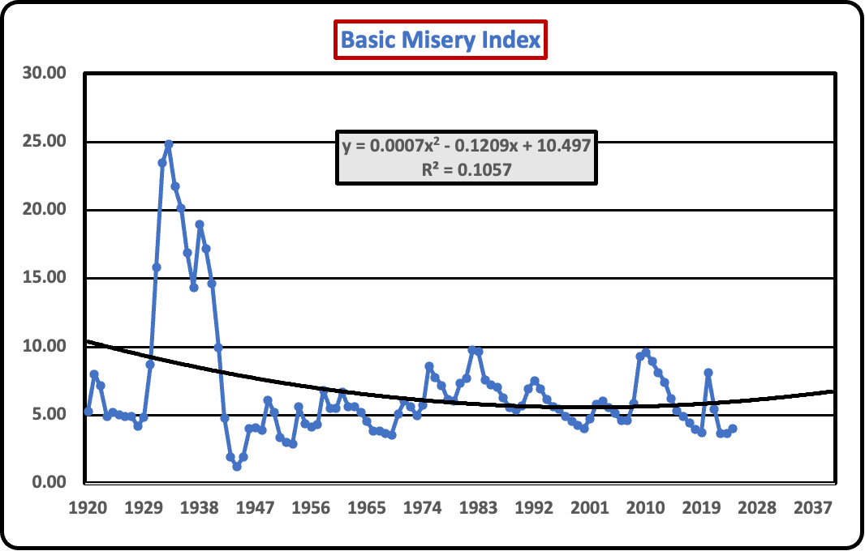
Tracking Monetary Policy
The Misery Index, first coined by the late New York Times columnist Leonard Silk, is an index derived as the sum of the inflation and unemployment rates. Since neither is desirable, the lower the misery index, the better off monetary policy is seen as having performed. An augmented misery index takes the basic index and subtracts the rate of real per capita income, or GDP. Overall, the augmented and basic indices are closely correlated.

Slide 6
Monetary Policy in Perspective World Currency Reserves
Today, the United States economy accounts for approximately sixteen percent of global production, coming in on Purchasing Power Parity, or PPP, measures of GDP, with China as the largest at twenty-five percent. Although China has a PPP GDP larger than that of the United States, its currency, the yuen, represents only a fraction of global currency reserves. The reason why this disparity exists is that the United States dollar is fully convertible throughout the world’s economies, and as long as inflation rates in the United States are lower on average than elsewhere, central bankers around the world are willing to rely on the collar as their principal reserve currency. This gives enormous latitude to the United States, in its ability to run chronic balance of payments deficits, which forestall adjustments.

Slide 7
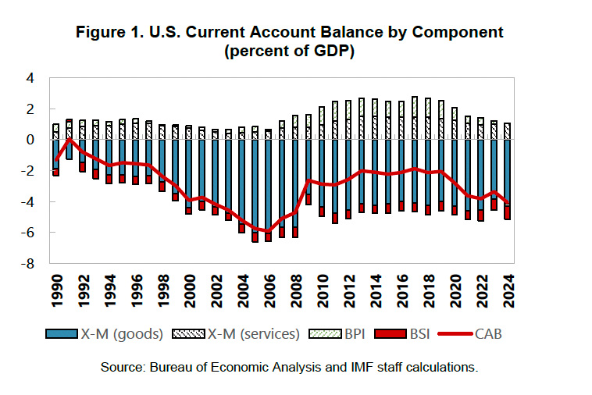
Reserve Currencies and The United States Balance of Payments
For most countries, running a balance of payments deficit is adjusted through a combination of measures – taking on additional debt, raising taxes, or a devaluation of a currency. Under the gold standard of the 1870’s to the 1970’s, a deficit would be corrected by transferring stocks of gold redeemable at a fixed price to surplus countries. Since the last devaluation in 1973, which reduced the exchange rate of gold to the dollar went from $35 an ounce to $38, the only reserve to which a country can turn is either the dollar itself or some other precious commodity or currency. Under times of monetary uncertainty, investing in gold has produced an extraordinary increase in its price, to current levels of approximately $5,000 a troy ounce. The only problem with this is that gold is not today a retail currency, and apart from teeth fillings and computer chips, it largely serves as a benchmark commodity by which global risk is perceived.

Slide 8
Crypto Currencies as Reserves?
As economies become more integrated through digital technologies, there have been several proposals to devise a dollar alternative reserve currency. Some have advocated a return to the gold standard, even at its currently high valuation. The only problem with gold as a reserve is that stocks of gold can not expand at a given price at a rate to sustain a rising level (or even stable one) of per capita GDP. As a result, a return to the gold standard would mean an ever growing price which would undermine the notion of a stable reserve currency, the very problem evoked with regard to the U.S. dollar.
One alternative is to substitute crypto currencies, that is, digital currencies whose value may be determined simply by a challenging mathematical formula with which to expand its stocks, as reserves. Given the challenges of “mining”, that is, using energy intensive algorithms to decipher stocks of digital currencies, the price of a bitcoin, for example, rises faster than either inflation or the rate of growth of an economy, thereby undermining the appeal of a crypto currency as a reserve currency choice.

Slide 9
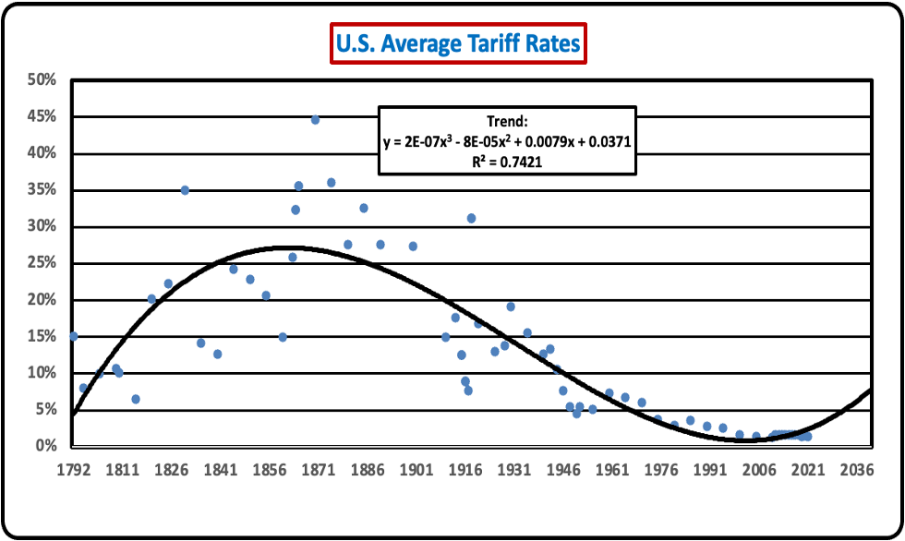
What about Tariffs as a Tool to Achieve balanced growth?
Since the Reciprocal Tariffs Agreement of 1934 was adopted amidst the Great Depression, major global economies have embraced a framework of progressive agreements to reduce tariffs, quotas, and regulation as impediments to greater international trade. The last such global agreement was the 1964-1967 Kennedy Round of General Agreement on Tariffs and Trade (GATT) negotiations. It resulted in a 35 percent average reduction in tariffs on 60000 industrial items, representing $40 billion in trade.
With the emergence of the World Trade Organization in 1995, instead of global negotiations, emphasis has been place on broad-based sector-specific agreements such as the Information Technology Agreement (IT A), along with regional trade agreements (US-India, EU-Mercosur). In the interim period between the end of the Second World War and today, tariffs, quotas, and regulations spurred global economic growth, even as the United States entered a period of chronic trade deficits fueled by the dominance of the U.S. dollar as a reserve currency and which stimulated major outsourcing of production throughout the global economy. It is the outsourcing and chronic deficit pattern that has motivated the Trump administration to raise or threaten tariff increases across the board as a negotiating tactic to ensure “fairness”.

Slide 10
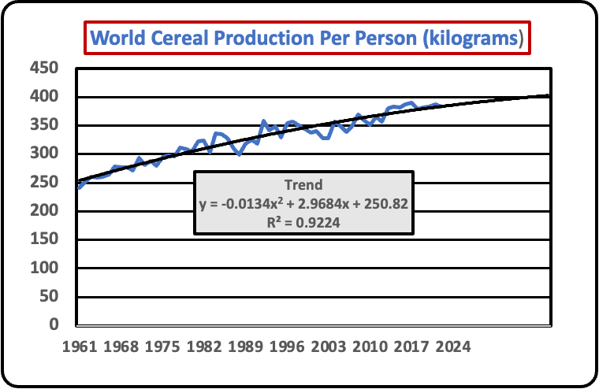
Tariff Wars and International Trade Relations
As English economist and Member of Parliament David Ricardo (1772-1823) wrote in his 1817 book, Principles of Political Economy and Taxation, a country’s comparative advantage should drive its trade policies rather than autarky, or self-sufficiency. His argument was directed in opposition to the protectionist trade policies enacted by an emerging industrial Great Britain that had been forced to become more self-sufficient during the Napoleonic wars. His argument stood in opposition to Thomas Malthus (1766-1834), who had applauded England’s response to the Napoleonic continental blockade system, arguing that the gains to enriched landholders would result in sufficient spending as to propel economic spending and growth. Neither lived to see the results of the debate as Great Britain abolished the Corn laws in 1846 sending Great Britain on a renewed path to industrialization and until the latter 19th century, made England the wealthiest country per capita in the world. This guided 20th century postwar trade policies through GATT, and then the WTO, but which now faces a reverse through Trump’s use of tariffs to “rebalance” trade and re-industrialize the United States, all in the name of national security under the phrase Make America Great Again (MAGA). Evidence points to a slowing of global economic growth. Food shortages may be one casualty in tariff wars.

