Slide 1

Standard Models in Economic Analysis and Political Science

Slide 2
Standard Assumptions in Economics
Individuals are rational decision-makers
Decisions are based on available information
Individuals make decisions based on self-interest
Self interest includes actions that benefit others
Markets bring together differing interests to achieve an equilibrium
Market equilibrium conditions can achieve economic efficiency in many cases
When markets fail, government intervention through taxes and spending may bring an economy closer to economic efficiency
Market institutions work to some degree to achieve distributive justice, which with the principle of economic efficiency constitutes a measure of total social welfare that is the object of actions by states and markets

Slide 3
Standard Models in Political Science
Rulers and institutions of political regimes seek legitimacy through elections, through coercion, or force.
Claims of political legitimacy may derive from historical, cultural, and religious traditions.
Some regimes base claims to political legitimacy on divine rights in the sovereign, the population, or as informed and diffused to the population through natural law.
In an evolutionary scheme, regimes may pass from autocracy, monarchy, oligarchy, and democracy. The historical evolution of regimes may not lead automatically to democracy, the institution by which most Western countries have established their governing institutions, but which many countries find alien to their local traditions.
In democratic regimes, elections that are inclusive and transparent are considered a key standard for achieving governing mandates, and thus political legitimacy.
Democratic regimes acknowledge that those who govern may act out of self-interest but in a competitive electoral environment, voting and legislative decisions work to the greater benefit of society as a whole.
Rules of elections are complex and can lead to distorted electoral and legislative voting outcomes. In comparison to alternative modes of governance, it is better to have a flawed democratic set of institutions than any of the alternatives.
Democratic elections are seen as opportunities to re-visit economic and social priorities as new information becomes available.
Constitutions both written an unwritten seek to articulate standards of governance that together constitute the basis of political legitimacy of a regime.

Slide 4
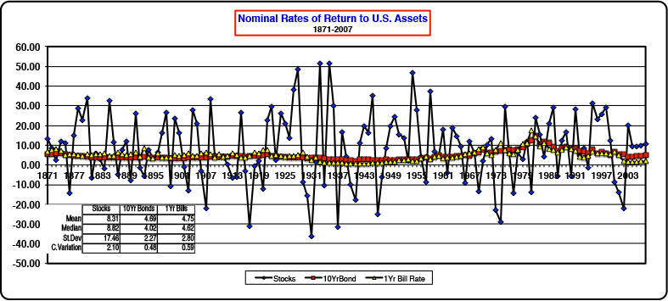
Risk in Economic Decisions

Slide 5
Risk in States and Markets
Economic theory and models have incorporated risk into decision-making, namely, through the emergence of game theory. Instead of utility or profit maximization in decision-making, it is expected utility and expected profit maximization that govern transactional relationships.
Incorporating risk into economic models has been pursued with the underlying theory that rational decision-making is the norm.
Risk-based decision-making still can lead to market equilibrium solutions, and where market failure conditions arise, suitable forms of government spending and taxation can be used to make rational corrections.
The incorporation of risk in political science involves a larger drawing of insights from psychology, in which manipulation can displace the rational reasoning used in economic models. Fear and hope displace the standard calculus of governing models and these can cause disequilibria in governance to arise. Greater disequilibria in governance undermines political legitimacy but measures can be adopted to reduce the underlying volatility in which sentiment displaces the rationality calculus of reasoning in economic and traditional political models.
Given the divergence of economics and political science under conditions of risk, the question that remains is how can society make rational decisions involving taxation and government spending. Ultimately, this question links risk to addressing the optimal size of government in the presence of economic institutions.
To the extent that democracy is the basis of political legitimacy, can one resolve the question of the optimal size of government in the presence of risk? This requires new insights that draw from research in psychology to get at the determinants of risk and risk perceptions.

Slide 6
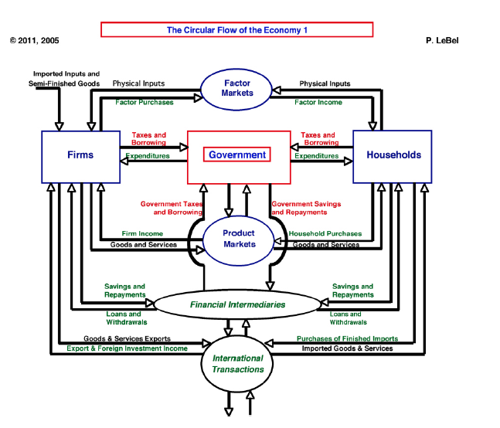
The Circular Flow of Goods and Services 1

Slide 7
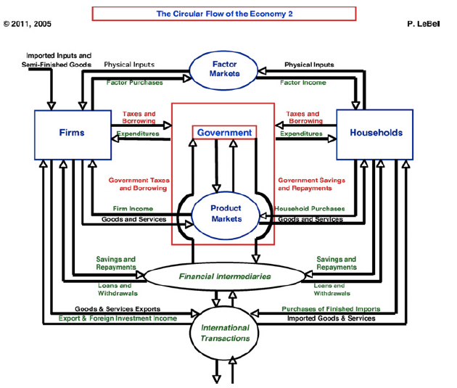
The Circular Flow of Goods and Services 2

Slide 8
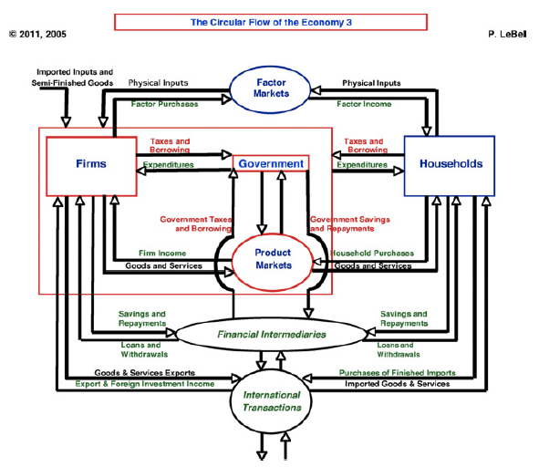
The Circular Flow of Goods and Services 3

Slide 9
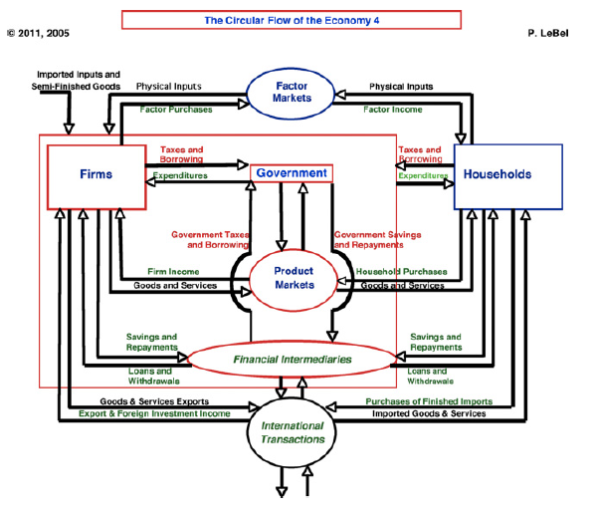
The Circular Flow of Goods and Services 4

Slide 10
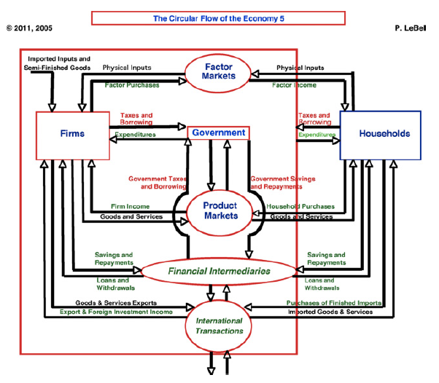
The Circular Flow of Goods and Services 5

Slide 11
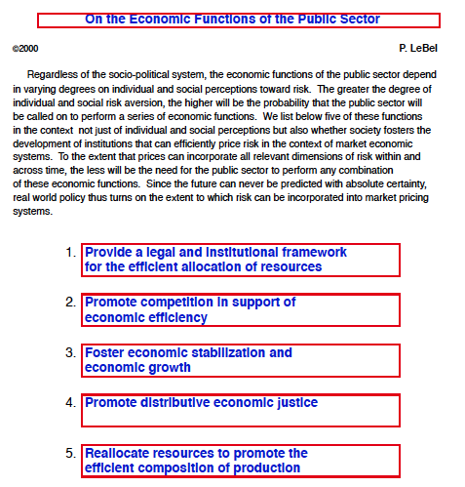
Economic Functions of the Public Sector

Slide 12
Reforming Political Governance - A
Decide All Elections by Popular Vote Majority - a. Enjoin a de facto elimination of the Electoral College in Presidential elections; b. Allow a simple majority to obtain political legitimacy in Presidential and Congressional elections
Establish more representative election districts - a. In any election, the losing largest minority party is entitled to redraw legislative districts. Within a few election cycles, this will lead to bipartisan election districting commissions that will ensure more representative districts.
Establish term limits for public office. a. No member of the Senate may run or be elected to office after three terms (or 18 years); b. No member of the House may run or be elected to office after six terms (or 12 years). c. No former member of government can serve in a lobbying advisory capacity for 10 years. d. Term limits for the Supreme Court shall be no greater than 24 years.
Enforce strict adherence to budgetary adoption calendar dates. a. Should Congress (or any other legislative body) fail to respect a given calendar deadline, this will automatically disqualify sitting members of a legislature to govern and a new election will be held within 60 days. b. In a new election, no sitting members of the House shall be eligible to run for office. c. Continuing resolutions are abolished.

Slide 13
Reforming Political Governance - B
Voting on all legislative proposals and on appointments to any pubic office shall require a two-thirds majority. a. Failure to achieve a two-thirds majority on a budget shall nullify the most recent election, with consequences as per the previous item number 4.
The federal budget shall consist of no more than 200 pages and must be available publicly on line within 10 days of a budget adoption deadline. a. Representatives must inform voters of the budget prior to the 10 day notification deadline. b. No more than 5 amendments may be attached to any budget proposal. Failure to respect this limits shall nullify the budget proposal, and failure to adopt within the calendar deadline will nullify the most recent election.
The federal government budget will conform to capital budgeting principles. a. All recurrent expenditures are to be matched by federal tax revenues. b. Any borrowing by the federal government shall be done strictly in conjunction with capital expenditures on the public sector infrastructure.

Slide 14
Reforming Political Governance - C
8. All nominees to the Supreme Court and all federal agencies requiring Senate confirmation must be done with a two-thirds majority vote, as per item 5. Confirmation of a nominee is automatic should the Senate fail to vote on a nominee within 60 days of a vacancy.
9. The Executive Branch shall submit nominees to fill all vacant positions within 30 days of an election. Failure to do so shall be considered tantamount to failure to satisfy a budget calendar deadline, and thus will result in a new election, as per items 4 and 5.
10. Transparency in voting – a. All spending on candidates and elections must be held in absolute transparency. b. While Citizens United may still be used to provide contributions to an election, virtually every dollar spent must be traced to the individual in a corporation who is responsible for its contribution and expenditure.

