Slide 1
Standard Models of Monetary and Fiscal Policy
While sub-groups can always engage in quasi-monetary transactions to conduct economic activity, for the most part, nation-states around the world as well as the European Union, operate with fractional reserve central banking, in which fiat currency is a de facto instrument. A fiat currency is a fractional reserve currency, and its value is driven by the willingness of the public to hold it for purposes of fulfilling the four key functions of a currency, namely, a medium of exchange, a unit of account, a store of value, and a standard of deferred payment.
Prior to the establishment of fiat currency central banking, states relied on either barter (to a very limited extent via tribute from a conquest for the most part), or the minting of coins. The coins contained varying degree of metallic purity. When a sovereign debased the currency through substituting less valuable metal in minted coins, at some point, the public would try to use the debased currency and withhold the more valuable metal. This was formally stated by Thomas Gresham, from whom we have the eponymous law.

Slide 2
Fractional Reserve Central Banking - 01
Fractional reserve central banking is largely a 20th century innovation. Prior to this system, governments relied on their treasuries to receive tax revenues and debt obligation settlements. Paper money began to circulate as early as the 12th century, in northern Italy. It did not immediately replace coins in circulation but rather served to simplify the physical transport of gold and silver specie along with the associated coins issued by a bank mint. In the early 18th century, paper money gained widespread use, only to be temporarily repudiated in conjunction with financial bubble scandals, notably the Mississippi Bubble and South Seas Bubble of 1718 and 1720, respectively. Yet paper money resumed its importance in the following decades. During the American revolution, individual colonies issued their own paper currencies, and a common currency, the continental, began to serve as legal tender across the newly declared thirteen states. Excessive printing led to inflation and to the devaluation replacement by the dollar. The dollar was issued by the U.S. Treasury, but often in the form of dollar denominated coins. During the civil war, green backed paper dollars were adopted to facilitate Union financing, while confederate states did likewise with their own paper money that would later become worthless except to collectors.

Slide 3
Fractional Reserve Central Banking - 02
The United States inaugurated the first national bank in 1816, shortly after the War of 1812 when it was learned that a central bank might more easily manage credit to firms and households. The first national bank charter stood in operation until 1836, when Andrew Jackson refused to re-authorize its statute. Throughout the Civil War, and in the decades thereafter, the U.S. experienced periodic financial crises – in 1836, 1839, 1845, 1847,1853,1857, 1865,1870, 1873, 1882, 1887, 1890, 1893, 1896, 1899, 1902, 1907, and 1911. When the 1907 crisis unfolded, J.P. Morgan forced a group of Wall Street bankers to pledge sufficient funds to increase the level of liquidity that would bring an end to the panic. That experience produced a decision by Congress to establish the Federal Reserve Bank in 1913. With a dozen branches, the charge to the Federal Reserve was to provide adequate liquidity to member banks in such as way as to avoid inflationary and recessionary episodes.

Slide 4
Monetary Policy in Perspective - 1
The Federal Reserve oversaw the great expansion in economic activity following World War I. The “Roaring Twenties” was a period in which mass consumption innovations in automobiles, domestic electrical appliances, and telecommunications was financed to a great extent by equity issues on Wall Street. With a robust expansion, the Dow Jones index of 30 of the most important industrial stocks increased by 244 percent from 1926 to its October 1929 peak. This far and away exceeded the growth in real per capita income, and it was viewed as a classic stock market bubble. The crash of October 1929 put a spotlight on the Federal Reserve as to how it would react.
The Federal Reserve at the time was guided by emphasis on managing the impact of reparations from World War I and viewed the stock market crash as a speculative episode to be purged from investor sentiments. Instead of lowering interest rates and injecting credit into the economy, the Fed did the opposite in the months that followed. In his classic 1963 Monetary History of the United States, 1857-1960, Milton Friedman and Anna J. Schwartz came to this conclusion, arguing that the severity of the Great Depression could have been avoided through prudential credit management. It also reinforced Friedman’s libertarian suspicion of central banking but he never embraced the role of central banks in managing economic stabilization and growth, unlike the commodity cryptocurrency enthusiasts of today.

Slide 5
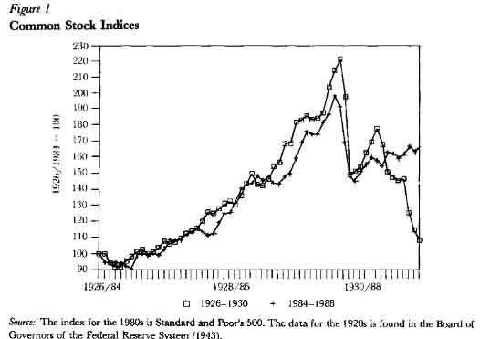
Equity Market Index Levels 1926-1929

Slide 6
Monetary Policy in Perspective - 2
Since World War II, the United States has experienced several recessions. They differ from previous crises in that they have lasted a shorter period of time and have been less severe than the Great Depression of the 1930’s. That this has been the case reflects in part the more aggressive role of the Federal Reserve in undertaking monetary policy.
The Employment Act of 1946 pledged the United States to managing both inflation and unemployment at socially acceptable rates. It established the Council of Economic Advisors, which advised the Executive Branch on the formulation of fiscal policy, and by extension, how monetary policy could be framed. It did not, however, supersede the independence statute that defined the responsibilities of the Federal Reserve in implementing monetary policy. And, for the most part, it fostered a climate of accommodation between the Federal Reserve and the implementation of fiscal policy as enacted by Congress.
When faced with an economic downturn, the Federal Reserve largely adopted a policy of monetary easing by lowering interest rates and making credit more available through financial institutions.

Slide 7
Recent Experience - LTCM
The financial crises of 2000 and 2008 illustrate how the scope of monetary policy has changed. In 2000, asset prices had risen to unprecedented levels, and for which the case of Long Term Capital Management (LTCM) provided an illustration. Using derivative contracts, LTCM used its hedge fund framework to place bets on different assets and commodities on the global market. When launched in the 1990’s, it was thought to be a magic key to enjoy returns without risk. Its annual returns of 21, 43, 41, between 1995 and 1997. In 1998, it began to lose money, having failed to anticipate the 1997 Asian financial crisis and then the 1998 Russian default. If all of the contracts were to have been exercised, the total outstanding obligations would have been one trillion dollars. At that point, under Roger Fisher, the New York Federal Reserve took over LTCM’s operations at its Greenwich, Connecticut headquarters, recapitalized assets at $3.6 billion, and wound down the firm by the early 2000’s. John Meriwether, Myron Scholes, Robert C. Merton, and others lost millions of dollars. This set the stage for future bailouts that Andrew Ross Sorkin would later summarize in his 2009 book, Too Big to Fail.

Slide 8
Recent Experience – the 2008 Great Recession
The 2000 recession had been fueled in part by the rise of derivative contracts as well as by the expansion of internet technology companies. Investors and public officials tend to discount past events as well as future prospective ones as well. By the mid-2000’s, the memory of LTCM was all but forgotten, and in the expansion that unfolded, both stock market and housing prices reached unprecedented levels, only to experience significant drops starting in late 2007 and lasting for the next five years.
What made the Great Recession different was that both housing and equity valuations dropped significantly. This was yet another example of asset bubble dynamics driven to some extent by highly leveraged derivative contracts not unlike what LTCM had been trading in the 1990’s. And as with the temporary Fed bailout of LTCM, the Fed and Treasury engaged in quantitative easing, which is to say, purchases of assets with Federal money in the form of warrants of major firms – GM, Chrysler, Citibank, and Bank of America, to prevent a major collapse. To avoid charges of bailing out every firm, the Fed and Treasury allowed Lehman Brothers Investment bank to fold, based on a conclusion that a merger partner could not be found and that neither the Fed nor the Treasury wanted to wind up owning the balance sheet of Lehman Brothers in its entirety.

Slide 9
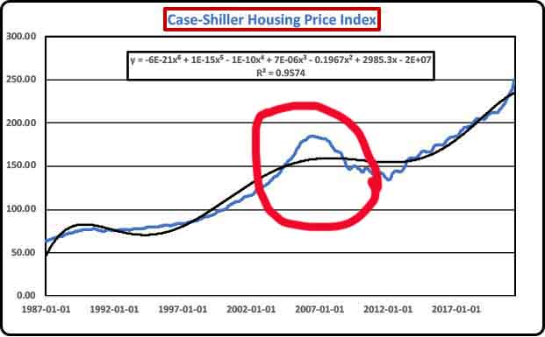
Housing Index Price Performance

Slide 10
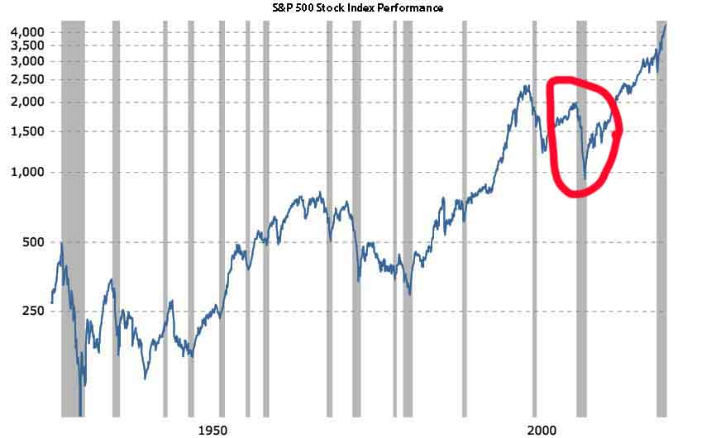
Stock Index Performance

Slide 11
Monetary Policy Defined
Monetary policy is determined by measures that affect the stock of money and level of credit. As defined by both the 1913 act that created the Federal Reserve, and the 1946 Employment Act, the objective is to support a noninflationary level of full employment growth in the economy. A short way of viewing the objective of the Federal Reserve is the misery index, a notion first coined by then New York Times columnist Leonard Silk back in the 1960’s in which the goal is to minimize both the inflation and unemployment rates. By combining them, one has a simple version of the misery index, against which performance of the Fed may be given an approximate judgment. While the misery index is not as widely quoted as the individual inflation or unemployment rates, it does have a bearing on market behavior as well as on political election outcomes.

Slide 12
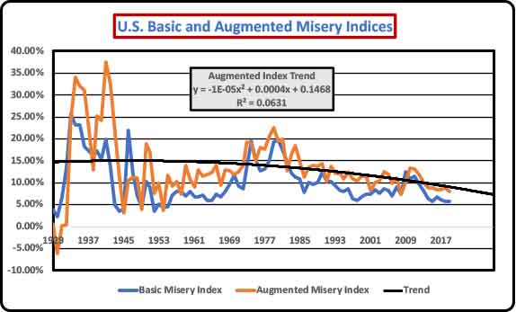
The Misery Index
The basic misery index is the sum of the consumer price inflation and unemployment rate. An augmented misery index adds the rate of economic growth to the inflation and unemployment rates.

Slide 13
Tools of Monetary Policy
Unlike cryptocurrency commodities such as bitcoin, because monetary policy relies on fractional reserve fiat currency, the Federal Reserve has an extensive toolbox from which it can choose to adopt a particular monetary policy. Monetary policy is macroeconomic in scope, whereas fiscal policy can be both macroeconomic and microeconomic in scope at the same time. The basic tools of monetary policy are:
Required Reserve Ratios
Open market operations
The discount and federal funds rates
The interest rate paid on excess reserves
Moral suasion

Slide 14
Fiscal Policy
Fiscal policy is the setting of tax and spending rates to support a noninflationary full employment rate of economic growth. In contrast to monetary policy, fiscal policy can be more micro-focused in that it may select targets that are designed to affect the degree of income and wealth inequality, the level of poverty, the degree of competition, as well as the level of environmental and health quality. In the United States, individual states are bound to adopt balanced current expenditure budgets, and only through voter approved referenda, can a state borrow funds.
No such restriction applies to the Federal government. It only has a statutory debt limit that affects its ability to continue a budget deficit as well as affect the overall level of public debt. Since the Federal Reserve operates on a fractional reserve basis, as long as the Federal Reserve accommodates the level of Treasury debt, there is, in the absence of any federal legislation, no other limit on the level of borrowing undertaken by the Congress. What facilitates a near automatic extension and increase in federal debt limit is, in the first instance, the ratio of public debt to the GDP, and secondly, the willingness of countries to use the dollar as a means of setting balance of payments obligations. As long as the dollar is seen as relatively stable in value, and in which it trades with relative liquidity, it will continue as a key international reserve currency.

Slide 15
Elements of Fiscal Policy
Unlike individual domestic and foreign states, the Federal government is not bound by capital budgeting. The late Robert Eisner of Northwestern University argued for years that the Federal Government should adopt capital budgeting principles. The essence of capital budgeting is that expenditures designed primarily to affect the distribution of income or the composition of recurrent services should be financed by a corresponding level of tax revenue. In contrast, those expenditures that generate an increase in productive capacity of the economy should logically be financed through deficits such that the life cycle of investments would be amortized over time. In today’s parlance, this refers to infrastructure spending proposals, but because Congress has failed to adopt even the most basic of capital budgeting accounting, it winds up in endless battles, compounded by partisan divisions, as to what constitutes as justifiable level of infrastructure spending through public deficits. What is worse, is that this debate unfolds independently of any consideration as to how it may affect the misery index framework as discussed under monetary policy.

Slide 16
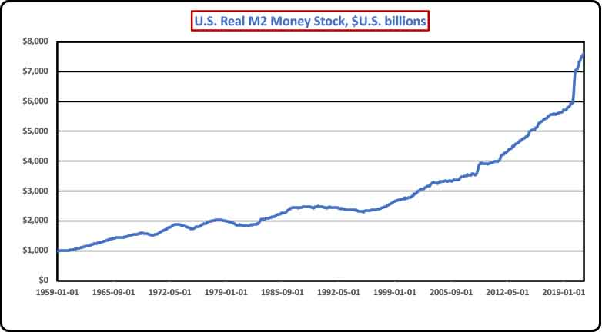
Tracking Monetary Aggregates – M2

Slide 17
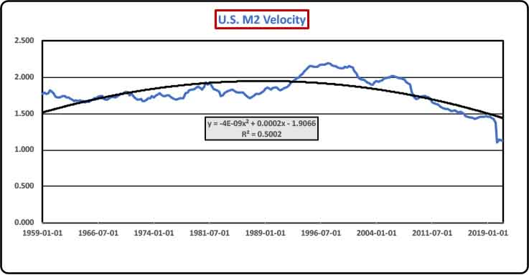
Tracking Monetary Aggregates – M2 Velocity

Slide 18
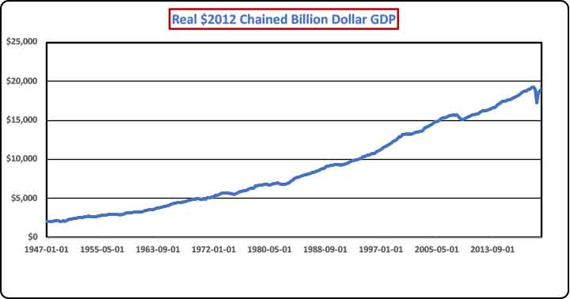
Tracking Economic Aggregates – Real GDP

Slide 19
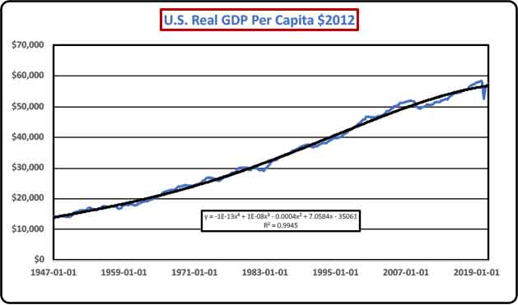
Tracking Economic Aggregates – Real GDP Per Capita

Slide 20
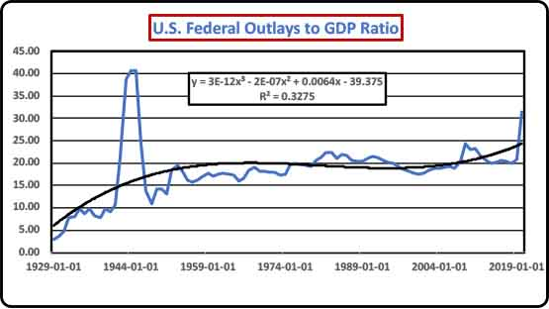
Tracking Economic Aggregates – Federal Outlays to GDP Ratio

Slide 21
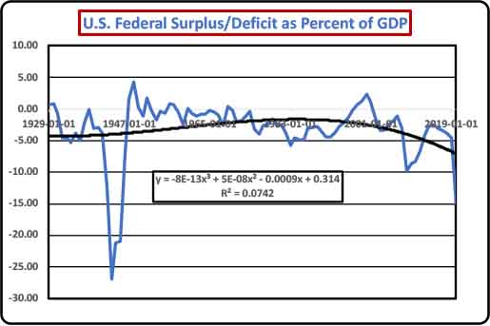
Tracking Economic Aggregates – Federal Balance GDP Ratio

Slide 22
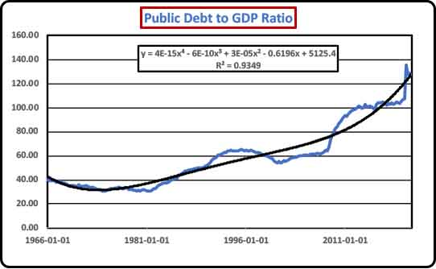
Tracking Economic Aggregates – Public Debt to GDP Ratio

Slide 23
Summing Up Monetary and Fiscal Policy
Despite the appeal of cryptocurrencies, the U.S. and other major countries are likely to continue reliance on fractional reserve central banking. The basis of this conclusion is the flexibility that standard currency models afford to policymakers to respond to the triple concerns of inflation, unemployment, and growth rates.
Monetary policy has borne the burden of macroeconomic policy management, in part because the Federal Reserve has operated as an essentially independent entity with a public obligation. In contrast, fiscal policy depends on the delays and political divisions that complicate the rational adoption of a more predictable budgetary cycle. This is compounded by the absence of any notion of capital budgeting, nor any constraint other than a legislatively approved debt limit that governs public spending. Although institutions such as the Council of Economic Advisors, the Congressional Budget Office, and the Office of Management and Budget have been created to better track federal tax and spending legislation, thus far the crafting of fiscal policy has been beset by a deepening trend of partisan divisions.

