Slide 1
Financial Stability
While responsibility for financial stability may be assigned to a central bank, the quality of information and leadership shape the decisions that affect the degree of stability of instability in the financial system.

Slide 2
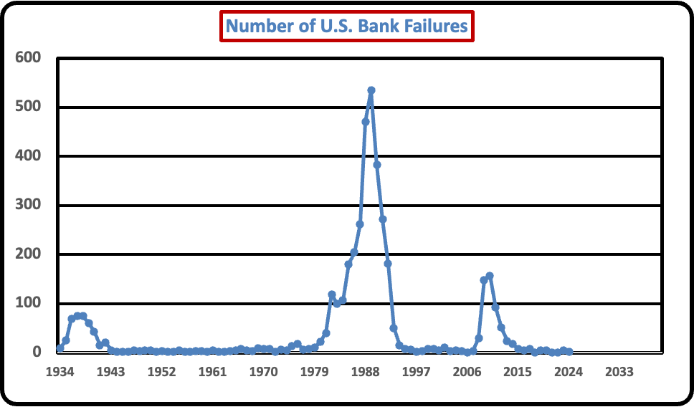
Tracking Bank Failures – 1
The number of bank failures is one indicator of financial instability. However, it should also be taken into account the constant dollar value of bank failures.

Slide 3
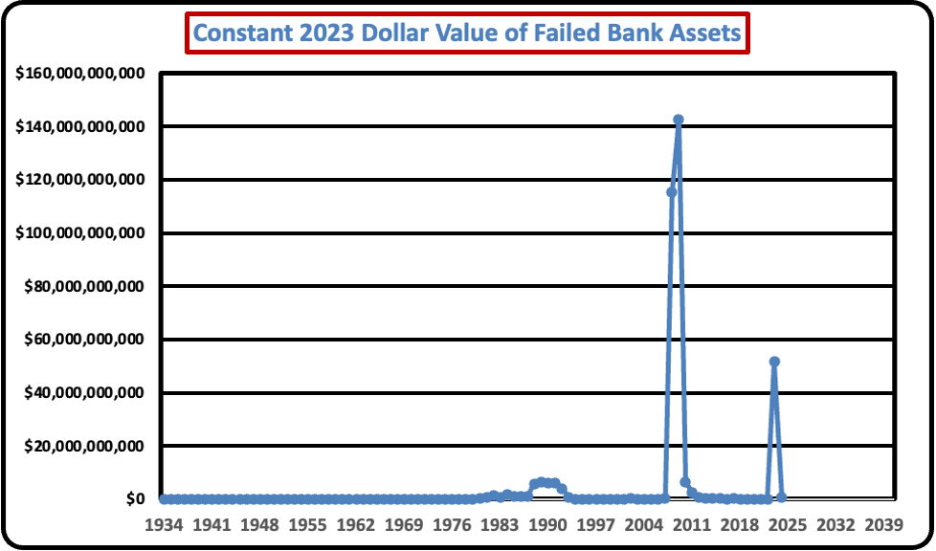
Tracking Bank Failures - 2
The number of bank failures is one indicator of financial instability. However, it should also be taken into account the constant dollar value of bank failures.

